Slide 1
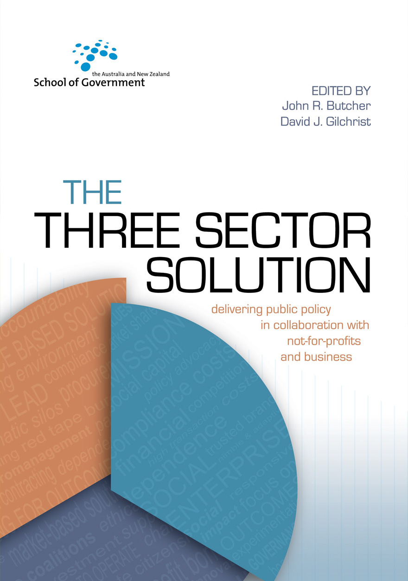
Core ingredients for good collaboration Circularity 2024
26 November 2024
Notes:
First, I would like to thank the organisers for inviting me to contribute to this conference.
Second, a confession: I am NOT an expert on the circular economy, but I DO recognise that achieving ‘circularity’ necessarily requires working collaboratively across national, jurisdictional, sectoral, disciplinary, and technological boundaries.

Slide 2
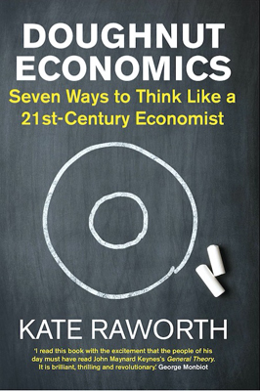
Getting to the doughnut
Think outside the box
Challenge traditional assumptions
Question the axiom ‘growth is good’
What is ecologically safe & socially just
Notes:
In her 2017 book ‘Doughnut Economics’ Kate Raworth challenges readers to think outside the box and interrogate the constraints imposed on policy and action by neoliberal economic orthodoxy.
In Raworth’s analysis the ‘doughnut’ describes an ecologically-safe, and a socially-just space for humanity – a space in which nations, governments, businesses, civil society, communities, households, and individuals need to work together to achieve what she calls ‘a regenerative economy’.
Collaboration, done thoughtfully, allows us to span multiple interests, modalities, and priorities, and bring together the diverse expertise, capabilities, and skills required to realise a circular economy.
The problem is that people and organisations often don’t know how to begin or sustain collaborative action.

Slide 3
Transforming ‘Business as Usual’
Collaboration often pursued when traditional approaches have failed
No single organisation or sector acting on its own has the capacity or capability to solve complex problems
Often requires a departure from accepted ‘legacy’ conventions, practices, norms, rules and boundaries
Entails agendas for change that can meet internal resistance
Notes:
The need to collaborate arises because no single organisation or sector, acting on its own, has the capacity or capability to solve complex problems – sometimes called ‘wicked problems’.
When it comes to tackling wicked problems ‘business as usual’ often entails approaches that are fragmented, short-term, and ultimately, ineffective.
Collaboration offers a pathway to better organise and deploy resources to achieve impact, especially if ‘business as usual’ means organisations and organisational units are working in rigid functional silos.
However, while collaboration makes intuitive sense, it sometimes runs counter to prevailing organisational culture and operational norms.
This can be a hard pill for some to swallow, even when the logic of change is broadly accepted.

Slide 4
Collaboration by design
There is no one-size-fits-all template
All collaborations are unique and context-dependent
Built on a comprehensive, and shared, understanding of the problem
Notes:
Kate Raworth makes the point that the circular economy will not emerge spontaneously: it needs to be designed with ‘regeneration’ at its core.
Business, finance and governments are trapped, she says, in the mindset and metrics of degenerative design.
Likewise, collaboration needs to be ‘designed’ if we are to encourage behaviour-change in organisations trapped in the mindset of top-down command and control, functional siloes, and resource-hoarding.
In a way all collaborations are unique and highly context-dependent:
Partners and stakeholders might differ in terms of their respective histories, priorities, and capabilities.
The presenting problems they seek solve to might be multifactorial in nature; and span multiple policy domains.
Collaborations work best when they are built on a comprehensive understanding of the presenting problem(s); and when there is clarity about the collaboration’s purpose, objectives, rationale, strategic direction and proposed actions.

Slide 5
A pathway to impact
Requires clear pathways to impact, together with a strong evidential base.
Partner organisations can sometimes be impatient for results.
NOT the same as project management
Notes:
When designing the collaboration framework, it's essential to clearly spell-out the pathways to impact, and how impact will be measured and reported.
A strong evidential base is essential for providing assurance and sustaining the confidence and on-going support of partners and other stakeholders.
Demonstrating impact isn’t always easy. Collaborations are sometimes subject to heightened levels of scrutiny by partner organisations impatient to see results and this can be problematic, because collaborations take time to mature.
It’s important to note that collaboration can deliver intangible benefits that are difficult to measure such as improved relationships, a shared sense of purpose, as well as heightened levels of trust, cooperation and social capital, and these need to be acknowledged and valorised.
As an aside, I’d like to make it clear that collaboration is not the same as ‘project management’ with a bit of ‘Kumbaya’ thrown in:
Collaboration frameworks are organic, experiential, and iterative, whereas;
Project management frameworks are typically focused on the allocation of resources, process, timeframes, and the delivery of outputs.

Slide 6
Collaborative intelligence (CQ)
CQ refers to the mindset necessary for collaboration to flourish.
Interpersonal relationships are important building blocks of collaborative action.
Collaborators need to bring appropriate aptitudes and skills to the table.
Individual members of collaborative frameworks need ‘authority’ to collaborate.
Notes:
A critical factor in collaboration is something we call ‘collaborative intelligence’ or CQ.
CQ implicitly accepts that interpersonal relationships are important building blocks of collaborative action and is based on a recognition that it's ‘people’ who collaborate, not organisations.
It’s a ‘mindset’ that is essential to the challenge of making making collaboration ‘happen’ because it equips people to bridge differences in experience, perspective, and levels of seniority in the pursuit of shared aims.
This means a preparedness to listen and consider diverse views; a willingness to compromise and engage in shared decision-making; and an understanding of systems and the environment in which collaboration occurs.

Slide 7
Organisational intelligence
Organisational intelligence determines the nature of the ‘authorising environment’
Organisations can be constrained by internalised ‘logics’
Determines whether CQ is rewarded and reinforced, or discouraged and repressed
Organisational logics of partners can clash
CQ enables partners to navigate & bridge cultural differences
Notes:
Whether or not CQ is valued and nurtured depends upon organisational intelligence which, in turn, shapes the authorising environment.
Intelligent organisations are learning and adaptive organisations that appreciate the potential benefits of disruption and reward measured risk-tasking.
So, it really isn’t sufficient to focus solely on the qualities that individual actors bring to collaboration: it is essential to also consider whether those qualities are rewarded and reinforced by the authorising environment.

Slide 8
Organisational siloes
Siloed behaviour can be a barrier to collaboration
Authorising environment is critical for success
Needs clear unambiguous authority to collaborate
Collaboration needs a persuasive rationale
Not a response to resource scarcity
Notes:
It’s well recognised that the siloed behaviour of large bureaucratic organisations represents a barrier to collaboration.
Unfortunately, siloing is often reinforced by the authorising environment, which can result in fragmented and disjointed responses to complex problems.
Senior executives who understand the potential of collaborative action can re-shape the authorising environment to enable collaboration to occur.
Strong executive backing and clear, unambiguous authority to collaborate empowers people to exercise initiative, engage in collective decision-making, and measured risk-sharing.
For that to happen, collaboration needs a clear and persuasive business case.
Here I offer a note of caution, although working collaboratively might result in a more efficient use of resources, it is not a recipe for ‘doing more with less.’

Slide 9
Leadership and assurance
Sustaining trust through distributed leadership
Formal authority and assurance can be enhanced by ‘collaboration champions’
A robust governance framework
Notes:
Although there's a natural tendency for organisations to assume that the partner with the largest investment of resources or assets should have a proportionately greater say, some form of shared or distributed leadership might provide a more durable foundation for building trust and sustaining buy-in.
Support for collaboration can be enhanced by appointing 'collaboration champions’: people with sufficient standing and formal authority to bolster executive authorisation, broker trust among the ‘unconvinced,’ and shore up the ‘waverers.’
Ultimately, executive support, stakeholder buy-in, and an on-going licence for collaboration hinge on the provision of assurance through a robust governance framework.
Assurance means being transparent about what you are doing and why, identifying achievements, acknowledging problems, and mapping the way ahead.
Of course, multi-party governance can be challenging, especially when the operational norms of partner organisations exist in dynamic tension with the hybrid values, behaviours, and governance required for effective collaboration.
Although this ‘dynamic tension’ can make for uncomfortable conversations, it can also be a stimulus for innovation and adaptation.

Slide 10
Collaboration pro-tips
Be willing to cede control
Build trust
Communicate, communicate, communicate
Actively maintain your authorising environment
Use ‘zippering’ to jointly manage operational functions
Notes:
Collaboration also requires a willingness to cede control.
Ceding control requires trust, and trust can only be built through open and clear communication about the respective positions, priorities, and values of stakeholders.
Communication is the bedrock of collaborative action and is central to the task of generating internal and external buy-in: regular engagement with key decision-makers is essential.
Above all, avoid making “Captain’s Calls” – there’s no surer way to erode trust.
A common sticking point in collaboration concerns the joint management of operational functions and this is where the concept of ‘zippering’ comes in.
Zippering involves peer-to-peer contacts at all levels of the organisation, and supports organisational alignment with the purpose, aims and strategies of the collaboration.
When people at various levels across the partner organisations are connected into the partnering process, you move beyond individuals collaborating to organisations collaborating.

Slide 11
Sustainability is a ‘tough gig’…
“the view from the trenches ain’t pretty . . . We’re dying on the battlefield. It’s a tough gig being a sustainability practitioner in corporate Australia as it currently stands.”
Anita Mitchell 2014
Notes:
In 2014, the then General Manager of Sustainability for Lend Lease, Anita Mitchell said:
“the view from the trenches ain’t pretty … We’re dying on the battlefield. It’s a tough gig being a sustainability practitioner in corporate Australia as it currently stands.”
I’ll rely on you to tell me how much progress we have made in the last ten years, but I’m reminded of a couple of recent articles by Heinz Schandl, reporting that Australia has a circularity rate of between 4-5%, which is below the global average and far less than world leaders Japan (at 20%) and the Netherlands (at 30%).
Even allowing for differences in the economies of these three nations, we clearly have a way to go.

Slide 12
Collaborate better…
“Collaboration between players is key but difficult to achieve. In the traditional economy, players at different ends of the value chain rarely engage with each other, so circular innovations are often costly with low levels of adoption.”
Jacqueline Poh, Managing Director,
Singapore Economic Development Board
Notes:
According to Jacqueline Poh, Managing Director, Singapore Economic Development Board, “Circular economy solutions are critical for sustainable growth and climate action”.
She says, “Collaboration between players is key but difficult to achieve. In the traditional economy, players at different ends of the value chain rarely engage with each other, so circular innovations are often costly with low levels of adoption."
She adds that meaningful progress in circularity requires the creation of a collaborative ecosystem: as she puts it: “turning trash to treasure and scaling that up”.
She suggests focussing on three key things:
Cross-sector collaborations – and resource pooling on common problems to mobilise stakeholders from across the entire value chain to co-create circular solutions.
Strategic research and development (R&D) partnerships – between private companies and leading research institutes which helps translate academic research into real-world applications. And;
Strengthening commercial viability – by establishing programs to help circular innovators finetune their business models and growth plans, raise capital, and access buyers for their solutions.

Slide 13
Not a panacea
“collaboration is not an easy answer to hard problems but a hard answer to hard problems”
– Bryson et al
Notes:
My final point is that collaboration is not a panacea.
Although collaboration evokes the potential to harness a wider array of resources, knowledge and human capital and apply them to the resolution complex problems, it “is not an easy answer to hard problems but a hard answer to hard problems”.
Collaboration possibly works best where the partners are not also rivals for market share or market dominance or influence – symbiotic or complementary relationships mean that that the rivalrous aspect is not quite so pronounced.
The hardest thing to do will be to collaborate in spaces with people or organisations who occupy the same niche in the ecosystem.
To achieve circularity organisations – and firms especially – will have to favour the logics of partnership over the logics of competition.
And that is going to require a re-set.
Neither government, nor the business sector, nor civil society can ‘go it alone’.
Intellectual and policy leadership will be required from all quarters if the promise of circularity is to be achieved.

Slide 14
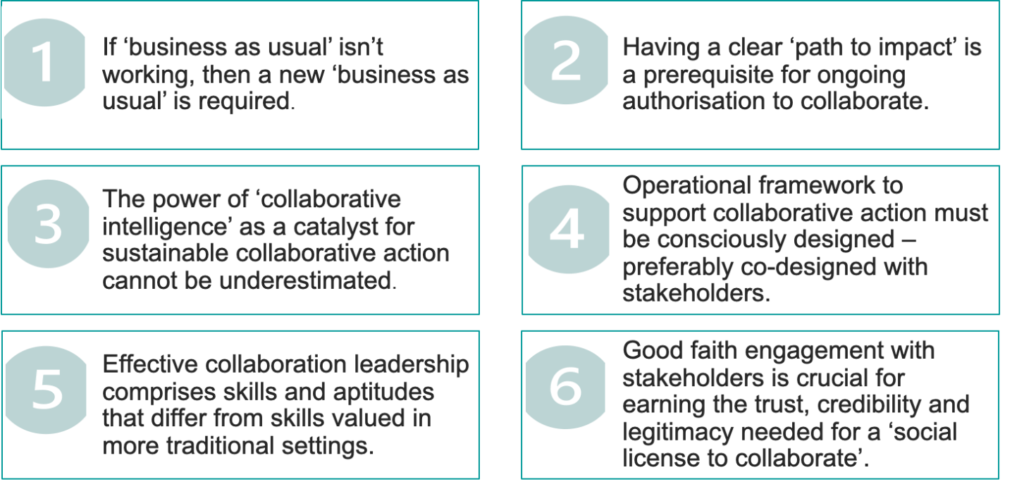
For the fridge door…
Notes:
My final slide is what I call the "Collaboration Fridge Magnet". I'll leave it up on screen while we move on to my Fireside Chat with Veena.

