Slide 1
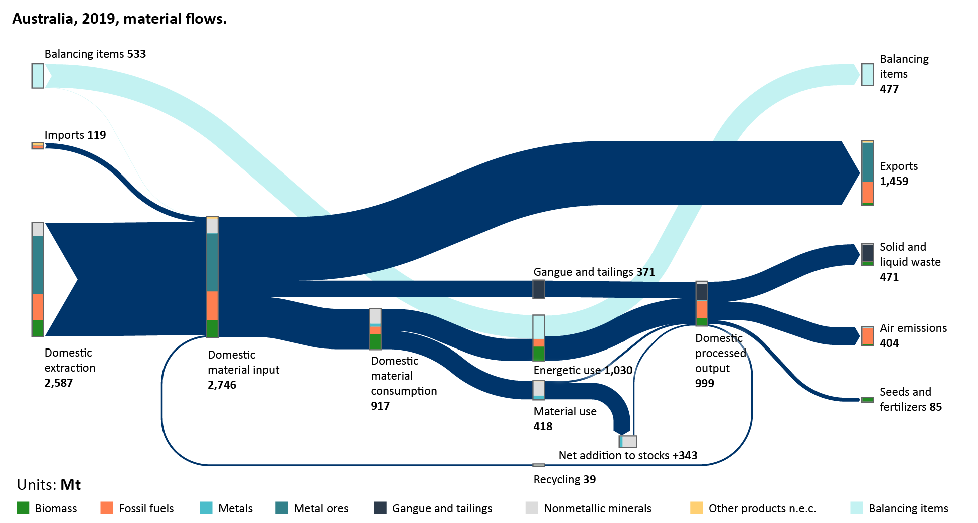
Australia’s Material Flows, 2019

Slide 2
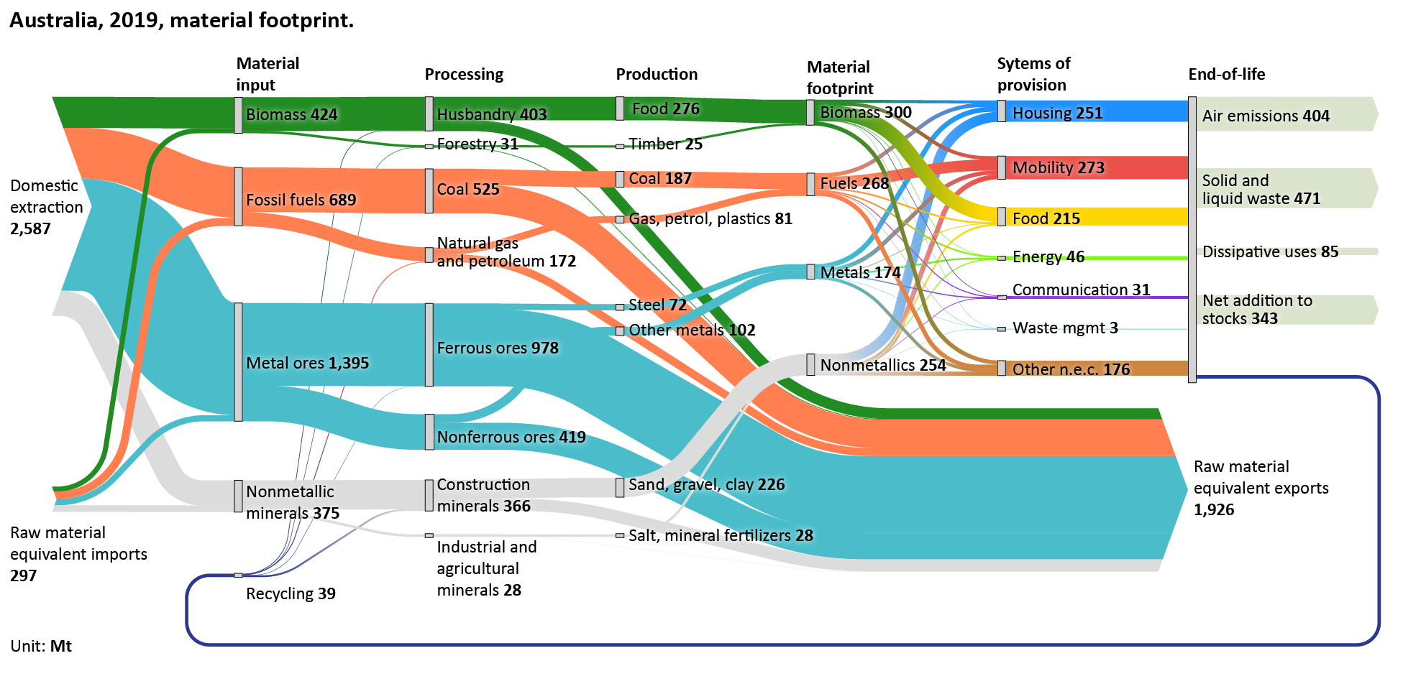
Australia’s material footprint, 2019

Slide 3
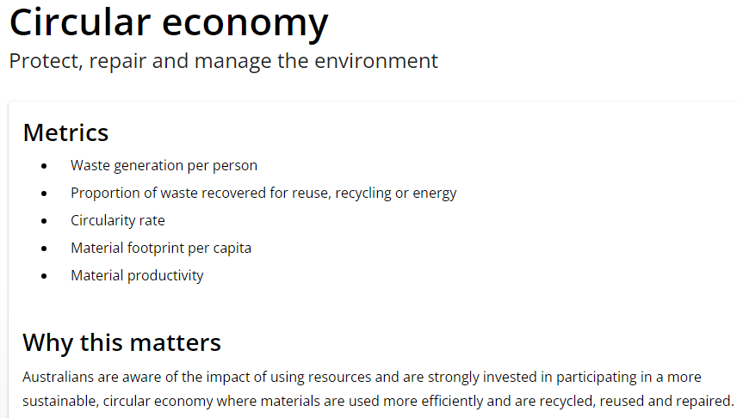
Measuring What Matters Themes and Indicators

Slide 4
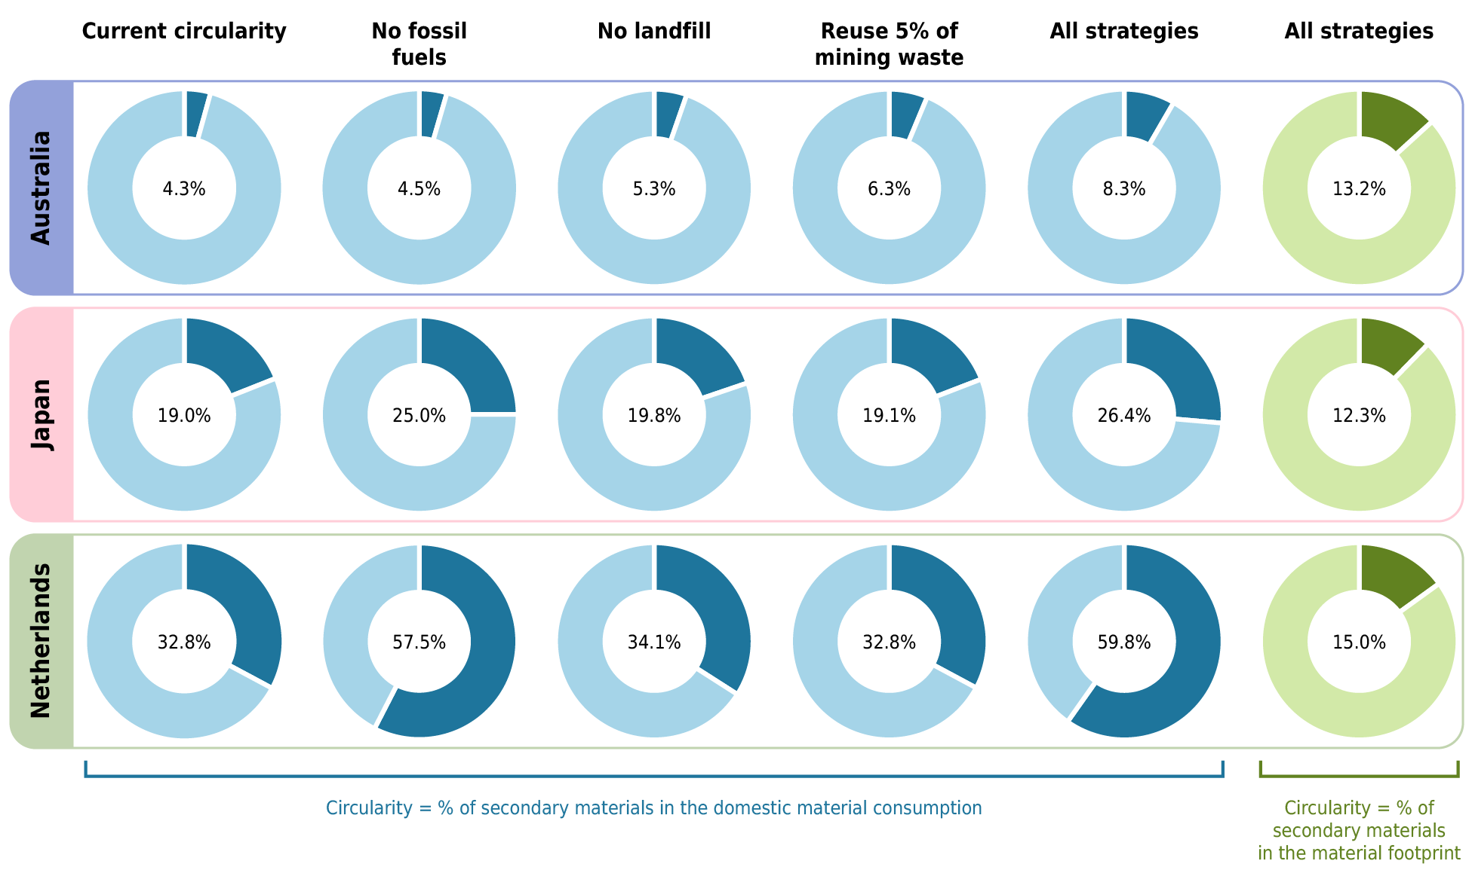
How big is the circularity gap?

