Slide 1
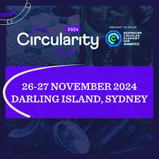



Bend the Trend
Main shifts needed for sustainable future and the role of resource management and circular economy
JANEZ POTOČNIK
Co-Chair International Resource Panel - IRP
Partner SYSTEMIQ
Member Club of Rome
Sydney, 26th November 2024

Slide 2



Who are we?
International Resource Panel - IRP was launched in 2007 with the idea of creating a science-policy interface on the sustainable use of natural resources and in particular their environmental impacts over the full life cycle
Climate Change
Biodiversity Loss
IPBES
Resource Management
Notes:
So what is IRP?
IRP was created in 2007 by UNEP to generate independent and authoritative scientific assessments of policy relevance on the sustainable use of natural resources to help policy makers to take effective and long-term decisions on sustainable use of natural resources. This connection between scientists and policy is a fundamental characteristic of the IRP .
‘
So the Panel was created in a similar fashion to the Intergovernmental Panel on Climate Change (or Intergovernmental Platform on Biodiversity and Ecosystem Services), but in this case to provide policy-relevant knowledge not on climate change (or biodiversity loss), but on how to use natural resources more sustainably and efficiently.

Slide 3




















International Resource Panel
Panel Co-Chairs:
Janez Potočnik and Izabella Teixeira
Steering Committee Co-Chairs:
Astrid Schomaker and Steven Stone
SCIENTIFIC PANEL
Internationally recognized experts on sustainable resource management;
Scientific assessments and advice, networks
Science-Policy interface
STEERING COMMITTEE
Governments from developing and industrialized countries;
Strategic guidance, political support, regional synergies
Head of Secretariat: Merlyn van Voore
UNE SECRETARIAT
Direction, procedures, support in development and implementation of assessments, outreach
Strategic Partners

Slide 4













IRP’s High Impact Priority Areas for 2022-2025
HIPA 1
Current trends and future prospects for global resource use and sustainable resource management
Metrics & data
Science-based targets
Pollution
Equity
HIPA 3
Sustainable Resource Management for effective action on human health, well-being, prosperity and equity
Scenario modelling
Global resources outlook
Biodiversity loss
UNDERSTANDING
RESOURCE USE
Well-being
HIPA 2
Sustainable Resource Management for effective action on Climate Change, Biodiversity and Pollution
Climate change
Health
CONNECTING
THE RESOURCE MANAGEMENT AGENDA WITH SDGS
HIPA 4
Role of trade, finance and innovation in enabling sustainability transitions
Trade
Financing & investment systems
Innovation
ENABLING
SUSTAINABILITY TRANSITIONS
Notes:
We recently finalized an ambitious Work Programme, shaping High Impact Priority Areas for IRP’s research up to 2025.
In 2022-2025, IRP research should:
Help improve the understanding of natural resource use.
Connect this understanding to knowledge from other scientific bodies on relevant UN SDGs.
Provide options to enable transitions to sustainable management of natural resources.
Understanding natural resource use means providing the data, analytical insights and tools, and overview of the status and prospects for global stocks and flows of natural resources.
Connecting the knowledge on natural resource management with other relevant SDGs is about better understanding the links (drivers, synergies, trade-offs) between current global resource use and its impacts on the environment (such as climate change, biodiversity loss and pollution) as well as human health, well-being, and equity.
Enabling sustainability transitions is about understanding the role of trade, finance, and innovation in global resource use, how they are shaped by different policies, and how they could be directed in a way that effectively addresses all major environmental crises. This provides knowledge of socio-economic institutions which underpin resource use, for example development banks, international trade agreements, and national planning agencies, and therefore policy recommendations for how these institutions must adapt to enable sustainability transitions.
There will be 4 HIPAs:
Current trends and Future Prospects for Global Resource Use and Sustainable Resource Management.
Sustainable Resource Management for effective action on climate change, biodiversity and pollution.
Sustainable Resource Management for effective action on human health, well-being, and equity
The Role of Trade, Finance, and Innovation in enabling Sustainability Transitions

Slide 5
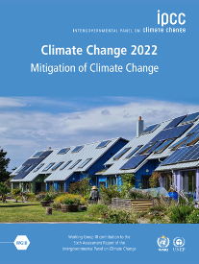
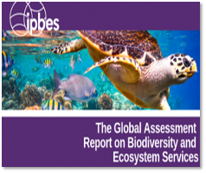

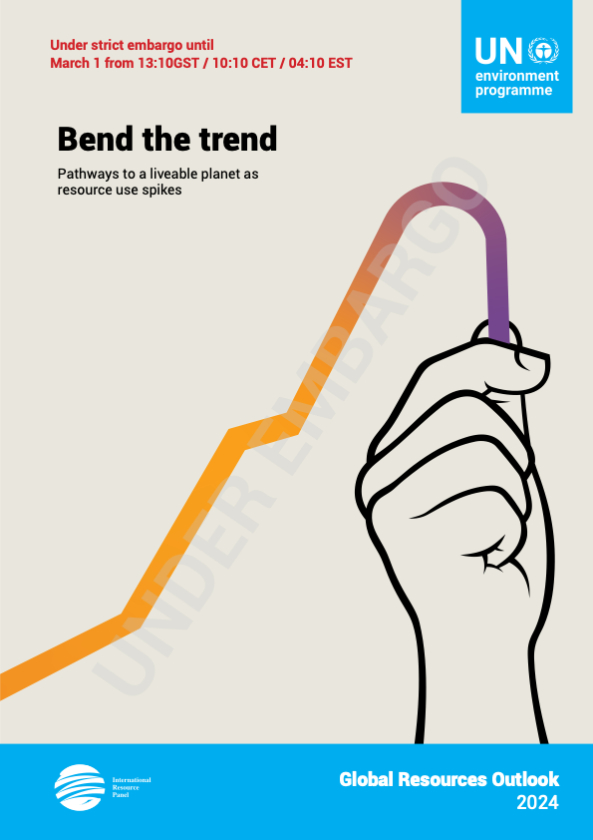
Resources - The Missing Link
IPCC
Climate Change
IPBES
Biodiversity loss and Ecosystem Services
WHO
Environment and Health
IRP
Unsustainable Resource Use
Notes:
The report follows the overall logic and structure of the 2019 edition along the lines of the DPSIR framework: materials flows and pressures, environmental impacts, 8 outlook through scenario exploration and proposal for policy responses.

Slide 6
Main Challenges
The diagnosis and context of the problem

Slide 7
Let’s start this story in my home country Slovenia
“It is clear that we are approaching the ecological and digital apocalypse … but we should not loose nerves.”
“Everything under heaven is in utter chaos;
the situation is excellent.”
“It is easier to imagine the end of the world than the end of capitalism.”
Slavoj Žižek

Slide 8
For the first time in a human history, we face the emergence of a single, tightly coupled human social-ecological system of planetary scope.
We are more interconnected and interdependent than ever.
Our individual and collective responsibility has enormously increased.

Slide 9
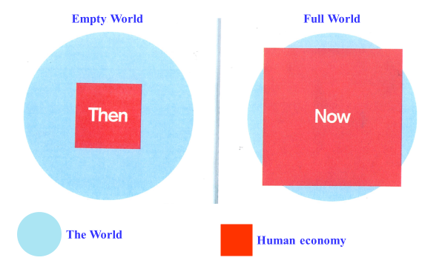
From “Empty” World to “Full” World
Source: Club of Rome: Simplified after Herman Daly
Labour and Infrastructure limiting factors of human wellbeing
Natural resources and Environmental sinks limiting factors of human wellbeing

Slide 10
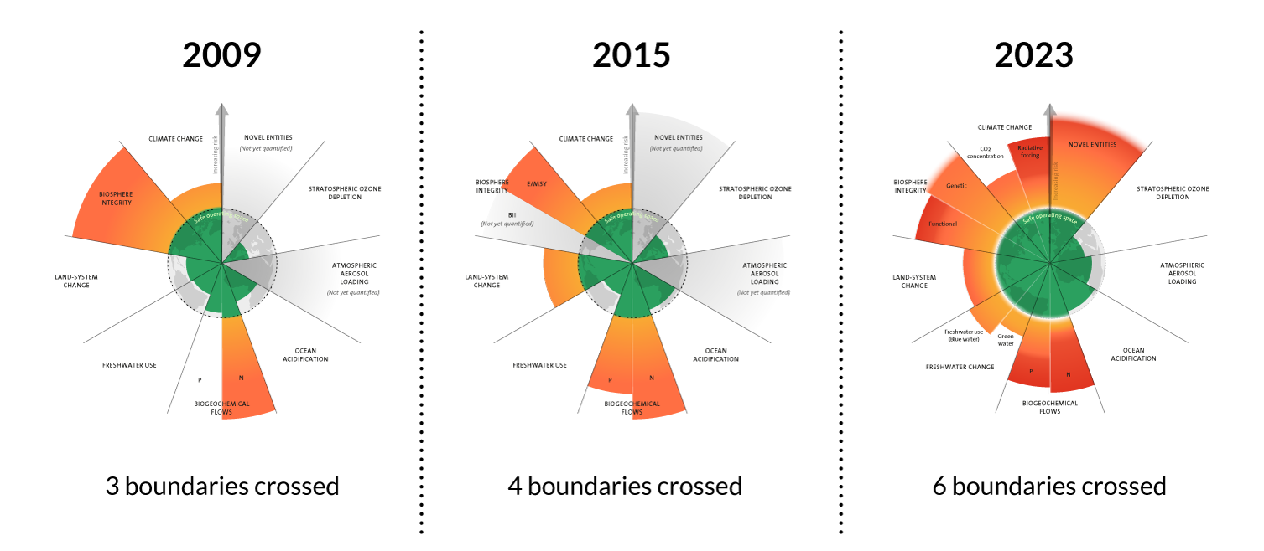
Planetary crises is making instability the norm
Source: Azote for Stockholm Resilience Centre, based on analysis in Richardson et al 2023

Slide 11
A compass for human prosperity
  Basis human needs
  incl. minimum requirements of resource supply
  Outer limit by Planetary Boundaries
Adapted from Raworth 2017
Notes:
So what is IRP?
IRP was created in 2007 by UNEP to generate independent and authoritative scientific assessments of policy relevance on the sustainable use of natural resources to help policy makers to take effective and long-term decisions on sustainable use of natural resources. This connection between scientists and policy is a fundamental characteristic of the IRP .
‘
So the Panel was created in a similar fashion to the Intergovernmental Panel on Climate Change (or Intergovernmental Platform on Biodiversity and Ecosystem Services), but in this case to provide policy-relevant knowledge not on climate change (or biodiversity loss), but on how to use natural resources more sustainably and efficiently.

Slide 12

If we want to avoid extinction of elephants in nature …
we must extinct elephants in our rooms
Source: Hop distance - The elephant in the room ...blogs.bmj.com

Slide 13
Main Blind-Spots preventing us to move faster and deeper
I
II
Lack of Drivers and Pressures Perspective
  Policy attention does not focus on the roots of the problem and address the drivers and pressures. It lack focus on natural resource use and management, as well as on market signals leading consumers and producers’ behaviour.
Lack of Holistic System approach
  Public leaders and others lack capacity or knowledge of how to translate system change visions into their concrete policies/investment structures which ends in conflicting policy logics that hinder real transformation
III
Lack of Demand Side Focus
  Policy attention is mainly given to the supply side of the economy, to the cleaning of the existing economic system - lacking the attention to the demand side which is leaving out an important solutions potential and questions of responsibility and equity.

Slide 14
Main Blind-Spots preventing us to move faster and deeper
I
Lack of Drivers and Pressures Perspective
  Policy attention does not focus on the roots of the problem and address the drivers and pressures. It lack focus on natural resource use and management, as well as on market signals leading consumers and producers’ behaviour.

Slide 15
I. Drivers and Pressures Perspective
Importance of Resource Management Global Resource Outlook 2024

Slide 16
This Importance of Natural Resources
Access to and use of natural resources have been in the human history closely related to the level of the achieved wellbeing of the nations, but also to stability, security, conflicts, wars ( Access to Land, Water, Oil and Gas, Minerals, Precious Metals … )
It was driving the geo-political efforts of consumption countries to control the resource rich countries.
The whole history of the colonialisation of nature, is also central to fairness and equity.
Notes:
[PLACEHOLDER – TITLE SLIDE TO BE INCLUDED]

Slide 17






Definition: Materials and Resources
Biomass: crops for food, energy and bio- based materials, wood for energy and industrial uses
Materials: Everything extracted from the Earth
Fossil fuels: covering coal, gas and oil, among other
Metals: such as iron, aluminum and cooper, among other
Resources:
Materials + Land and Water
Non-metallic minerals: sand, gravel, limestone and minerals used for industrial applications
Land
Water

Slide 18
Economy Championed by Industrialised Nations is Wasteful and Unjust
We must shift away from the prevailing resource wasteful economic approach based on maximising the output of sectors, simplistically defined by GDP, towards an economy that is efficiently meeting human needs and optimise human wellbeing. The current logic is both ethically and ecologically unsustainable.
We must set the order right. Economy was invented to serve humans and our needs, and not the opposite.

Slide 19
GRO 2024
Natural resource use trends

Slide 20
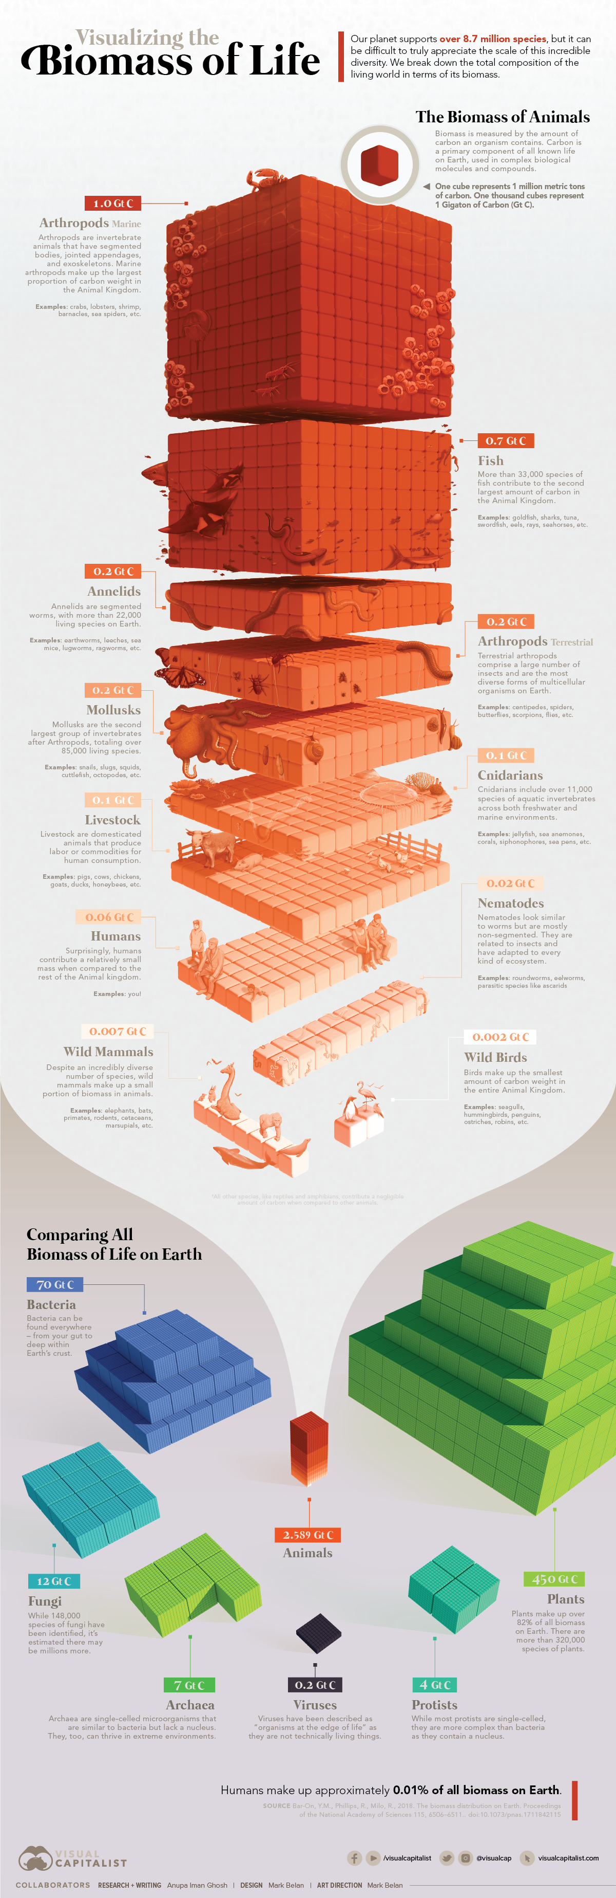
Biomass of Life
Humans in Perspective
Source: Visualcapitalist.com

Slide 21
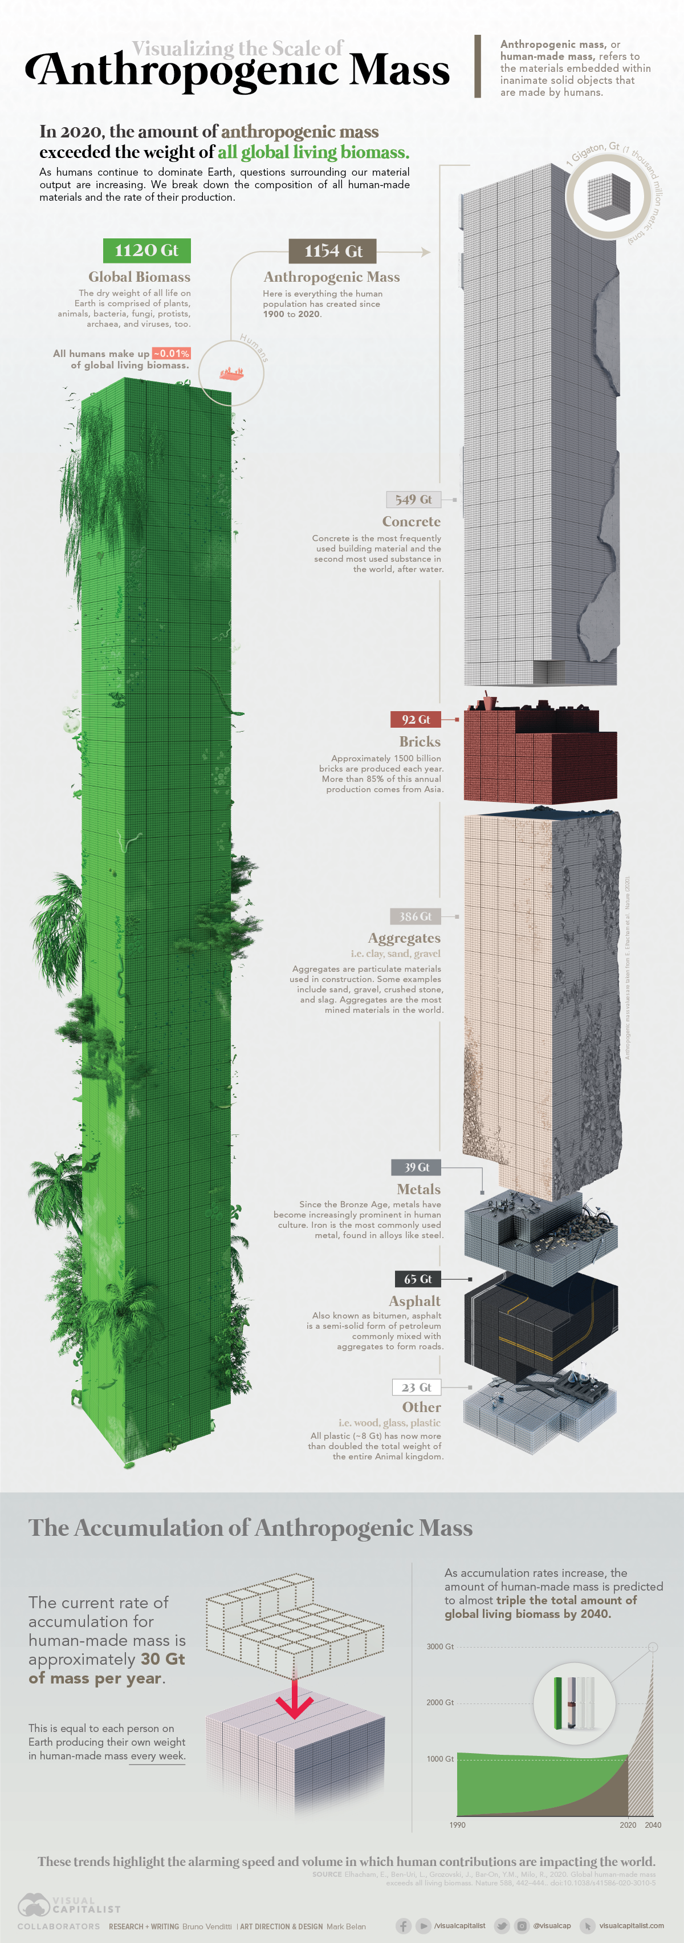
Source: Visualcapitalist.com

Slide 22
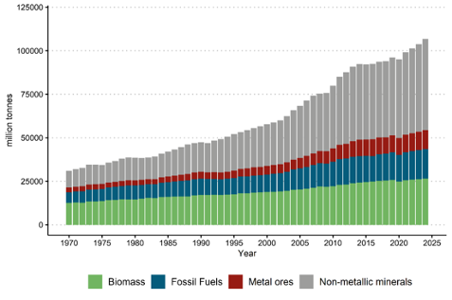
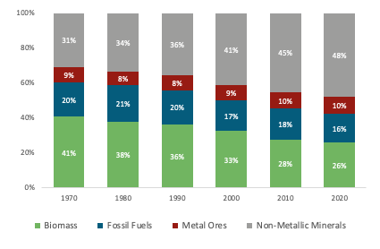
Trends: Global Material Use and Share in 1970-2023
Global Material Use has increased for more than a factor of 3 since 1970 due to urbanisation and industrialisation (and population growth) - 2.3% per year
… which is increasing also the share of Non-Metallic Minerals in Global Material Use
(Main Asia-Pacific Region Impact)
Global material extraction, four main material categories, 1970 – 2024, million tones.
Global material extraction, four main material categories, 1970-2020, shares
Notes:
Environmental impacts occur at all stages of the supply
chain, and they have been intensifying in proportion to the growing global demand for
materials.

Slide 23
Definition: Material footprint
Primary materials associated with final demand, independently of where they are sourced (domestically or abroad)
Material Footprint = Domestic Extraction + Raw Material Trade Balance
Domestic Extraction = Material harvested (agriculture, forestry and fisheries) or extracted (mining and quarrying) domestically
Raw Material Trade Balance = Import minus exports of raw materials required to produce materials and consumer goods

Slide 24
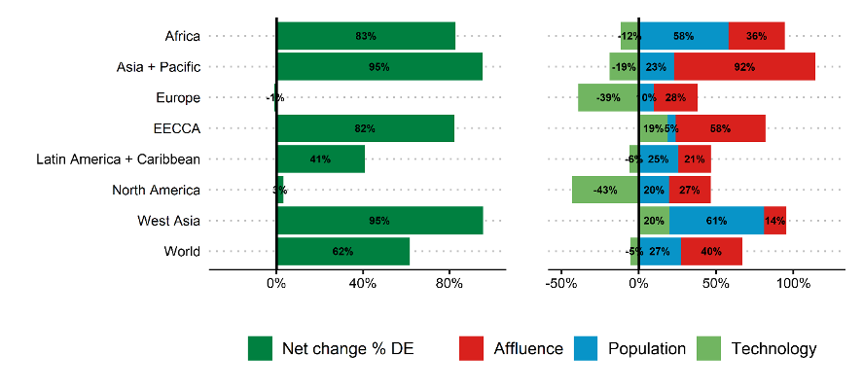
Trends: Drivers of Material Footprint 2000-2022,
% by world regions
Tons per capita - 2020
5
13
17
18
12
30
13
13
Material Footprint
Notes:
We observe a closer resemblance between the results of domestic extraction and material footprint. At the global level, the drivers'
contribution is practically the same for both, which is expected as MF equals DE globally (slight differences are due to rounding). The proportion between population and affluence remains consistent, but the absolute percentages generally shift. The altered impact and technological coefficient result from the reallocation of global direct material extraction among countries during the footprinting process.

Slide 25
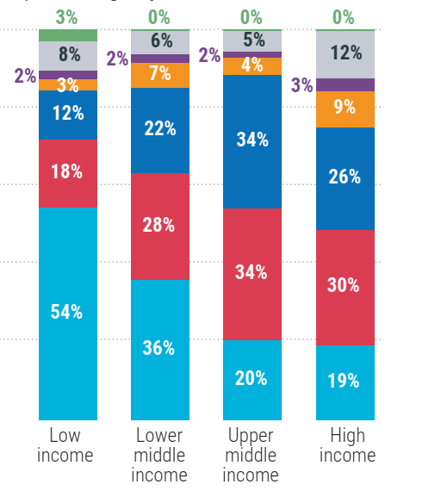
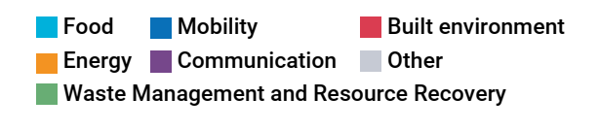
Trends: The material needs for provisioning systems (built
environment, mobility, energy and food) by country income groups (2020)
Energy includes household energy consumption
All other provisioning systems include their embodied energy
Built environment and mobility: (construction, transport sector&infrastructure): 59 billion tonnes
Food: 23.6 billion tonnes
Energy: (electricity, power, heat): 6.1 billion tonnes
Together = 90% of total global material demand, but differ in importance by income group
Source: Global Material Flows Database (UNEP 2023a)

Slide 26
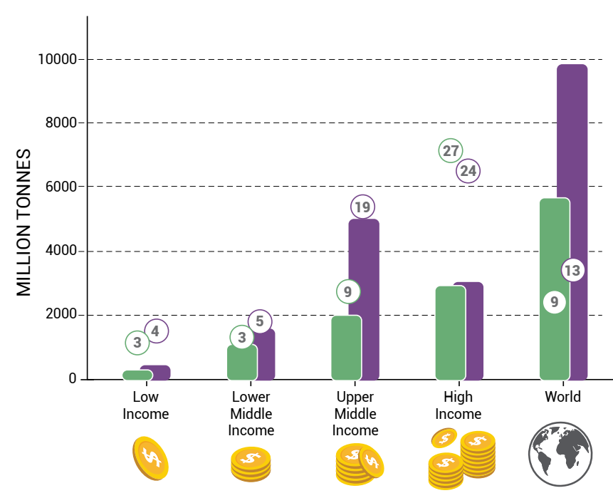
Trends: High-income countries use six times more materials per capita and are responsible for ten times more climate impacts per capita than low-income countries.
Material footprint (total and per capita) by income group
Since 2000 …
High-income: Highest material footprint of all groups, relatively constant. Climate impact per capita = 10 x low-income group.
Middle-income: material footprint more than doubled, approaching high-income levels. Climate impact per capita = roughly 50% of high-income group; 6 x low-income group.
Low-income: Remain comparatively low, and mostly unchanged.
Notes:
Material consumption and impacts differ between regions and across country income groups. This inequality must be addressed as a core element of any global sustainability effort.
The material footprint (which quantifies the material use supporting living standards and gauges environmental impact) of high-income countries is basically static since 2000 with growth largely mitigated by technology. Middle income countries have more than doubled their material footprint per capita in that time and are approaching high income levels driven by growing populations and increasing affluence. However, the per capita impacts of middle-income countries continue to be lower than high-income countries. Upper-middle income country climate impacts per capita are just over half those of the high-income group. Per capita resource use in low-income countries, who bear the brunt of negative impacts, has remained comparatively low and almost unchanged since 2000.

Slide 27
GRO 2024
Resource use is driving the triple planetary crisis

Slide 28
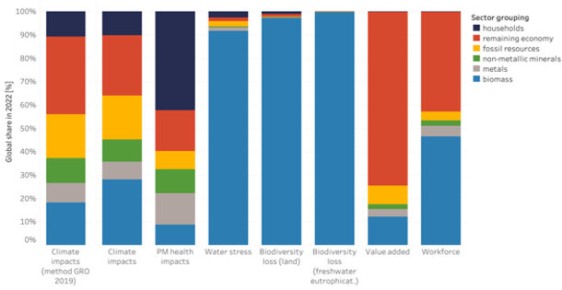
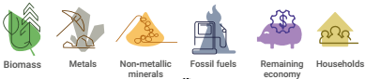

Impacts: Extraction and Processing of Natural Resources Drives all Aspects of the Triple Planetary Crisis
Environmental impacts of materials in the value chain in
extraction and processing phase
60% of global climate change impacts including land use change
40% of air pollution health impacts
More than 90% of water stress and global land and water eutrophication related biodiversity loss
Climate change
Pollution
Biodiversity loss
Economic Impacts
Notes:
The triple planetary crisis of climate change, biodiversity loss and pollution increasingly threaten our future.

Slide 29
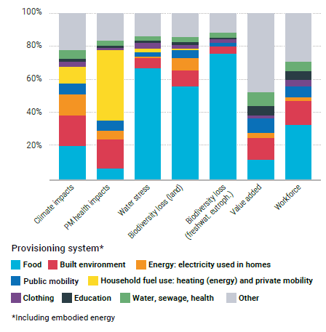
Impacts: “Provisioning Systems Human Needs in the Year 2022
Notes:
Figure 3.6. Relative contribution of provisioning systems
to global environmental and socioeconomic impacts for
2022. For each provisioning system, impacts cover the
whole life cycle including extraction, production, transport,
use and end-of life. The provisioning system “Energy”
includes impacts related to electricity, hot water supply
and the production of fuels used by household, while the
provisioning system “mobility” includes public transport
of households. The provisioning system “households”
further includes direct emissions from private mobility
and energy for heating (adding to the separate impacts
of these provisioning systems). Energy and mobility used
by the other provisioning systems (such as for food) are
allocated to these provisioning systems.

Slide 30
GRO 2024
Equity in Focus - Environmental and Social Efforts are two sides of the same Coin

Slide 31

Bruce M. Boghosian: Is Inequality Inevitable?
SCIENTIFIC AMERICAN, November 1st, 2023
“In fact, these mathematical models demonstrate that (in market economies) far from wealth trickling down to the poor, the natural inclination of wealth is to flow upward, so that the “natural” wealth distribution in a free-market economy is one of complete oligarchy. It is only redistribution that sets limits on inequality.”

Slide 32

Two scenarios:
Too Little, Too Late: continue our current destructive path and The Giant Leap: the fastest economic transformation in history.
The key outcome is that we will see negative social tipping before severe environmental tipping points and that equality and poverty alleviation is key if we want people to be concerned about regenerative economics and decarbonisation.

Slide 33
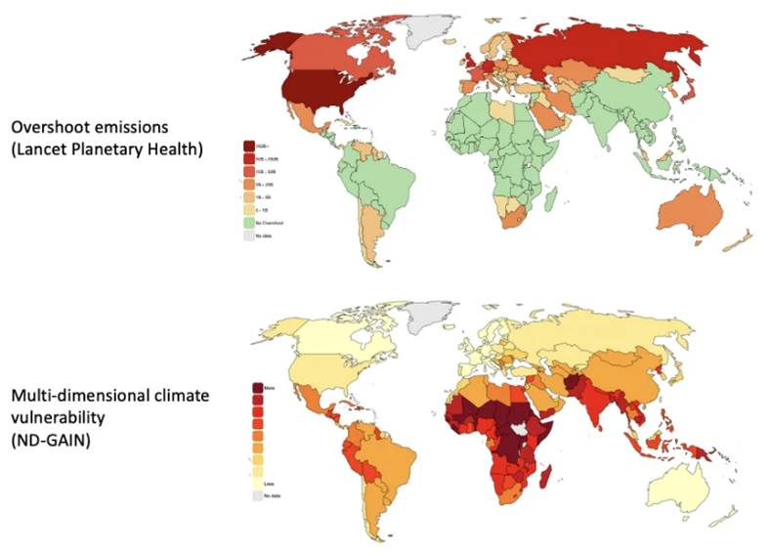
Those Benefiting Most, and Those Facing Worst Climate Consequences

Slide 34
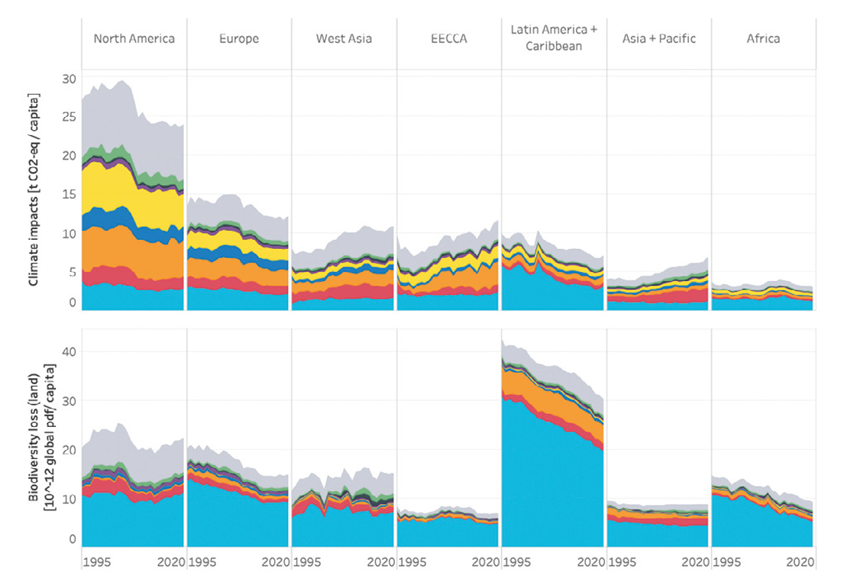
Impacts: World regions drive different climate and biodiversity impacts
*Global pdf: Global potentially disappeared fraction of species
Source: International Resource Panel, Global Resources Outlook 2024 (https://www.resourcepanel.org/reports/global-resources-outlook-2024)

Slide 35
GRO 2024
Scenario Outlook

Slide 36
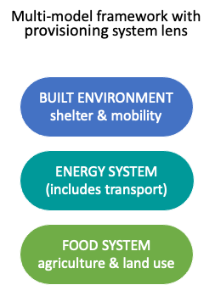
Scenario outlook: Scenario is built up as three ‘shifts’ plus measures to support Just Transition contrasted against Historical Trends
Resource Efficiency
Resource Efficiency
Sustainable Consumption
and Production (SCP)
Climate and Energy
Food and land
Food and Land
Just transition
Just Transition Module
Notes:
The Sustainability Transition scenario is made up of three shifts, each involving an evidence- based package of measures designed to maintain or improve human wellbeing while limiting environmental pressures and reducing adverse impacts.
The scenario also includes a package of distributional measures to support a just transition and ensure that these shifts do not burden or disadvantage low-income countries or groups.

Slide 37
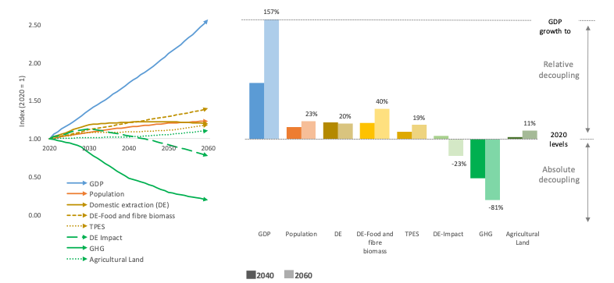
Scenario outlook: Decoupling Outcomes
Just Sustainability Transition scenario
Notes:
Sustainability transition scenario : absolute decoupling for some impacts, while pressures grow more slowly than under historical trends.
Overarching conclusion of the scenario : “The world does not need to choose between stronger economic growth or stronger environmental protection. Well designed and well implemented policies can deliver both at the same time, lifting economic growth and wellbeing while also moderating pressures and reducing environmental impacts”.

Slide 38
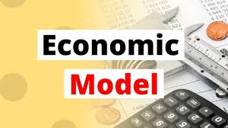
Scenario outlook: Sustainability Transition compared to Historical Trends Scenario (2060)
Growing Economy: + 3%
Reduced inequality:
Improved wellbeing: Higher HDI all income groups
Reduced growth in resource use: By 30%
Reduced environmental impacts: GHG emissions - 83%
Energy demand - 27%
Agricultural land area - 5%
Lower income group Material Footprint gap
YouTube
Notes:
Sustainability transition scenario : absolute decoupling for some impacts, while pressures grow more slowly than under historical trends.
Overarching conclusion of the scenario : “The world does not need to choose between stronger economic growth or stronger environmental protection. Well designed and well implemented policies can deliver both at the same time, lifting economic growth and wellbeing while also moderating pressures and reducing environmental impacts”.

Slide 39

A pathway towards sustainable resource use, which maintains and even enhances human wellbeing, while prevent planetary boundaries to be crossed is possible, but we urgently must change the direction and fix the broken compass.
Solutions pathway is getting narrower and steeper, and there are less, and more urgent options on our policy menu then decades ago.
Source: Pixabay

Slide 40
Main Blind-Spots preventing us to move faster and deeper
I
Lack of Drivers and Pressures Perspective
  Policy attention does not focus on the roots of the problem and address the drivers and pressures. It lack focus on natural resource use and management, as well as on market signals leading consumers and producers’ behaviour.

Slide 41
I. Drivers and Pressures Perspective
Importance of Market Signals
From Growth to Confusion on the Markets

Slide 42

Starting with wisdom from my former country …
Quote from Alan Ford, most famous comics from Ex-Yugoslavia, explaining well where the current rules and the established practice of the economic system are leading us …
It is not the problem to drive withouth the breaks …
The problem is to stop.
Source: Diplomacy and commerce exhibition-alan-ford-running-a-lap-of-honor-in-the-museum-of-yugoslavia

Slide 43
The concept of growth
Key challenge is how to shift from an economic system based on the notion of unlimited growth to one that is both ecologically sustainable and socially just.
‘No growth’ is not the answer. Growth is a central characteristic of all life; a society, or economy, that does not grow will die sooner or later. Growth in nature, however, is not linear and unlimited.

Slide 44
The concept of growth - where is the problem?
The linear view of economic development, as used by most mainstream and corporate economists and politicians, corresponds to the narrow quantitative concept of economic growth (GDP), while the biological and ecological sense of development corresponds to the notion of qualitative growth (wellbeing).
Humans, are in a way the result of this qualitative growth in nature based on evolutionary developments. It would be paradoxical if we would be also the reason to its end.

Slide 45
The role of Markets: Confusing market Signals
How can in policy making one impact the desired future developments in economy and society?
Simplified one has two options - market signals or regulation.
Market signals are leading consumers and producers’ behaviour. Our current system does not incentivize sustainable resource use, in fact quite the opposite. We should stop signalling producers that extraction based economic success is most profitable and avoid contradictory signals to consumers, to behave responsibly, but still routinely pay more if they do, instead of the reverse.
To avoid over-regulation, which is a frequent wish and remark of business representatives, we need in the first place to set market signals right. Sending policy signals one way, and market signals the other, is just creating confusion on the markets and leading to the resistance and lobbying by affected companies.

Slide 46
The role of Markets: Confusing market Signals
Producers/Consumers
Rational Behaviour
Market Economy
Human capital undervalued
Production capital overvalued
Natural capital not valued
Economic, social and environmental (in)balance
Pavan Sukhdev: ”Externalities are todays profits, tomorrow’s risks and future losses”

Slide 47
The role of Markets: Confusing market Signals
Fiscal Policy Example
Power of taxes to change the direction of travel
While keeping the budget in balance …
taxing more the things we would like to see less,
taxing less the things we would like to see more,
using state subsidies and public procurement for public purposes and making transition possible and
getting rid of tax havens, escape rooms for rich people and rich companies.

Slide 48
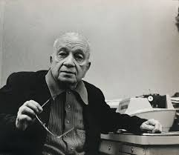
The role of Markets:
Stop Sending Confusing Market Signals
MARIO QUINTANA
Don't waste your time chasing butterflies.
Mend your garden, and the butterflies will come.
Industry needs clear agreed strategic direction, predictability, support for the agreed travel direction and as good level playing field as it gets. All based on a clear vision designed by policy makers based on science and public interest.
Source: Instituto Moreira Salles

Slide 49
Main Blind-Spots preventing us to move faster and deeper
II
Lack of Holistic System approach
  Public leaders and others lack capacity or knowledge of how to translate system change visions into their concrete policies/investment structures which ends in conflicting policy logics that hinder real transformation

Slide 50
II. Holistic System Approach
Applying the Resource Logic Perspective

Slide 51
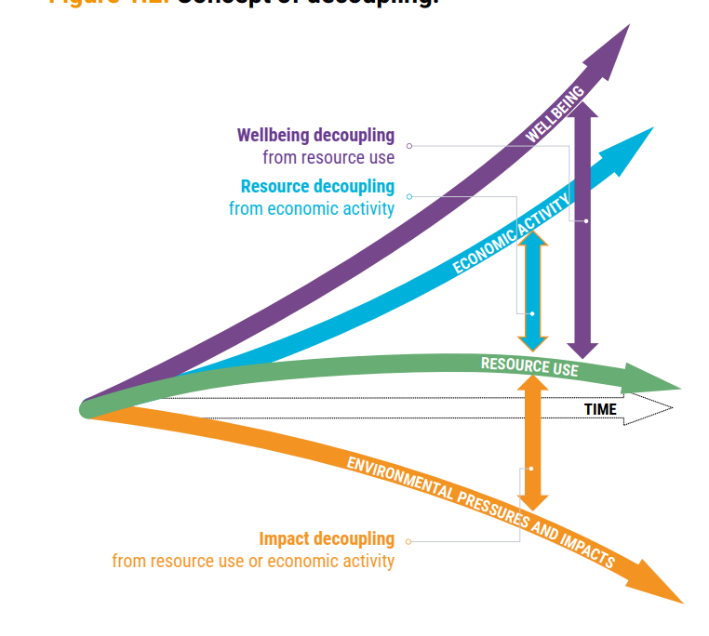



Solutions: Decoupling resource use from economic activity and human wellbeing & targeting it to human needs through provisioning systems
Natural resources
Biomass
Fossil fuels
Metals ores
Non-metallic minerals
Land
Water
Provisioning systems
Nutrition
Built
environment
Mobility
Energy
Human needs
Adequate, nutritious food for all
Safe, secure, resource-efficient built environment
Sustainable mobility and access to essential services
Access to clean, safe energy
Source: International Resource Panel (2024), Global Resources Outlook 2024 (https://www.resourcepanel.org/reports/global-resources-outlook-2024)
Notes:
We need to decouple environmental impacts from resource use, while still raising wellbeing and economic activity – how do we do that?
By looking through the lens of provisioning systems, and designing solutions for human needs.

Slide 52















Systemic Path to Wellbeing
What?
Meeting Human Needs Respecting Planetary Boundaries
Policy Focus
Resource Intensive Provisioning Systems
How?
System Change Approach
Democracy and Social Fairness
Leading in the World and Delivering in Europe
Food
Built Environment
Mobility
Energy
Defence and Security
Sustainable Prosperity and Competitiveness
  Planetary Boundaries
Source: Raworth 2017
Source: IRP 2024
Source: Europe’s Choice, Political Guidelines for the next European Commission 2024-2029
Notes:
So what is IRP?
IRP was created in 2007 by UNEP to generate independent and authoritative scientific assessments of policy relevance on the sustainable use of natural resources to help policy makers to take effective and long-term decisions on sustainable use of natural resources. This connection between scientists and policy is a fundamental characteristic of the IRP .
‘
So the Panel was created in a similar fashion to the Intergovernmental Panel on Climate Change (or Intergovernmental Platform on Biodiversity and Ecosystem Services), but in this case to provide policy-relevant knowledge not on climate change (or biodiversity loss), but on how to use natural resources more sustainably and efficiently.

Slide 53
Solutions: Main Recommendations for implementing the
Just Sustainability Transition scenario
Institutionalizing resource governance and defining resource use paths
Making trade an engine of sustainable resource use
Mainstreaming sustainable consumption options
Creating circular, resource-efficient and low-impact solutions and business models
Directing finance towards sustainable resource use
Global and national institutionalization of natural resource use within global sustainability agendas and action on environmental agreements
Definition of global and national resource use paths
Internalizing the environmental and social costs of resource extraction
Redirecting, repurposing and reforming public subsidies for sustainable resource
Channeling private finance towards sustainable resource use
Incorporating resource-related risk into Public and Central Bank mandates
Trade governance for fairness and sustainable resource use
Enabling local resource value retention in producer countries
Developing action plans to improve access to sustainable goods and services
Regulating marketing practices leading to over- consumption, and raising awareness
Setting up monitoring systems to identify priorities and develop ambitious circular economy action plans
Developing and reinforcing regulation to boost circular economy business models
Building circular economy capacity and coalitions
Notes:
The report follows the overall logic and structure of the 2019 edition along the lines of the DPSIR framework: materials flows and pressures, environmental impacts, 8 outlook through scenario exploration and proposal for policy responses.

Slide 54





Call to action: We need global materials governance to support and advance the sustainable resource use transition
Task Force for Global Materials Governance
to be set up on a global cross-agency level¹, including strong Global South representation
Task force refines pillars, recommends how to institutionalise them and identifies relevant institutions
Pillar 1
BETTER ORIENTATION
National and regional material use targets and related scientific guidance, including a global target
Pillar 2
BETTER MEASUREMENT
Indicators measuring the wellbeing performance and material productivity of provisioning systems
Pillar 3
BETTER ECONOMIC INCENTIVES
Shifts in taxation and subsidies to reflect environmental and social impacts in material prices
Pillar 4
BETTER TRANSPARENCY
Access to consolidated material flow and impact data provided by an International Materials Agency
1 potentially in the UN Secretary-General’s Panel on Critical Energy Transition Minerals

Slide 55
Main Blind-Spots preventing us to move faster and deeper
III
Lack of Demand Side Focus
  Policy attention is mainly given to the supply side of the economy, to the cleaning of the existing economic system - lacking the attention to the demand side which is leaving out an important solutions potential and questions of responsibility and equity.

Slide 56
III. Demand Side Solutions
Role of the Circular Economy and more …

Slide 57
Introducing demand side/resource use in political space
Setting the North Star for material use/decoupling based on Material Footprint
40
High-Income Countries
High Level of Stocks
Material Footprint
Tonnes/pc (flows)
30
20
Low-Income Countries
Low level of Stocks
Growth Including Resource productivity
10
0
Years
2020
2030
2050
2100

Slide 58
Why Circular Economy?
The Logic of the Obvious

Slide 59
Circular economy should be seen as an instrument helping delivering decoupling of economic growth from resource use and environmental impacts in practice, as well as a part of the bigger picture of economic, societal and cultural transformation needed to deliver the SDGs

Slide 60

Circular Bio-Economy is just using common sense
Circular (bio)economy is the oldest concept on planet Earth. All nature is based on the principles of a circular economy: nothing is lost, and everything has its purpose. We humans, as part of nature, should abide by the same principles. Unfortunately, what seems logical in theory isn’t so clear in practice.

Slide 61
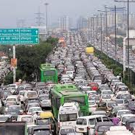
Importance of the Point of Perception
When you complain that you are caught in a traffic jam …
you are wrong.
You are traffic jam.
Source: Mint

Slide 62
From Product Maximisation to Providing Human Needs
It is not not about owing it is about using
We do not need cars … We need mobility
We do not need light bulbs … We need light
We do not need chairs … We need to sit
We do not need refrigerators … We need chilled and healthy food
We do not need CDs … We want to listen to the music
We do not need pesticides … We want healthy plants
Dematerialisation, Rethinking Ownership,
Efficiency should be Complemented with Sufficiency

Slide 63

Main question often-overlooked to be addressed
How to meet human needs in most energy and resource efficient way?
https://edistaffing.com

Slide 64
Efficiency … Sufficiency
Consumer … Producer
  Sufficiency (optimising supply and demand) could be addressed from consumption side through reducing consumption, optimising what is sufficient to meet human needs and/or from the production side by meeting human needs using less energy & materials, by improving energy and resource efficiency.
  Consumers behaviour is related to consumer, consumption system, is basically designed and impacted by governments and producers.

Slide 65
Circular Economy is a Major Business Opportunity
  Sustainability transition is unavoidable. And any transformation is a major business opportunity for those who are innovative, those who dare and those who understand the essence of the challenges ahead of us.
  We should not accept that meeting human needs should be resource intensive and stop stimulating extraction based economic success and rather reward responsible, innovative, creative ways of meeting human needs.

Slide 66
Climate Change
Receiving attention with good reasons, but limited success.
Why is circular economy important part of solution?

Slide 67
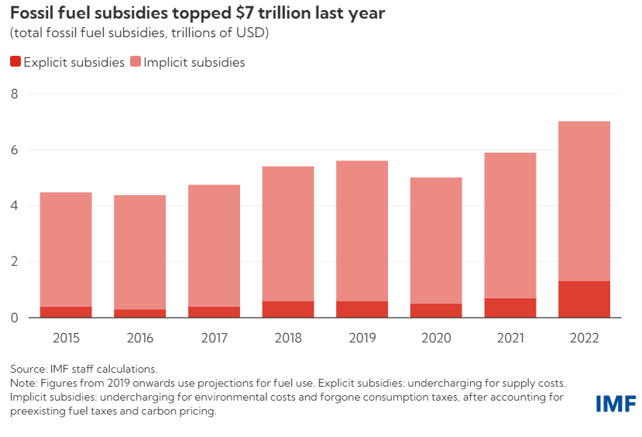
Some Climate Change Related Facts
Global CO₂ emissions in billion metric tonnes 37.55 highest ever (Source: Statista 2023)
Global surface temperature increase above pre-industrial level 1.48 degrees Celsious (Source Copernicus 2023)
The system that moves water around the Earth is off balance for the first time in human history (Source: Global Commission on the Economics of Water, The Economics of Water, 2024
Fossil fuel subsidies $7 trillion or 7.1 percent of GDP (Source: IMF 2022)
The Global Hypocrisy Indicator

Slide 68
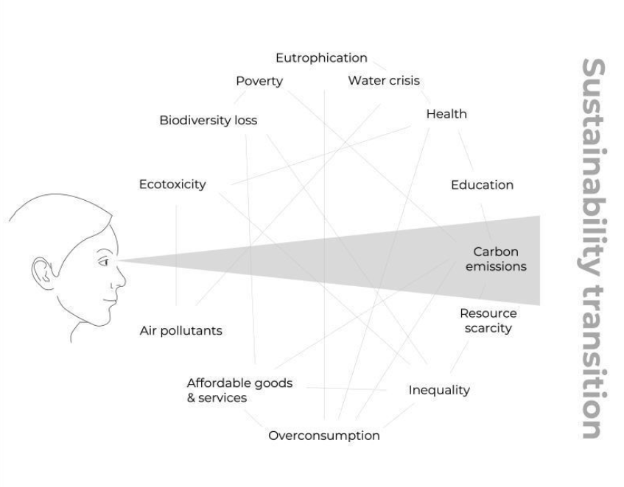
Energy Transition is Important
But not Enough
Climate breakdown is a symptom of ecological overshoot, which is caused by the deliberate exploitation of human behaviour.
The material footprint is dangerously underdiscussed. Most climate “solutions” lack focus on the root cause of the crisis. Where discussion of climate often centres on carbon emissions, which is of course important, while a focus on overshoot highlights the materials usage, waste output and growth of human society, all of which affect the Earth’s biosphere.

Slide 69

We should not focus only on production related energy challenges, but also ask for what that energy will be used.
Hart Hagan, environmental journalist summarised that picturesque by saying:
“Species causing the extinction of 150 species per day does not need more energy to do more of what it does”.
Source: YouTube

Slide 70
Climate Change can only be effectively addressed by combining
SUPPLY SIDE SOLUTIONS
CARBON MANAGEMENT
LAND
WATER
ENERGY
MATERIALS
DECOUPLING - CIRCULAR ECONOMY
DEMAND SIDE SOLUTIONS
ECO-SYSTEM SERVICES, ENVIRONMENTAL SINKS
NATURE BASED SOLUTIONS

Slide 71
Energy Transition
Critical Raw Materials and the role of Circular Economy

Slide 72

Key Critical Raw Materials (Transition Materials)
Transition to net zero GHG target is materials demanding on the supply (energy production), and on demand (energy use) side
Electric vehicles use close to ten times the material of conventional cars – using at least eight different critical material types, compared to just three for conventional cars.
Reaching net zero by 2050 will require about six times today’s critical mineral use in 2040. And even meeting today’s under-ambitious national climate plans would require more than doubling of critical minerals we are using today.
Source: International Energy Agency
Slide numbers to be added
as shown alongside

Slide 73




Indispensable Pillars for Material Resilience
Supply Transition Materials with highest environmental and social standards
Activate policies which encourage all circularity levers
Securing enough supply: ensuring supply is sufficient to power the energy transition
Recycling: Capturing future secondary Transition Materials
Aligning expanded supply with sustainable development
Improving supply resilience by improving TM geographic diversification

Slide 74
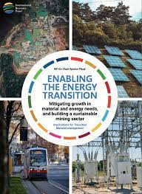
Transition materials (CRMs) are meeting two criteria:
  They are materials which are essential to key energy transition technologies (eg., the electrification of mobility needs powerful lithium batteries, while the expansion of electricity grids requires extensive copper cabling); and
  They are either projected to see significant growth in demand or likely to experience supply-demand gaps in the next decade or so. In particular, we focus on materials for which supply at scale is a new challenge. These include lithium and copper, for which demand is expected to exceed supply by 2030.

Slide 75
Pilar 2: Recycling Potential: Stable and Growing Needs
Stable Needs
Growing Needs
Recycling Potential
Recycling Potential

Slide 76




Indispensable Pillars for Material Resilience
Supply Transition Materials with highest environmental and social standards
Activate policies which encourage all circularity levers
Optimize delivery of human needs in energy and material intensive systems
Securing enough supply: ensuring supply is sufficient to power the energy transition
Recycling: Capturing future secondary Transition Materials
Most energy and material intensive systems
(GRO24)
Mobility: reduced need for travel through work from home, balanced urban design; communal and active transport
More intensive use: Using products that contain transition materials more intensively
Aligning expanded supply with sustainable development
Light weighting: Reducing the weight of products that contain transition materials
Buildings: better utilisation of buildings; space-efficient, balanced neighbourhoods
Improving supply resilience by improving TM geographic diversification
Lifetime extension: Increasing the lifetime of products that contain transition materials

Slide 77


Indispensable Pillars for Material Resilience
Optimize delivery of human needs in energy and material intensive systems
Activate policies which encourage all circularity levers
Supply Transition Materials with highest environmental and social standards
Most energy and material intensive systems
(GRO24)
Mobility: reduced need for travel through work from home, balanced urban design; communal and active transport
Recycling: Capturing future secondary Transition Materials
Securing enough supply: ensuring supply is sufficient to power the energy transition
More intensive use: Using products that contain transition materials more intensively
Aligning expanded supply with sustainable development
Buildings: better utilisation of buildings; space-efficient, balanced neighbourhoods
Light weighting: Reducing the weight of products that contain transition materials
Improving supply resilience by improving TM geographic diversification
Lifetime extension: Increasing the lifetime of products that contain transition materials

Slide 78
The Importance of Optimising the Baseline
Future Needs
Current Needs
Future Needs
Optimised Needs

Slide 79
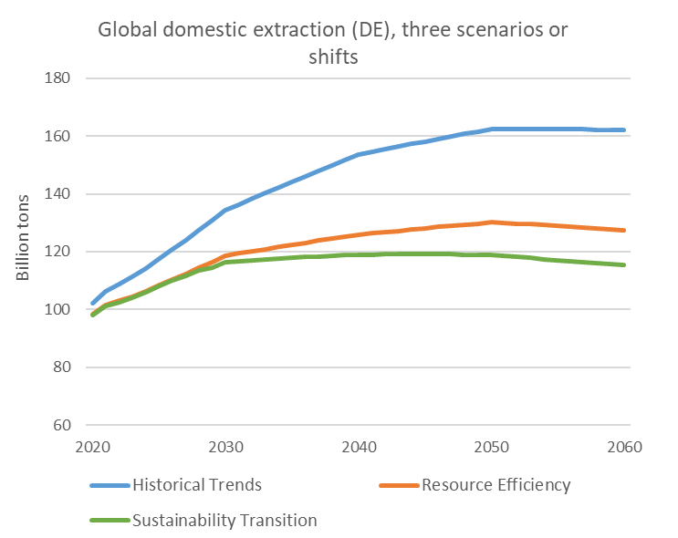
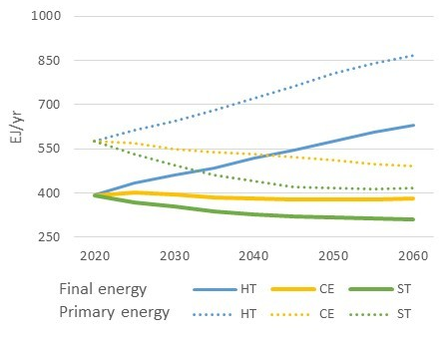
GRO24 IRP modelling:
Decoupling is possible and benefits are important
Global material extraction
Global energy demand
(HT)
(RE)
(ST)
RE
RE
We can mitigate growth in material use by 30% by 2060, compared to continued historic trends…
… and reduce energy demand by 25% by 2060, compared to 2020 levels.
Notes:
IRP’s upcoming Global Resources Outlook takes a provisioning systems approach – modelling how we can optimise delivery of human needs.
By doing this, we can mitigate growth in material use by 30% by 2060, compared to continued historic trends…
…and reduce energy demand by 25% by 2060, compared to 2020 levels.
… therefore improving transition material resilience.
Systemic change is the way to do this – resource efficiency alone isn’t enough

Slide 80
EU Developments
From Waste to Products …
and the need for System Based Approach

Slide 81

Circular Economy Action Plan I – December 2015
Eco-design to include reparability, durability, recyclability
Legislation on fertilisers, including organic and
waste-based fertilisers
Minimum requirements for the reuse of wastewater
Actions on Green Public Procurement
Funding of €650 million for ‘Industry 2020
in the circular economy’
Quality standards for secondary raw materials
Strategy on plastics, including marine litter
Interface between chemicals, products and waste legislation
Production
Consumption
Innovation, Investment & Monitoring
Secondary raw materials
Waste Management

Slide 82
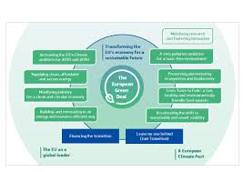
European Green Deal
Annual Sustainable Growth Strategy 2020
Climate Pact
A New Industrial Strategy for Europe
Circular Economy Action Plan 2020
Shaping Europe’s Digital Future
White Paper on Artificial Intelligence
A European Strategy for Data
Farm to Fork
Biodiversity Strategy
And … more documents existing and still coming

Slide 83
Circular Economy Action Plan II - March 2020
Make sustainable products the norm in the EU Eco-Design Reg.
Empower consumers and public buyers
Sustainable production processes
Making circular economy work for people, regions and cities
Sustainable
Product Policy Framework
Circular economy as a requisite for climate neutrality
Electronics and ICT
Batteries and vehicles
Packaging
Plastics
Textiles
Construction and buildings
Food, water and nutrients
Getting the Economics Right
Key
Value
Chains
Financial Markets
Less
Waste
More
Value
Investments and R&I
Reduce Waste
Reduce Waste Exports
Boost market for high quality and safe secondary raw materials
Global Level Playing Field
35 actions
Monitoring

Slide 84
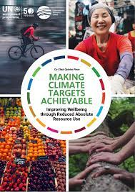
The first dimension is still to a large extent overlooked …
Dimensions
BETTER: Minimise product need through better system design | Refuse and Rethink strategies
LEANER: Optimise product design | Reduce strategies in manufacture and use
LONGER: Maximise lifespan of products and its parts | Reuse, Repair, Refurbish, Remanufacture, Repurpose and Recycle strategies
CLEANER: Minimise waste and pollution | Recovery strategies
Still not much present, but critical for effectiveness
1
2
Resource Efficiency
3
4

Slide 85
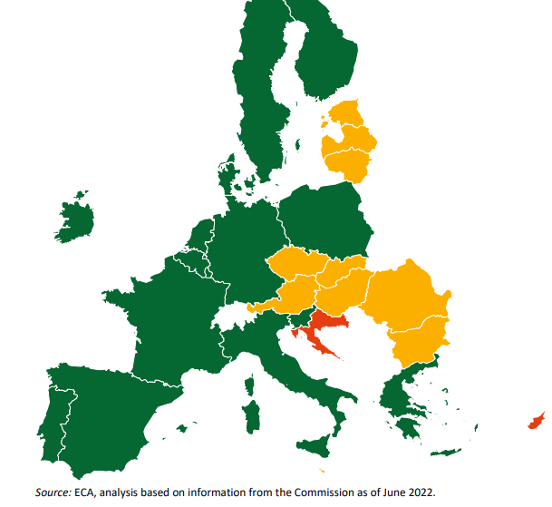
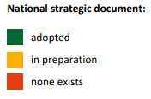
EU-27 Circular Economy Strategies

Slide 86
What next?
European Green Deal follow up …
EGD kickstarted EU-wide efforts for a very much needed whole economy and society transformation.
The direction set by the EGD should remain the north star also in the future. Any departure would be fatal mistake. Following the mission letters from Commission President VDL to future Commissioners the future of EGD is likely secured, but …
Considering also new geo-strategic reality, increasing security threats and additional competitiveness and social pressures keeping the appropriate and needed attention to environment in this changed European and global reality will be a challenge!

Slide 87

It is not easy being green
To Conclude
Source: Disney.com

Slide 88
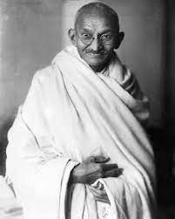
The world has enough for everyone’s need, but not for everyone’s greed”
Mahatma Gandhi

Slide 89

The World has Changed
1972
Population on the Planet
3.8 billion
2022
The Growth of Limits
Climate Change, Pandemics, Biodiversity Loss, Security Threats …
Population on the Planet
8 billion
To make our future sustainable
some basic shifts would be needed:
Notes:
[PLACEHOLDER – TITLE SLIDE TO BE INCLUDED]

Slide 90

1
From Humans in function of economic success and development to an economy in function of delivering human needs
We must set the order right!

Slide 91
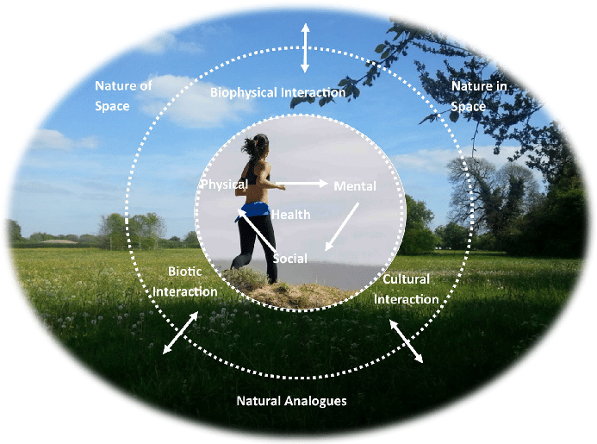
2
From economy considering Humans as external/superior to Nature
to an economy acknowledging that we are embedded with Nature
Destroying Nature is destroying ourselves!

Slide 92
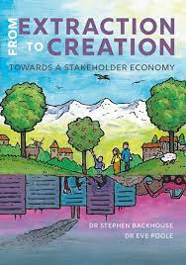
3
From extraction-based production
to a creation-based production
We should stop stimulating extraction based economic success and reward responsible, innovative, creative ways of meeting human needs!

Slide 93

4
From an egoistic, short-term based interests’ governance structures and logic to cooperation and sharing sovereignty.
We must improve our collective resilience. We need a convincing intergenerational pact, and all governments should nominate Minister for Future Generations.

Slide 94
We are indebting future generations, financially and by depleting the Nature. This is simply wrong.
Apparently, we humans are the most intelligent spices on this planet. It is high time to prove it.
More than an economic or a technological choice, this is a moral choice.

Slide 95
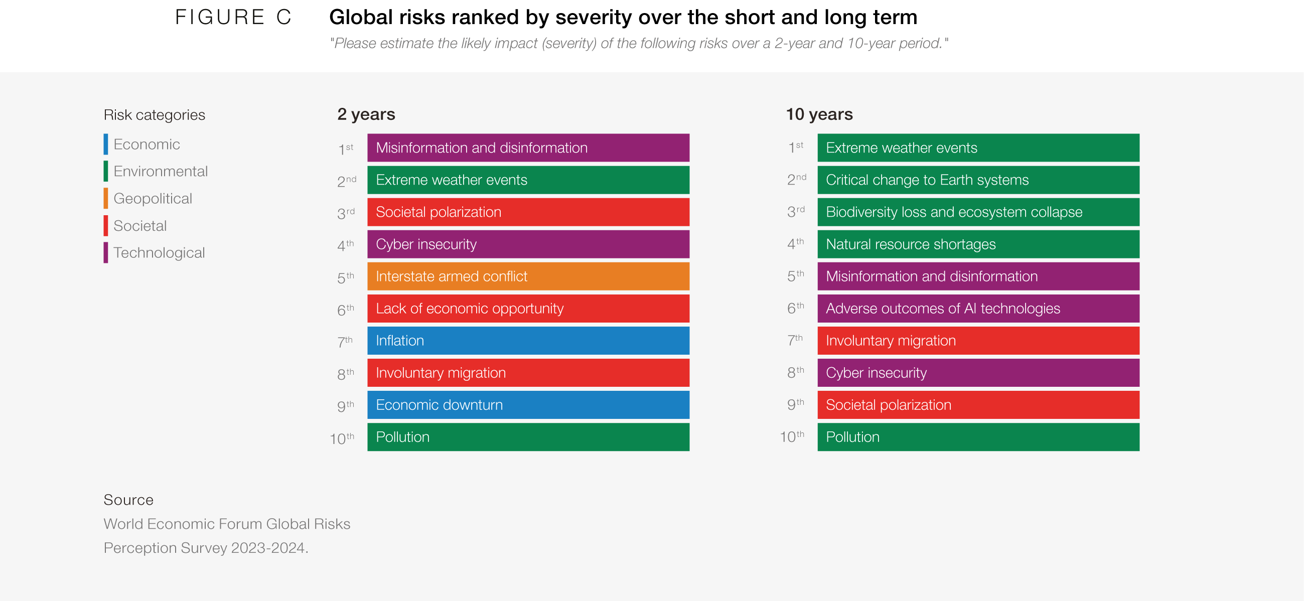
This System Change Transformation is also in the Interest of the Business

Slide 96
Changing our Relationship with (the rest of) Nature, is ultimately an Economic, Equity and Security Imperative to strengthen collective Resilience
The lessons learned recently (war, pandemic, the hottest summer) are more than convincing to understood that. This relationship is not stable, nor balanced, and it will be resolved either with collective wisdom and effort, or in a hard and very painful way (conflicts, pandemics, migration …)
The future will be green and more fair and equal … or there will be no future.
Notes:
[PLACEHOLDER – TITLE SLIDE TO BE INCLUDED]

Slide 97
And finally, with the most important advice from the famous Belgian, country hosting me last two decades
HERCULE POIROT
When asked why he is speaking about himself always in a third person he replied something like that:
If one is such a genius like me, it is very important to establish a healthy distance to himself.

Slide 98


THANK YOU
for helping us delivering the future we want!

