Slide 1
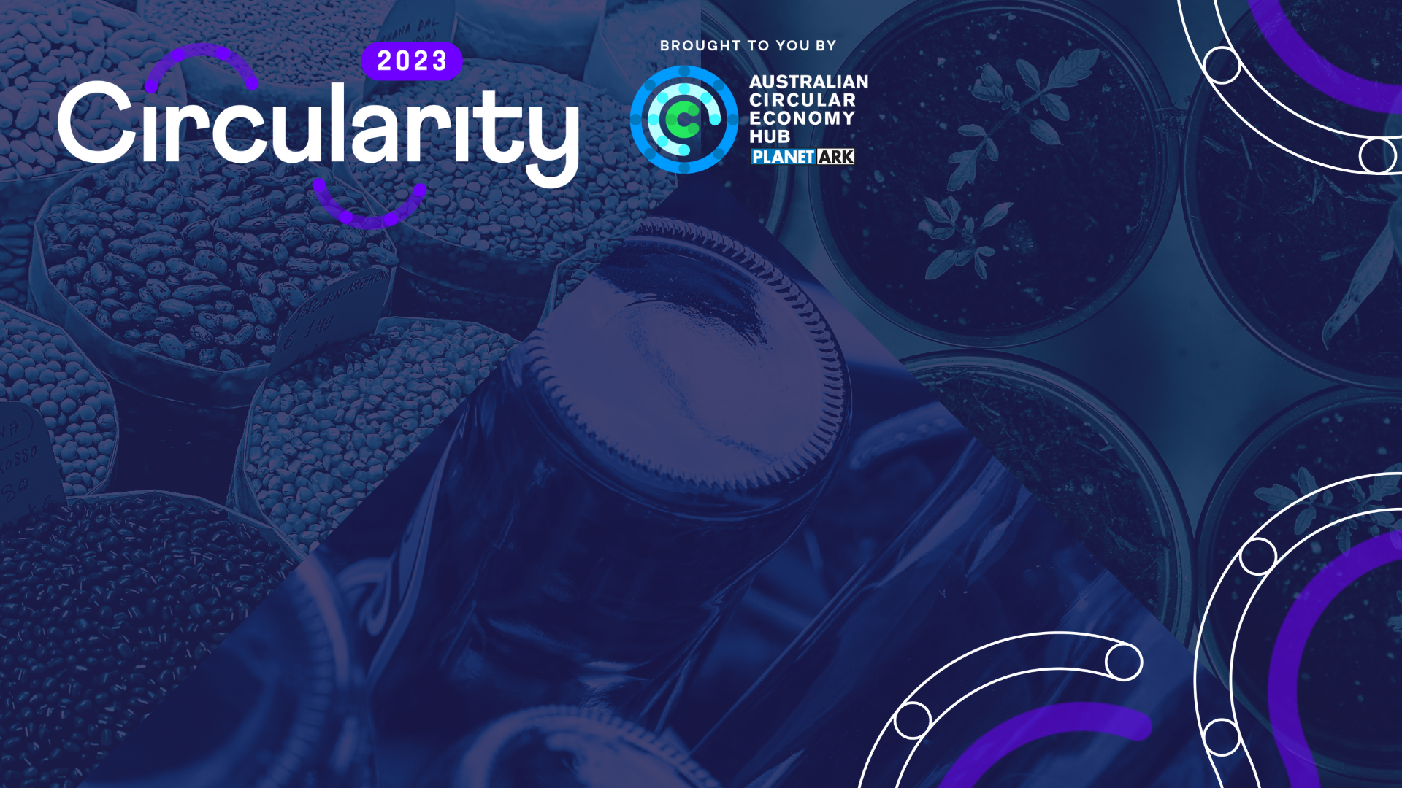
20 Nov | 11:35 AM – 12:10 PM
Circularity in
Australian Business:
Perceptions, Knowledge and Actions Beyond Recycling
Heading 1

Slide 2

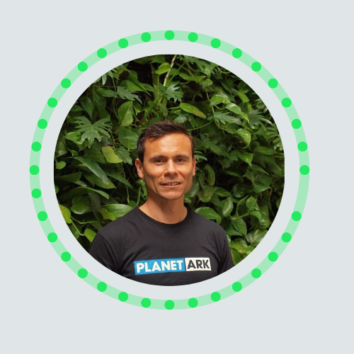



SPEAKERS
Circularity in Australian Business 2023: Perceptions, Knowledge and Actions Beyond Recycling
Nicole Garofano
Head of Circular Economy
Development
Planet Ark
Ryan Collins
Head of Circular Economy
Programs
Planet Ark
Claire Laws
Research Specialist
Planet Ark
Teslin Taylor
Head of Sustainability
Country Road Group

Slide 3



REPORT BACKGROUND
PURPOSE
Australia's only longitudinal research that captures the sentiment of Australian businesses in their circular economy (CE) journey.
Informs government, business, educators, researchers…
METHODOLOGY
Pollinate conducted the research:
  Qualitative – interviews with 11 x senior decision makers responsible for sustainability
  Quantitative – survey of 500 x business decision makers
NEW IN 2023
Circular Economy in Action
Your Call to Action
FOUNDING PARTNERS
OFFICIAL SPONSOR
Notes:
Interviewees included Aus Food & Grocery Council, Bingo, Built, Country Road, Polestar, Unllever,

Slide 4
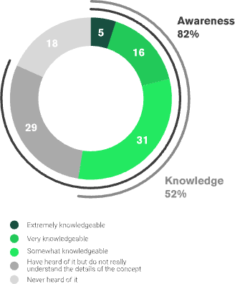
KEY RESULTS
Awareness of CE is high.
Claimed knowledge (confidence) is moderate.
Circularity in Australian Business 2023: Perceptions, Knowledge and Actions Beyond Recycling
Notes:
2021: 92% awareness (slight drop, perhaps different sample representation had an impact)
2020: 96% awareness (different sample size – 200; fewer large businesses represented)

Slide 5
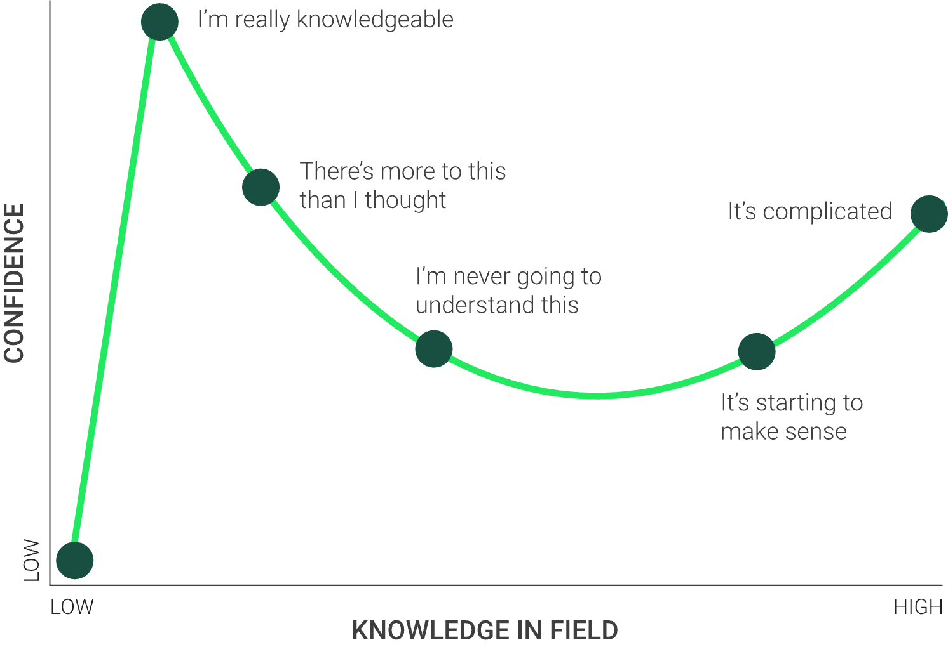
KEY RESULTS
The Dunning Kruger effect of confidence versus knowledge
The confidence-knowledge gap is closing
2021
2023
81%
claimed knowledge
-
27%
actual knowledge
52%
claimed knowledge
-
35%
actual knowledge
54% gap
vs
17% gap
Circularity in Australian Business 2023: Perceptions, Knowledge and Actions Beyond Recycling
Notes:
2020:
86% claimed knowledge
34% actual knowledge
52% gap
(different sample size – 200; fewer large businesses represented)

Slide 6

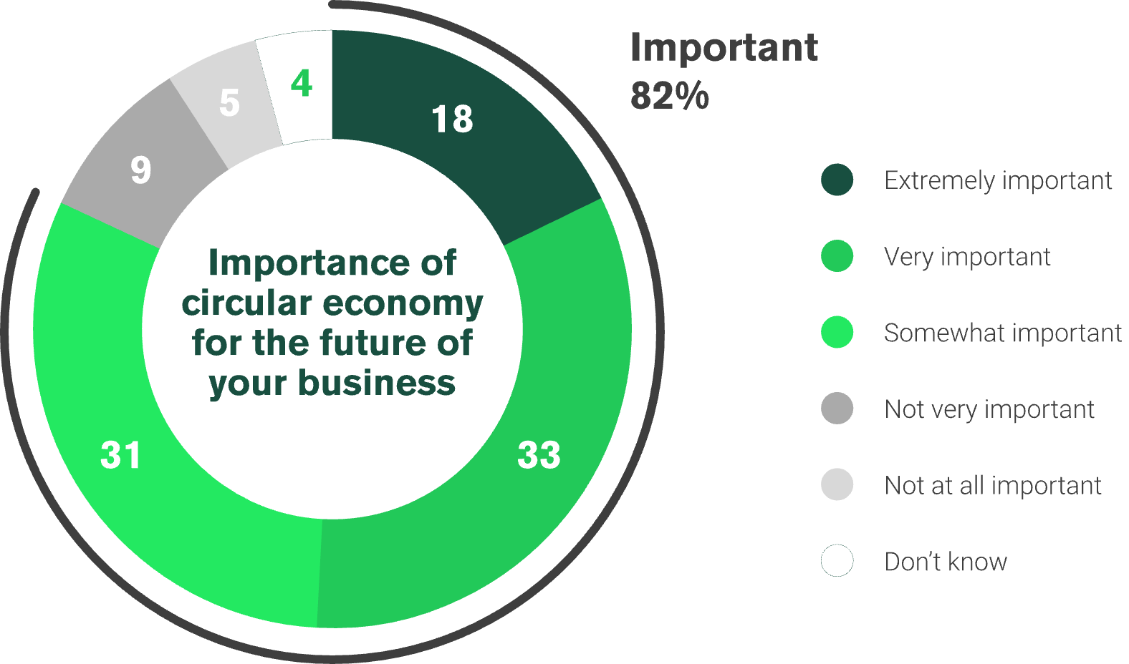
KEY RESULTS
CE is important for the future of Australian business.
Those who understand the importance are more likely to be from…
And least likely to be from…
Circularity in Australian Business 2023: Perceptions, Knowledge and Actions Beyond Recycling
Notes:
2021: 88% important
2020: 86% important

Slide 7
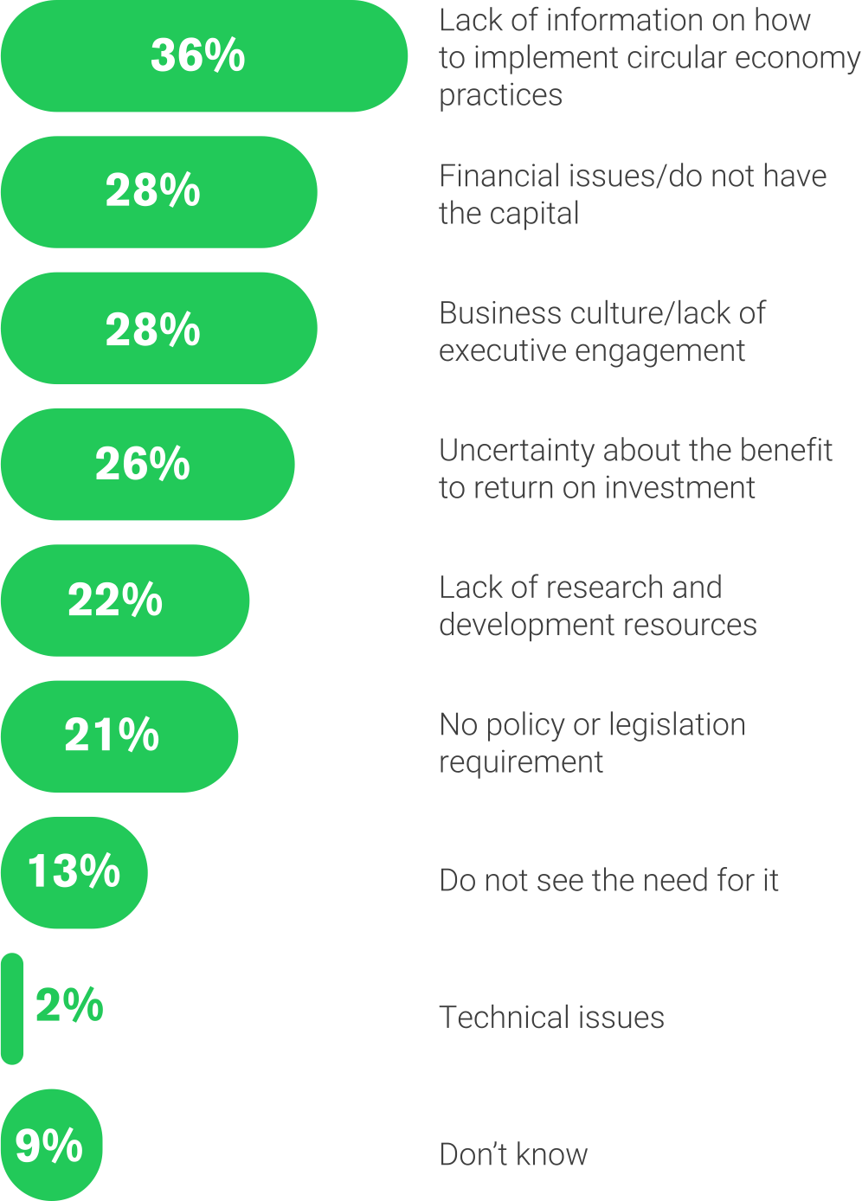
KEY RESULTS
Perceived barriers to implementing CE
Key barriers:
Lack of information and finance
Business culture
“…the whole system needs to move in harmony.”
Andrew Hinchliff, Group Executive,
Institutional Banking and Markets, CBA
Circularity in Australian Business 2023: Perceptions, Knowledge and Actions Beyond Recycling
Notes:
Similar to 2021 & 2020

Slide 8
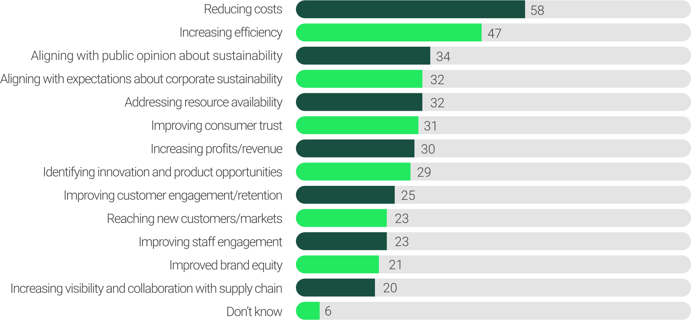
KEY RESULTS
Perceived benefits from implementing CE
Key benefits:
Reducing costs
Increased efficiency
“I think that there’s this mistake that you can’t be sustainable and commercial. I think we’ve proven that you can be both.”
Emma Lewisham
CEO and Co-Founder, Emma Lewisham
Circularity in Australian Business 2023: Perceptions, Knowledge and Actions Beyond Recycling
Notes:
2021 (2020):
42% (48%) Reducing costs >> BIG JUMP in 2023, potentially indicating increased knowledge
39% (52%) Increasing efficiency
39% (30%) Aligning pubic opinion about sustainability

Slide 9
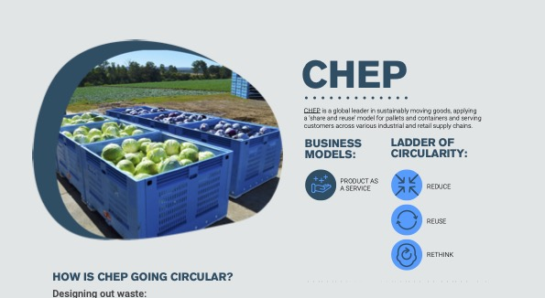
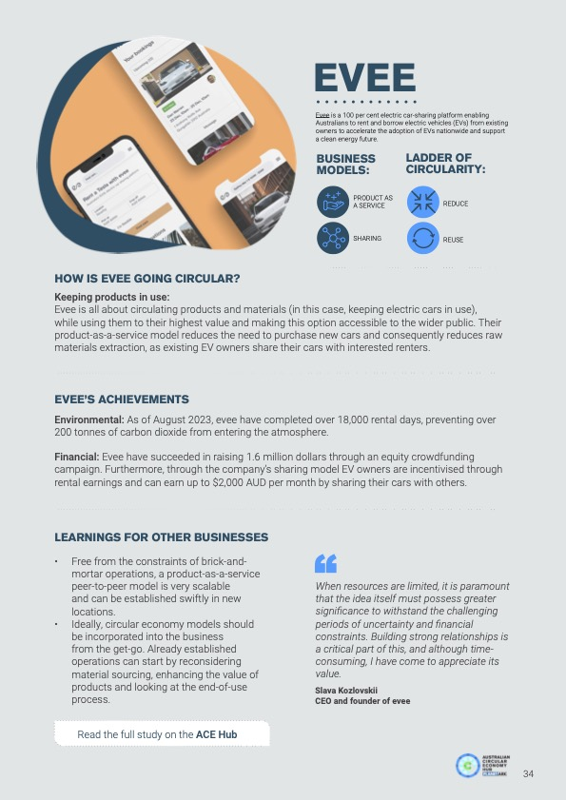
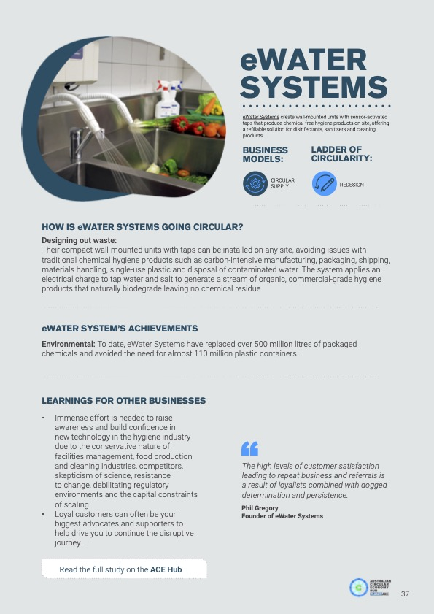
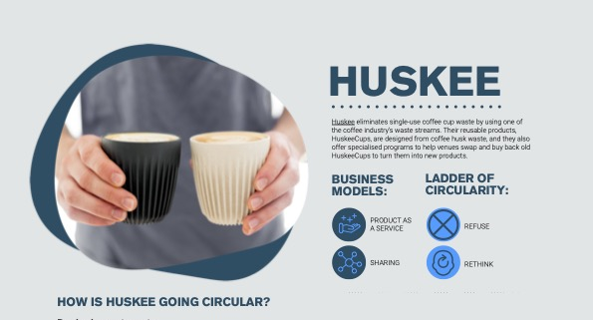
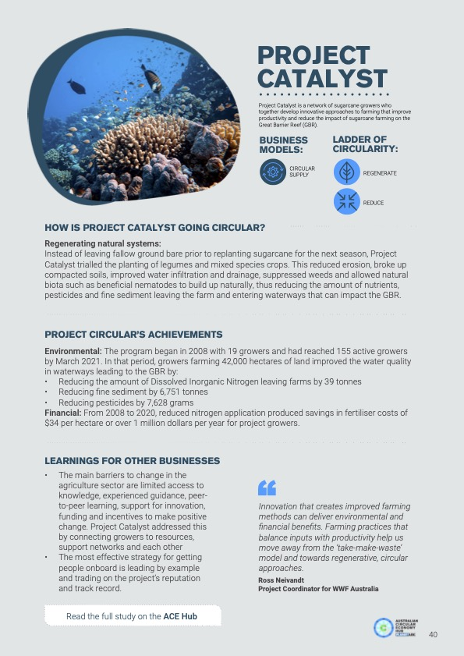
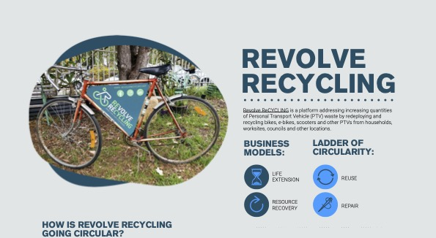
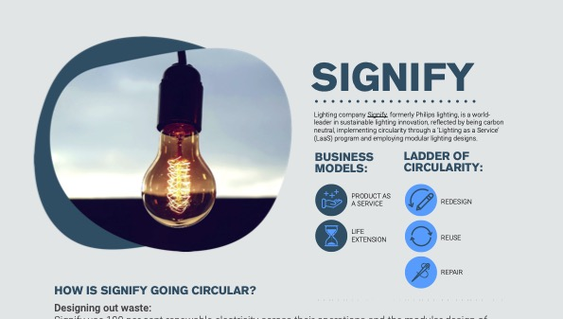
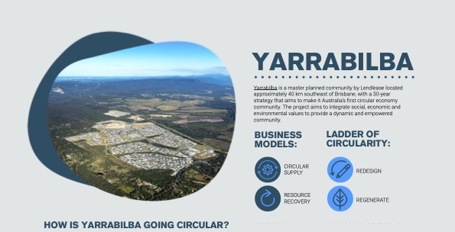
First movers are seeing the benefits
CE IN ACTION
HOW
Business models
R strategies
ACHIEVEMENTS
Environmental
Financial
Social
LEARNINGS FOR OTHER BUSINESSES
Circularity in Australian Business 2023: Perceptions, Knowledge and Actions Beyond Recycling

Slide 10
YOUR CALL TO ACTION - 1
1)
I AM…
MY ACTION…
A
Just starting…
Improve understanding
A
B
Making some progress…
Start a conversation
B
C
Well on the way but need help…
Tap into expert knowledge
C
Circularity in Australian Business 2023: Perceptions, Knowledge and Actions Beyond Recycling

Slide 11

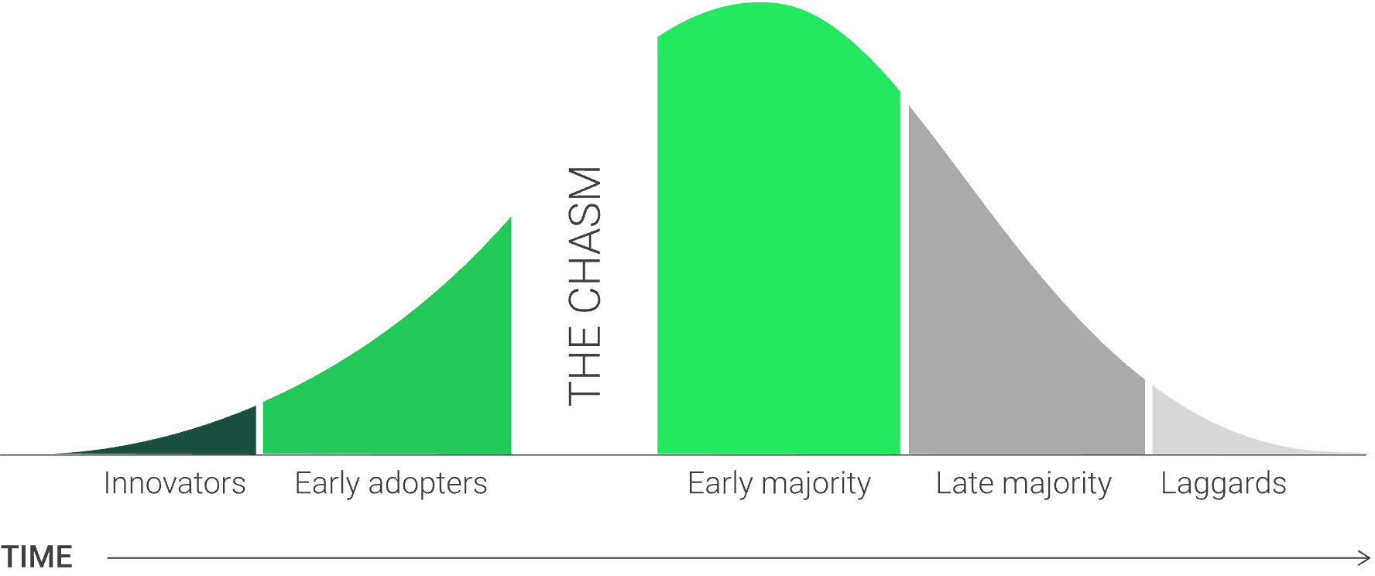
YOUR CALL TO ACTION - 2
2)
AUDIENCE DIFFERENCES
Characteristics
Motivations and drivers
Therefore…
Different engagement strategies
Circularity in Australian Business 2023: Perceptions, Knowledge and Actions Beyond Recycling
Notes:
The adoption curve using the ‘Diffusion of Innovations’ model with adoption gap (or ‘the chasm’).
This theory was popularised by Everett Rogers in his book Diffusion of Innovations, first published in 1962.
The ‘chasm’ was added to the original ‘Diffusion of Innovation’ curve by Geoffrey A. Moore in his book Crossing the Chasm, first published in 1991.

Slide 12
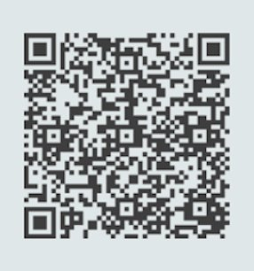
YOUR NEXT STEPS
DOWNLOAD THE REPORT
Scan the code
THANK YOU!
Or go to:
https://acehub.org.au/knowledge-hub/research
ryan@planetark.org
claire.laws@planetark.org
Notes:
Thank you: Pollinate, George Osborne (AB), Claire L, Jane, Liam, Nicole, Sarah, Tam

