Slide 4
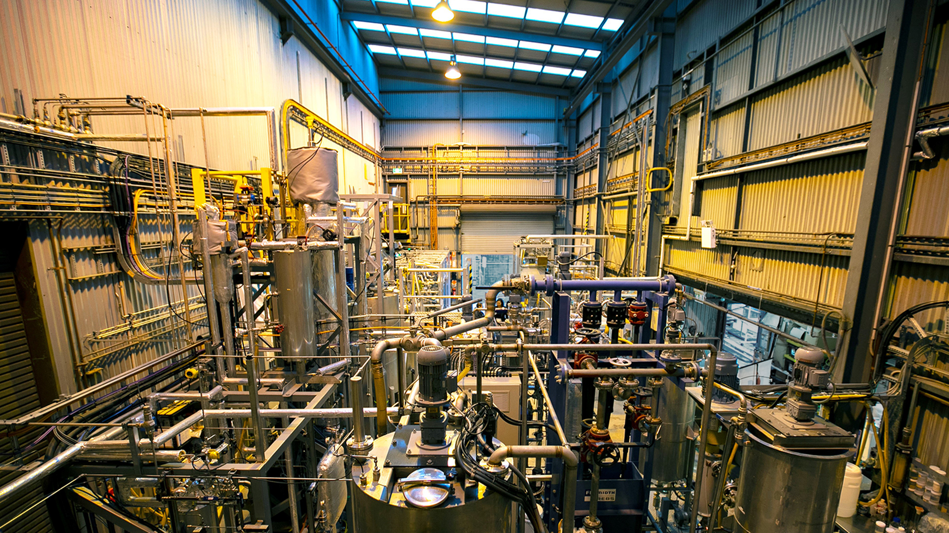
2016 – now
Global Reference Pilot Plant
University of Newcastle, Australia

Slide 5
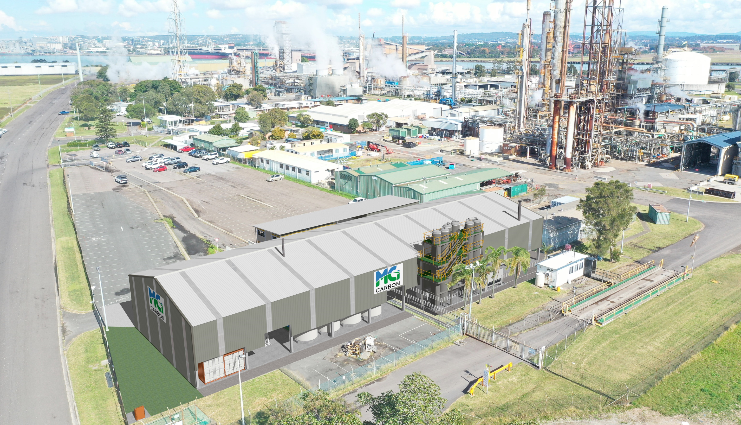
Kooragang Island, Newcastle

