Slide 1
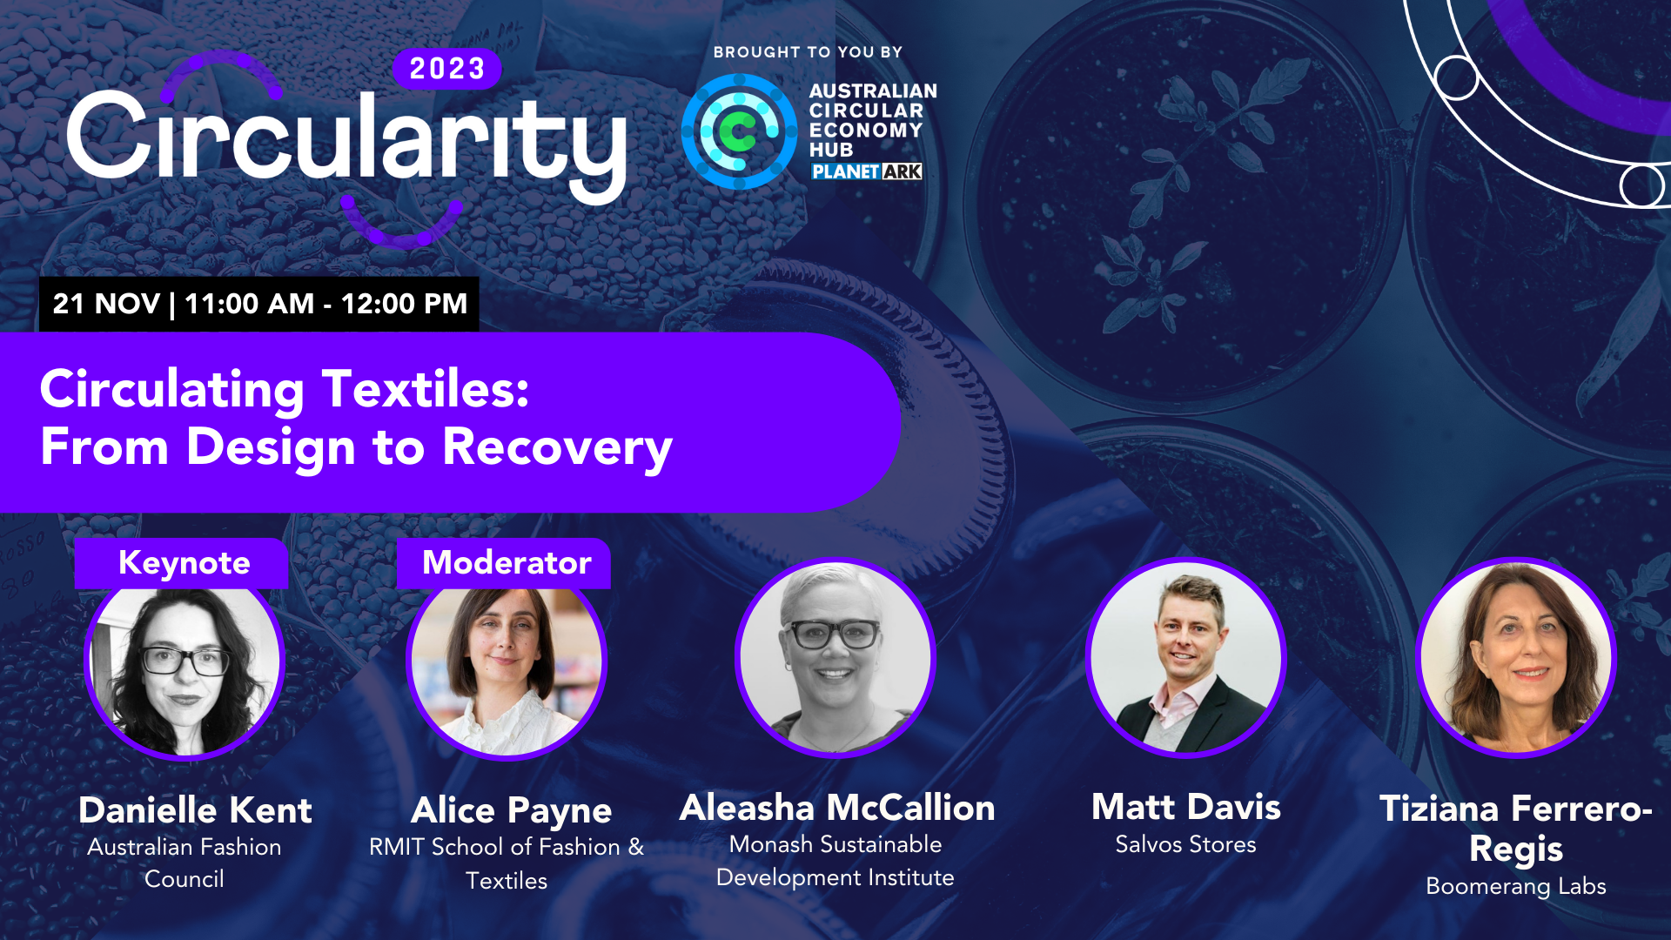

Slide 2
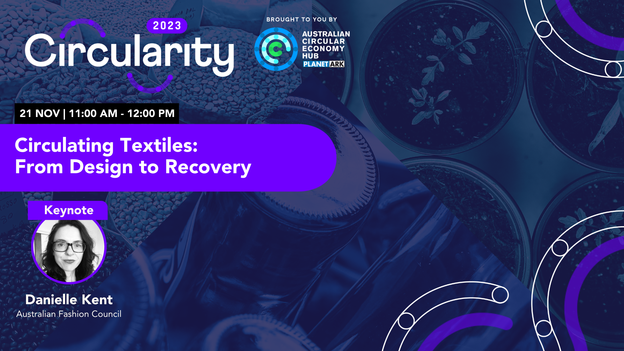

Slide 3
Seamless - National Clothing
Product Stewardship Scheme
KITX

Slide 4
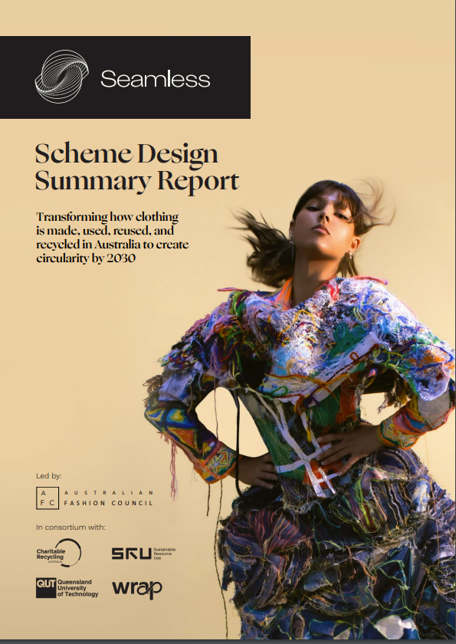
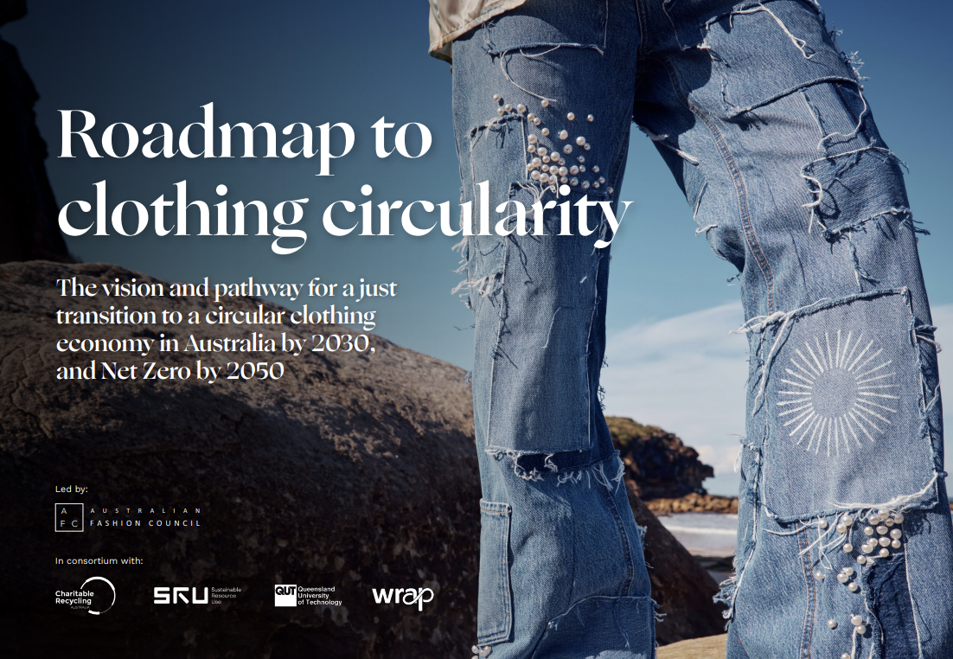
Scheme Design Summary Report
Australian Fashion Council led Consortium - Charitable Recycling Australia, QUT, Sustainable Resource Use, WRAP UK
Launched on 7 June 2023 by Minister for Environment, Tanya Plibersek
Consortium provided six key recommendations
Roadmap to clothing circularity
Notes:
The National Clothing Product Stewardship Scheme aims to transform how clothing is made, used, recirculated and recycled in Australia to create clothing circularity by 2030.
Includes all new clothing imported into or manufactured in Australia
Run by an independent product stewardship organisation
Financial contribution paid by brand owners, 'stewards,' on each new item of clothing they place on the market

Slide 5
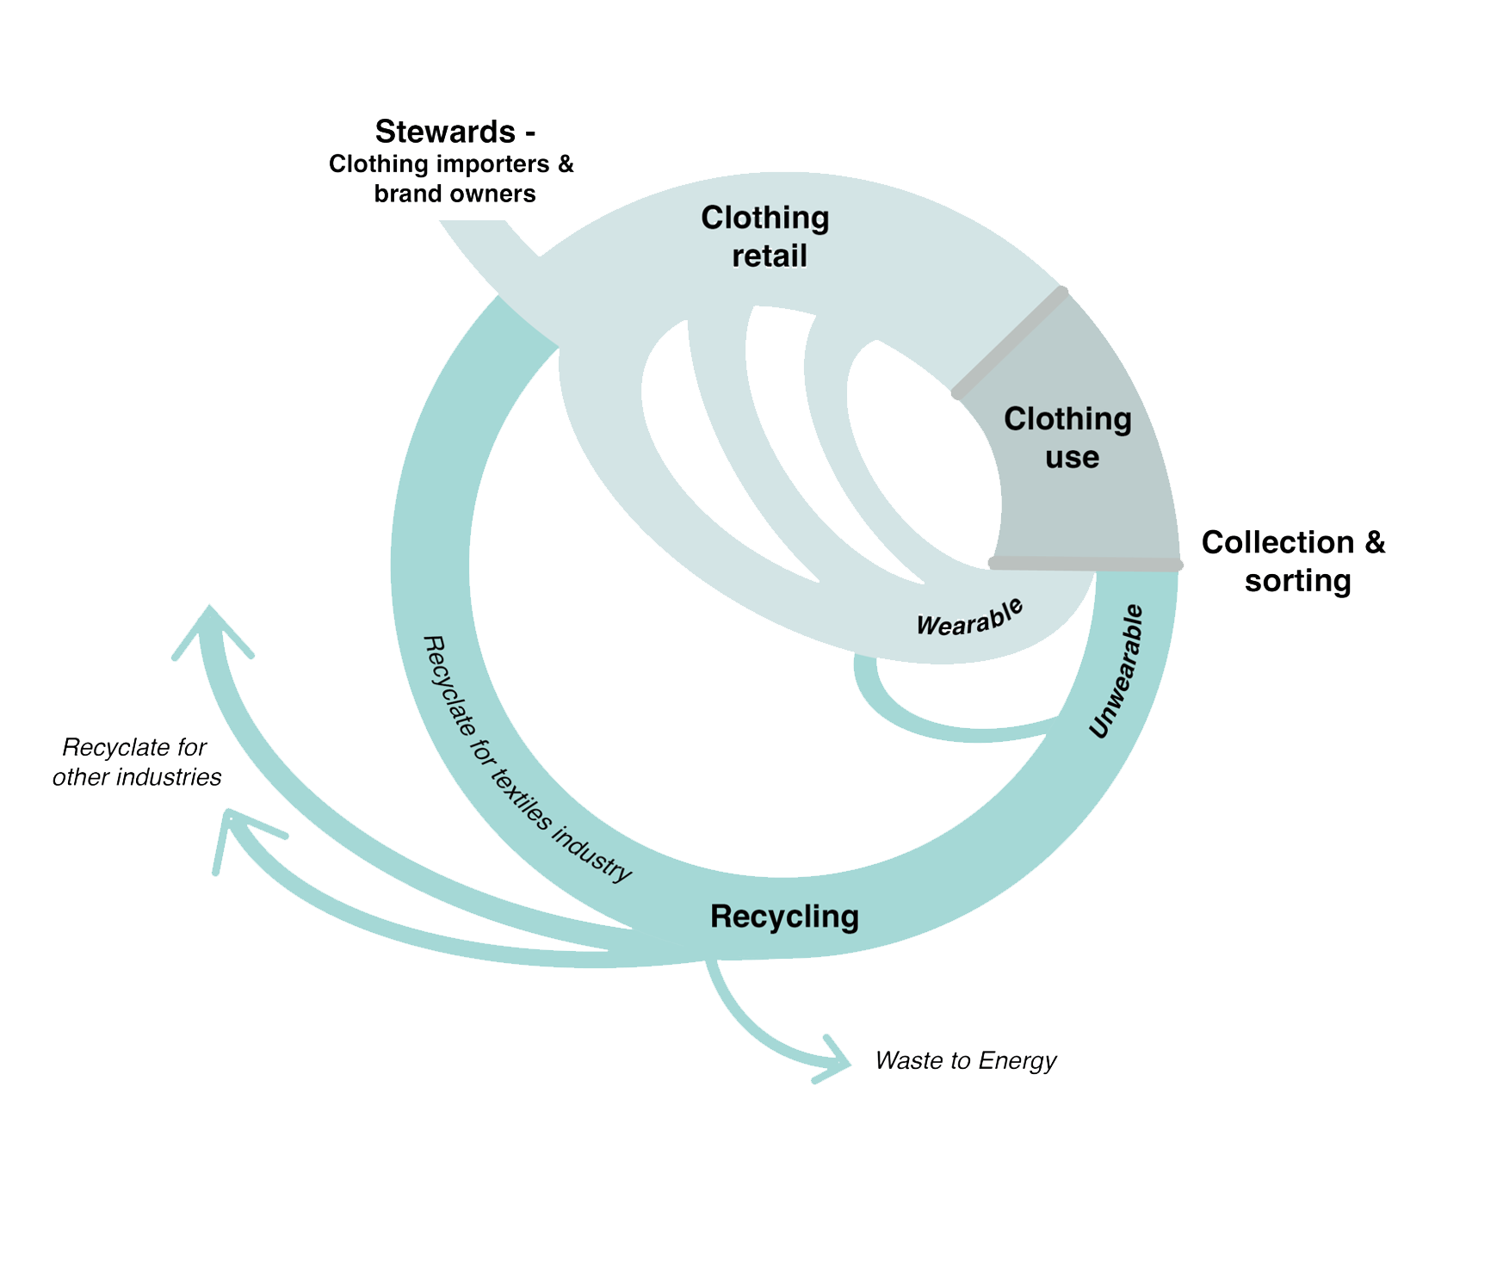
Circular clothing

Slide 6
Four central activities

Slide 7
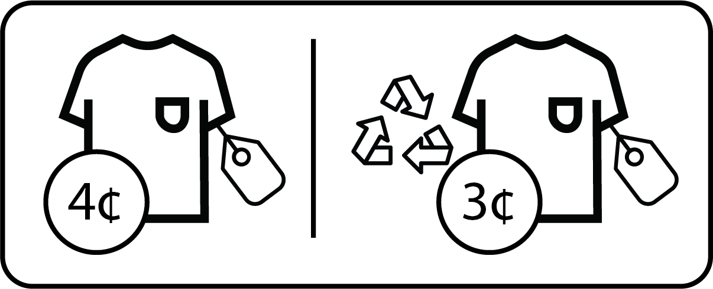
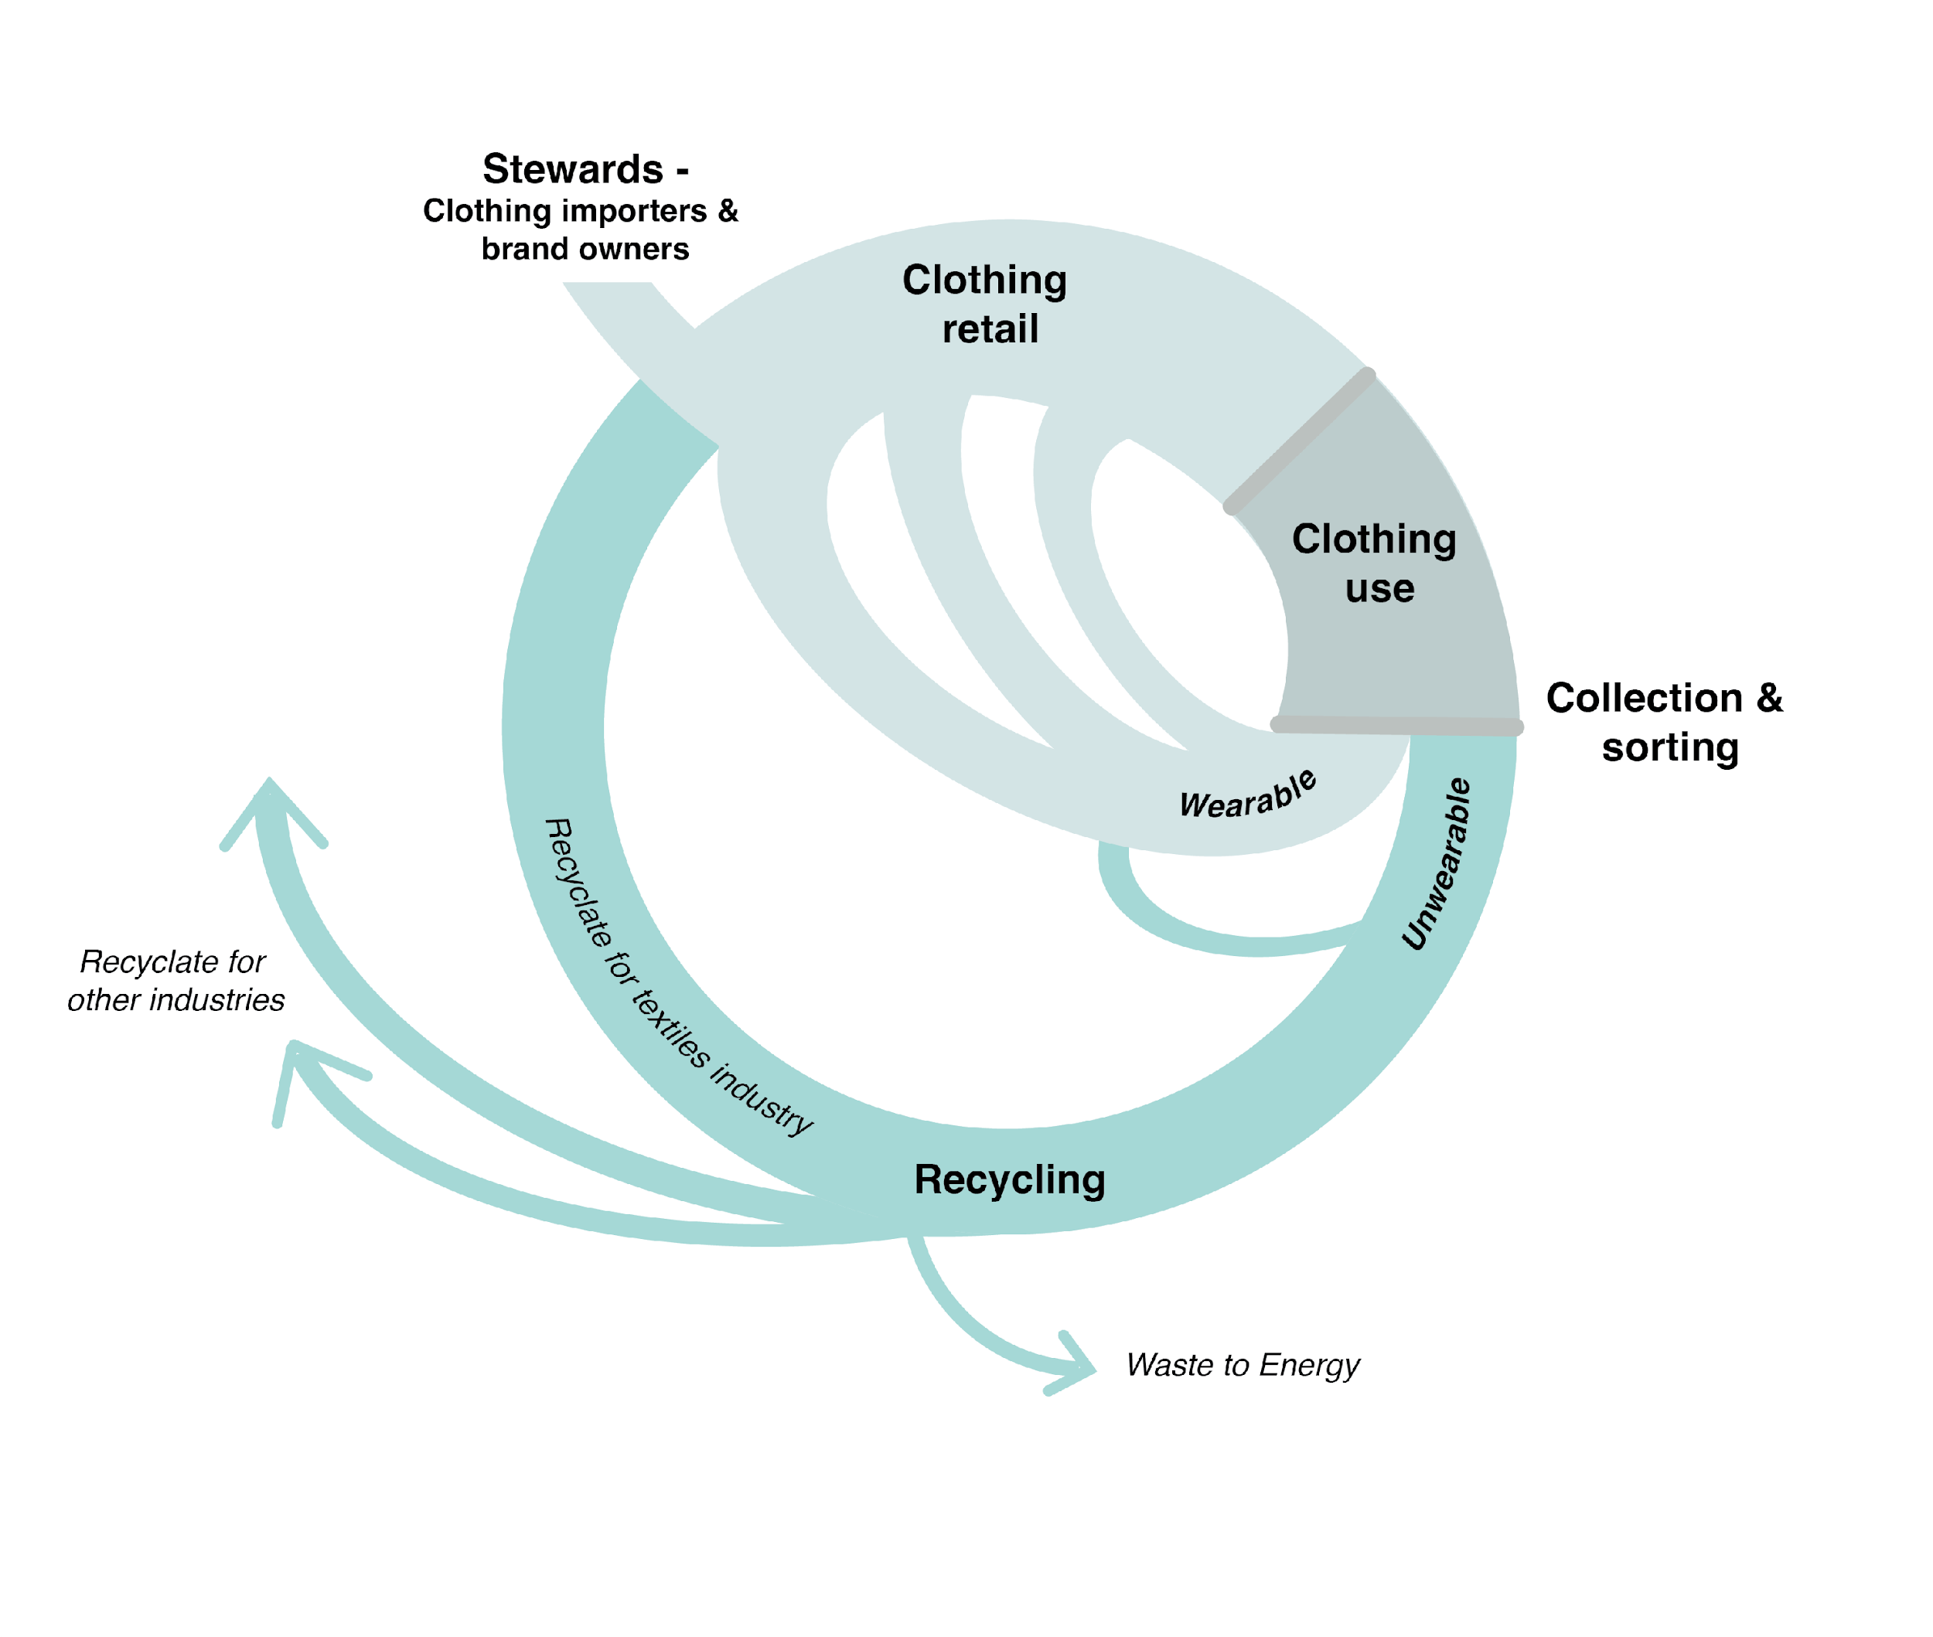
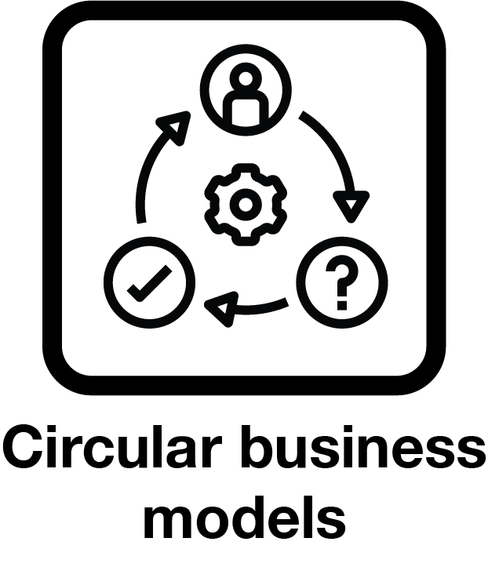
Scheme structure
Expenditure
REVENUE
1
PSO admin, reporting & accreditation
>
CLOTHING
PRODUCT STEWARDSHIP
ORGANISATION
>
1
>
Education & marketing campaign
2
Stewards pay a contribution per unit of new clothing
2
Rebates for collecting, sorting, reprocessing of both wearable and unwearable clothing
6
>
3
>
>
>
R&D funds & co-investment in recycling infrastructure
4
>
>
>
3
Pilots to de-risk circular business models like resale, rental, made-to-order
4
>
5
5
>
>
6
Technical support for brands to shift to circular design
>
>
Notes:
The consortium commissioned economic modelling by RPS to determine the feasibility of the scheme based on market analysis of the currently available data. The analysis is based on comparative schemes in Australia and overseas, tailored to the particularities of the clothing sector in Australia. The modelling helped the consortium determine the level of the contribution and how the funds raised by the contributions should be spent to deliver the objectives (see Annex for detailed objectives) of the scheme. It did this by incorporating the currently available data on clothing sales, collection and sorting costs, recycling infrastructure availability and costs, markets for recycled materials etc. into a complex model. This model is designed to be updated and amended as more or better data becomes available and the assumptions on which the modelling is based can be refined.

Slide 8
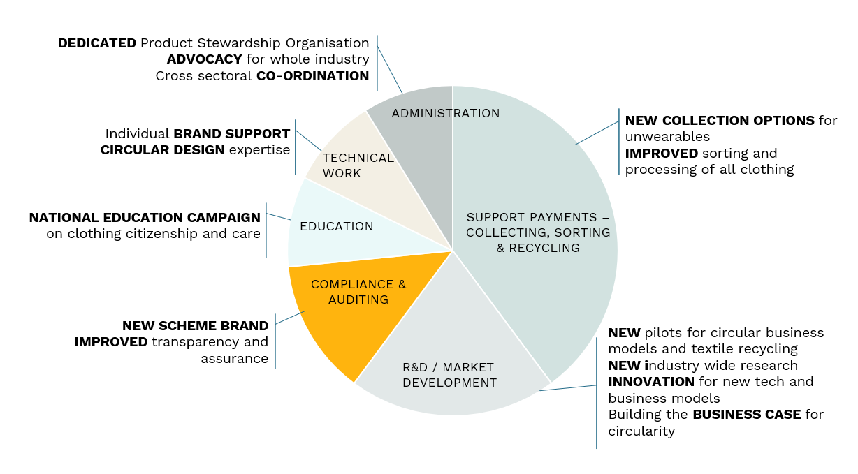
Scheme activities

Slide 9
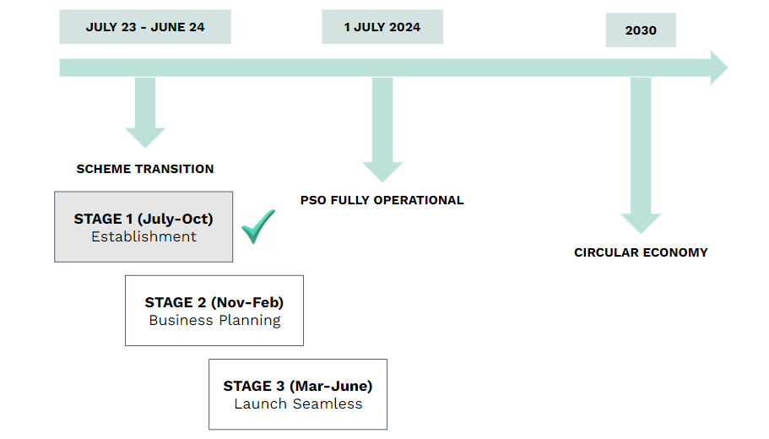
Seamless Transition
Notes:
The Transition phase will be focused on setting up the governance and structural arrangements required to form the PSO.
Once the PSO is formed as a legal entity, the PSO can build up resources and capacity whilst recruiting stewards to the scheme as well as delivering on early priorities such as generating the baseline, onboarding the founding stewards, creating clothing action plans etc.
There are three main areas of transition activity, PSO governance, PSO establishment and PSO Launch

Slide 13
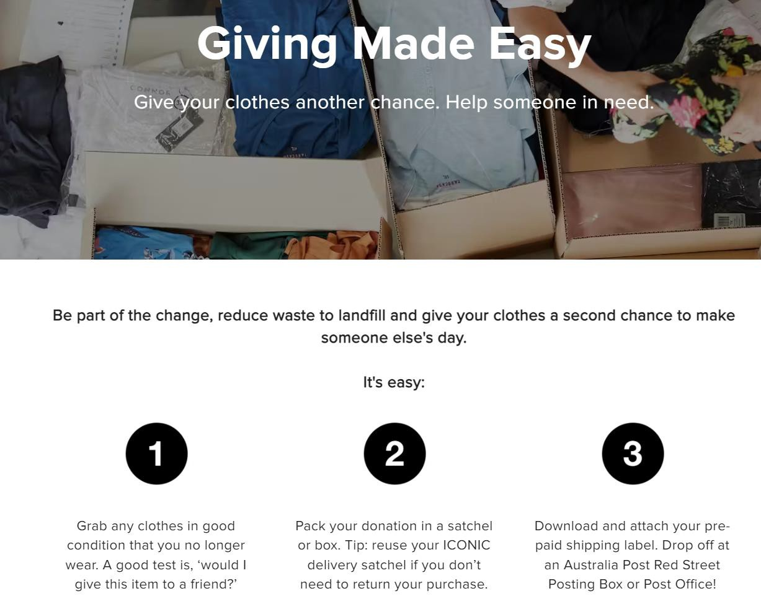
Charities are evolving
through partnerships
Q&A
‘Hierarchy of use’
needs leadership
Environmental and social impact must travel together

Slide 15
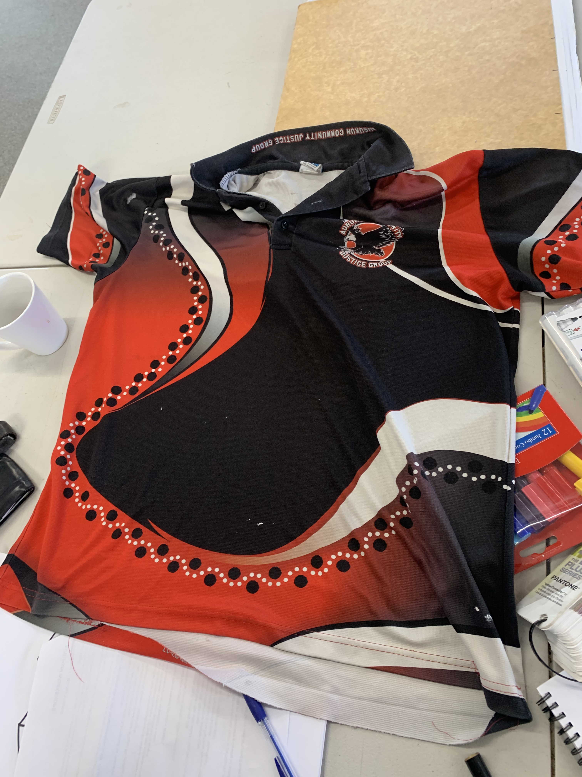
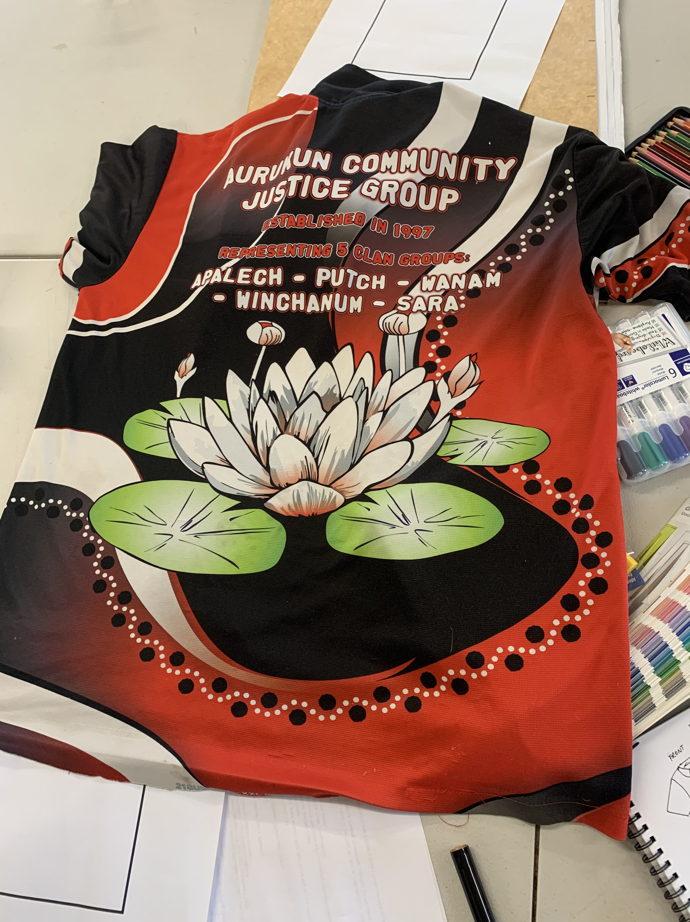
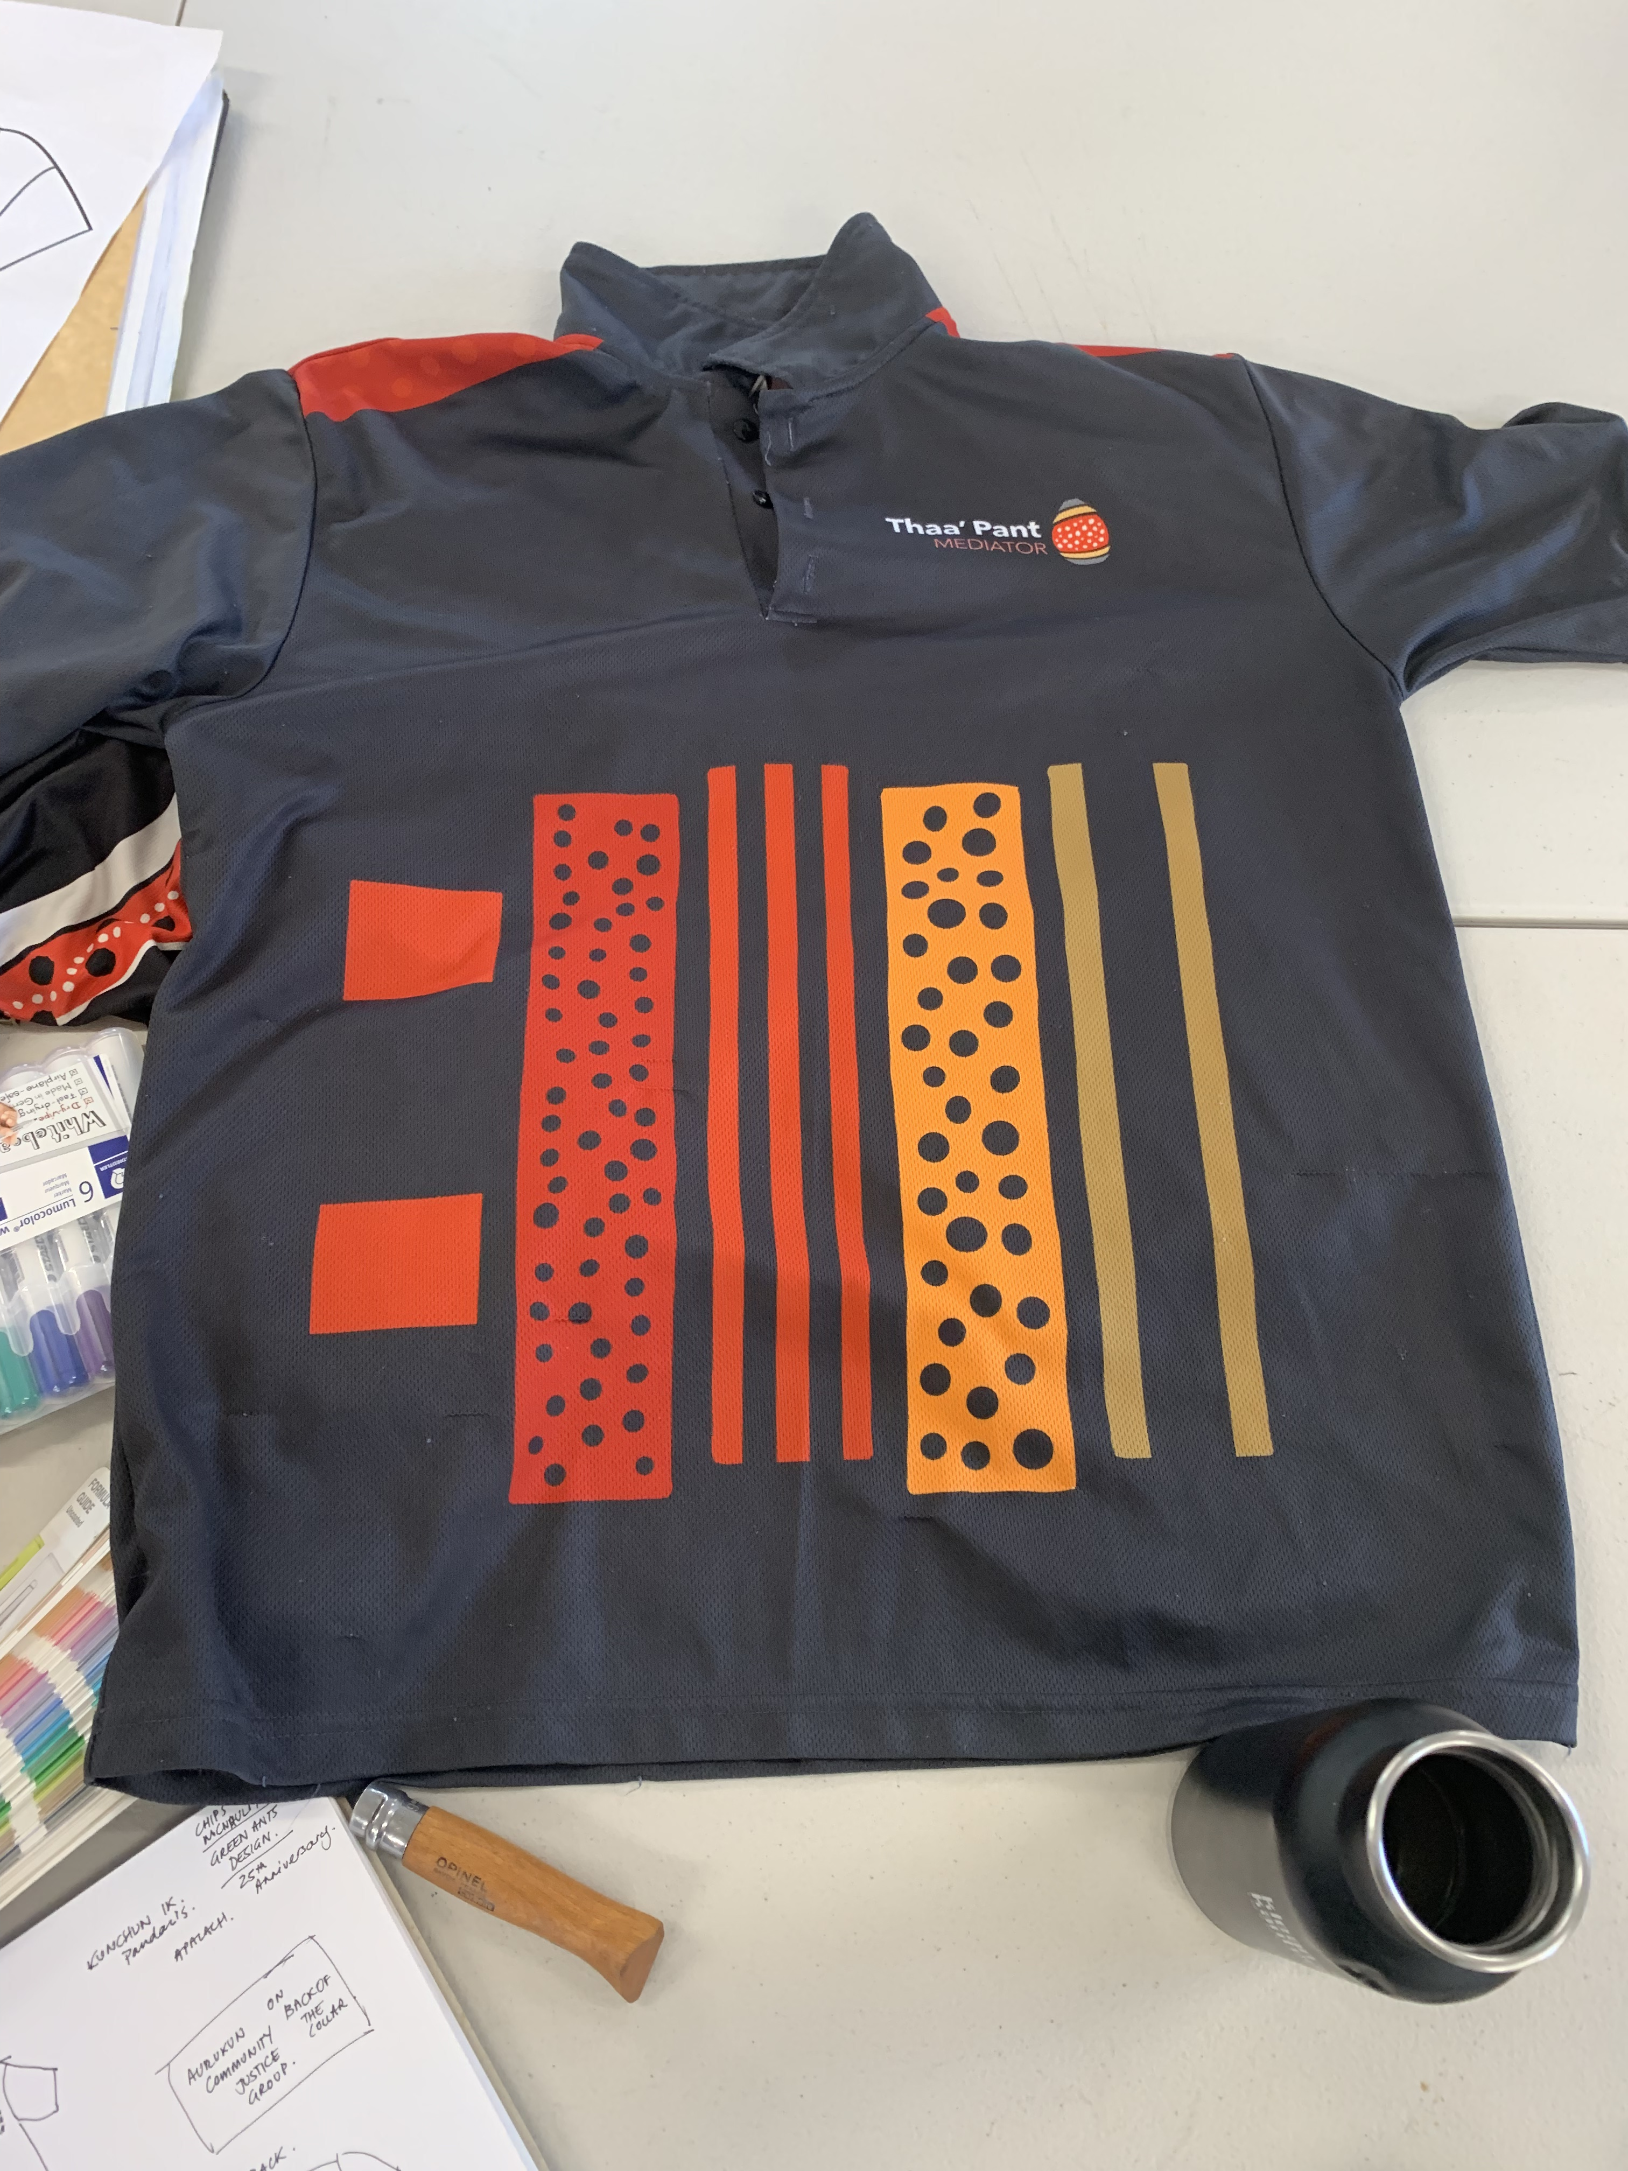
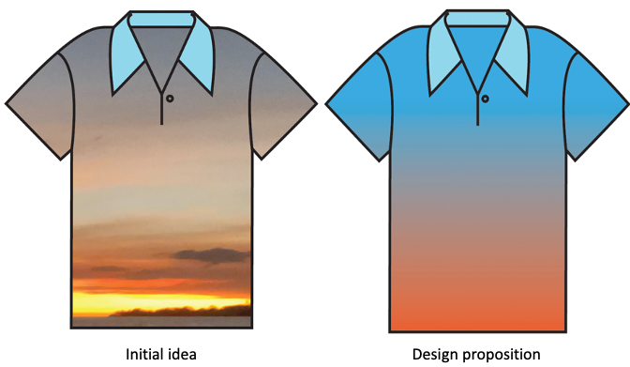
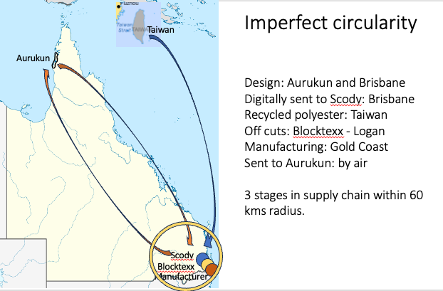
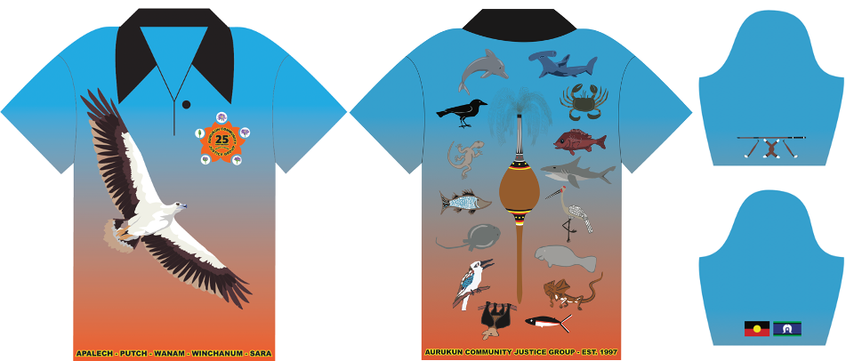
Imperfect circularity: Mainstreaming circular transitions and connecting communities
A/Professor Tiziana Ferrero-Regis
Fashion, School of Design,
Faculty of Creative Industries, Education and Social Justice
Notes:
Tiziana

