Slide 1
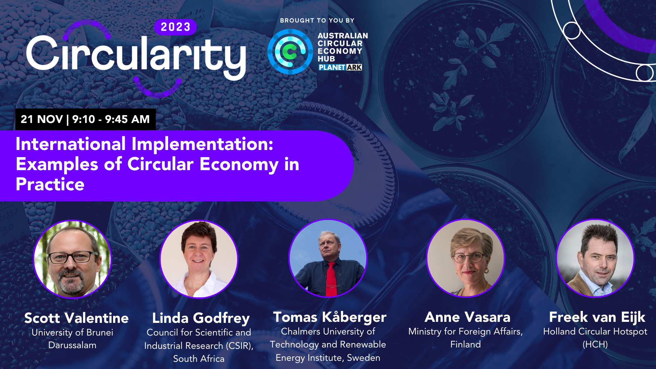

Slide 2
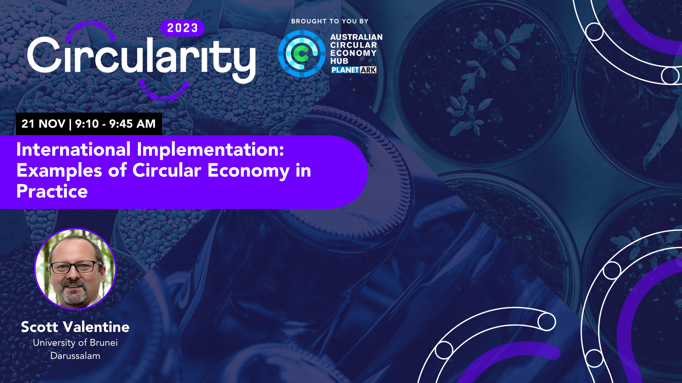

Slide 3
International Insights Exploring the Regenerative Side of The Circular Economy
Professor Scott Valentine
Professor of Regenerative Planning and Circular Economy, University of Brunei Darussalam
Chairperson, Asia Circular
Chair of Advisory Board, Australia Circular Economy Hub
Member of Standards Australia’s CE ISO Working Group

Slide 5
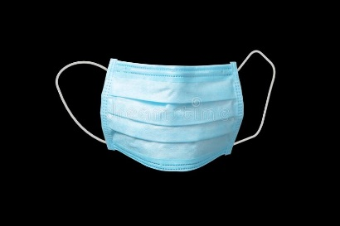
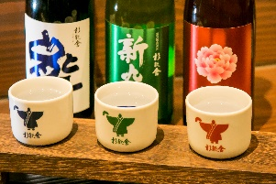
Essential oil company
Mask company
Tomato farm
Turmeric
farm
Sake brewery,
bakery & cafe
Bamboo
plantation
Organic farm
cafe
Knitted goods
Ramen
shop

Slide 6
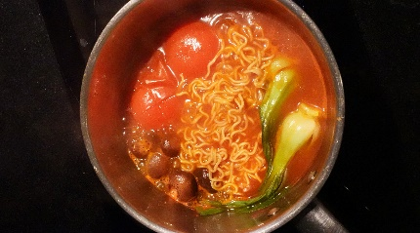
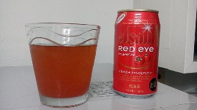
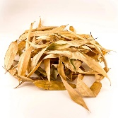
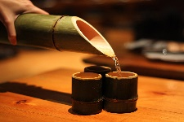
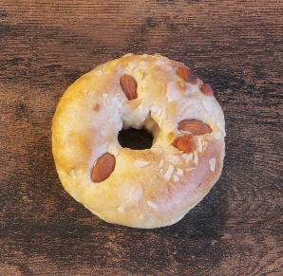
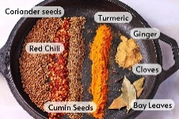
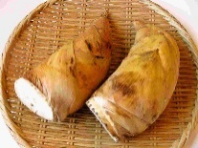
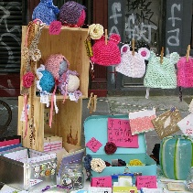

Slide 7
Essential oil company
Mask company
Tomato farm
Turmeric
farm
Sake brewery,
bakery & cafe
Bamboo
plantation
Organic farm
cafe
Knitted goods
Ramen
shop

Slide 9
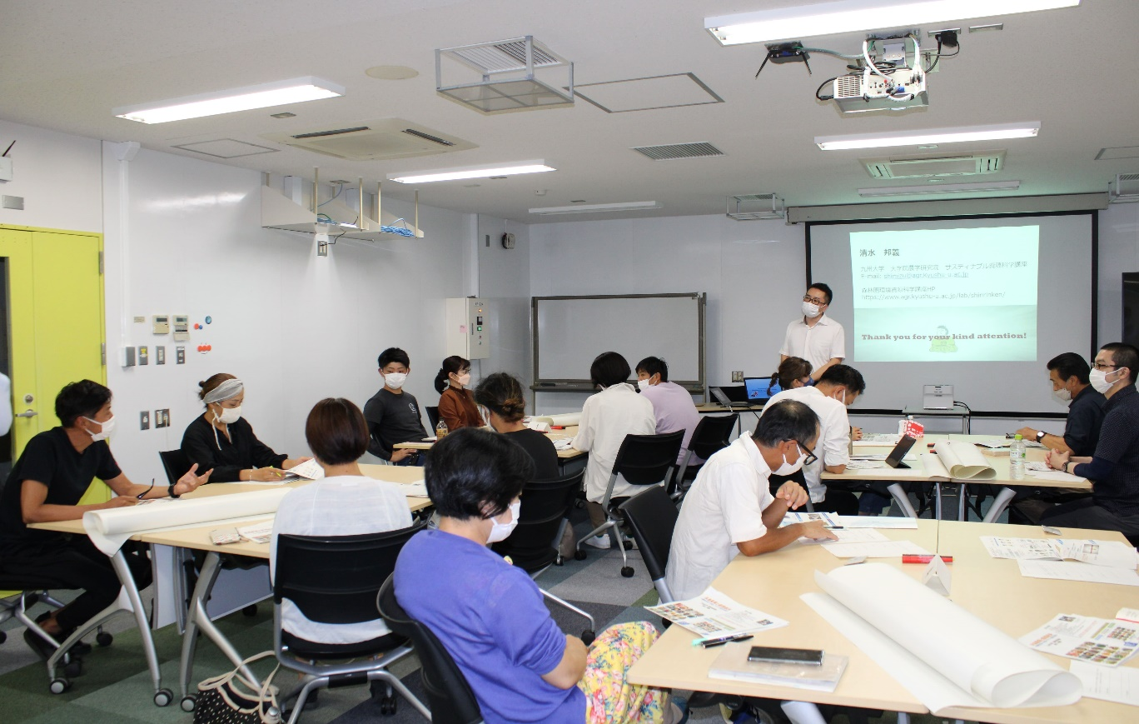
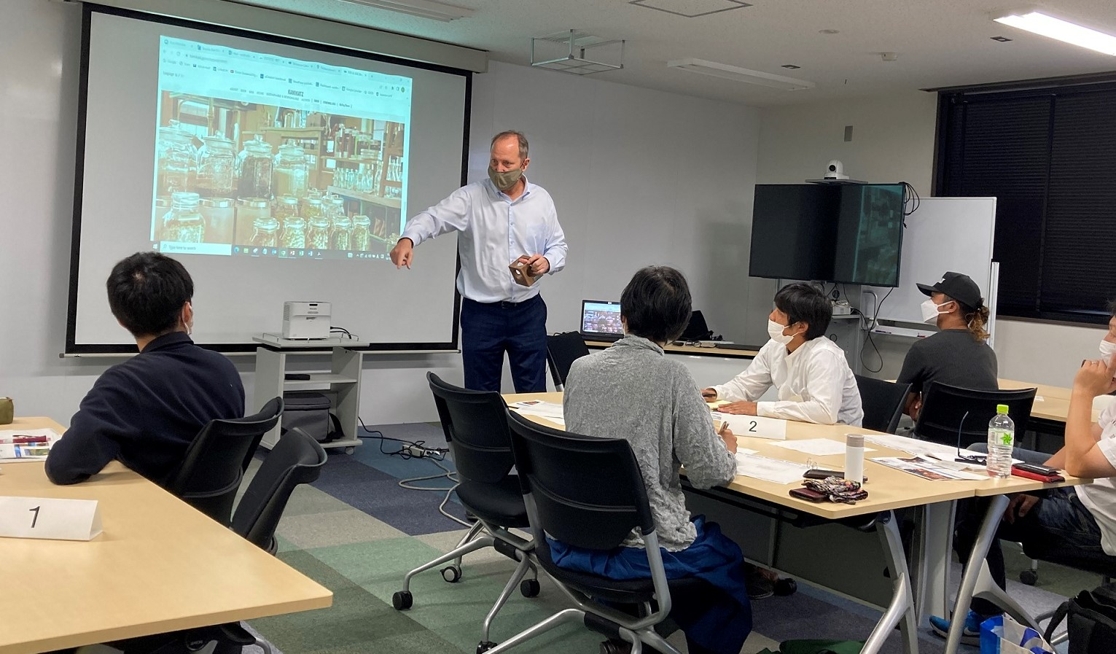
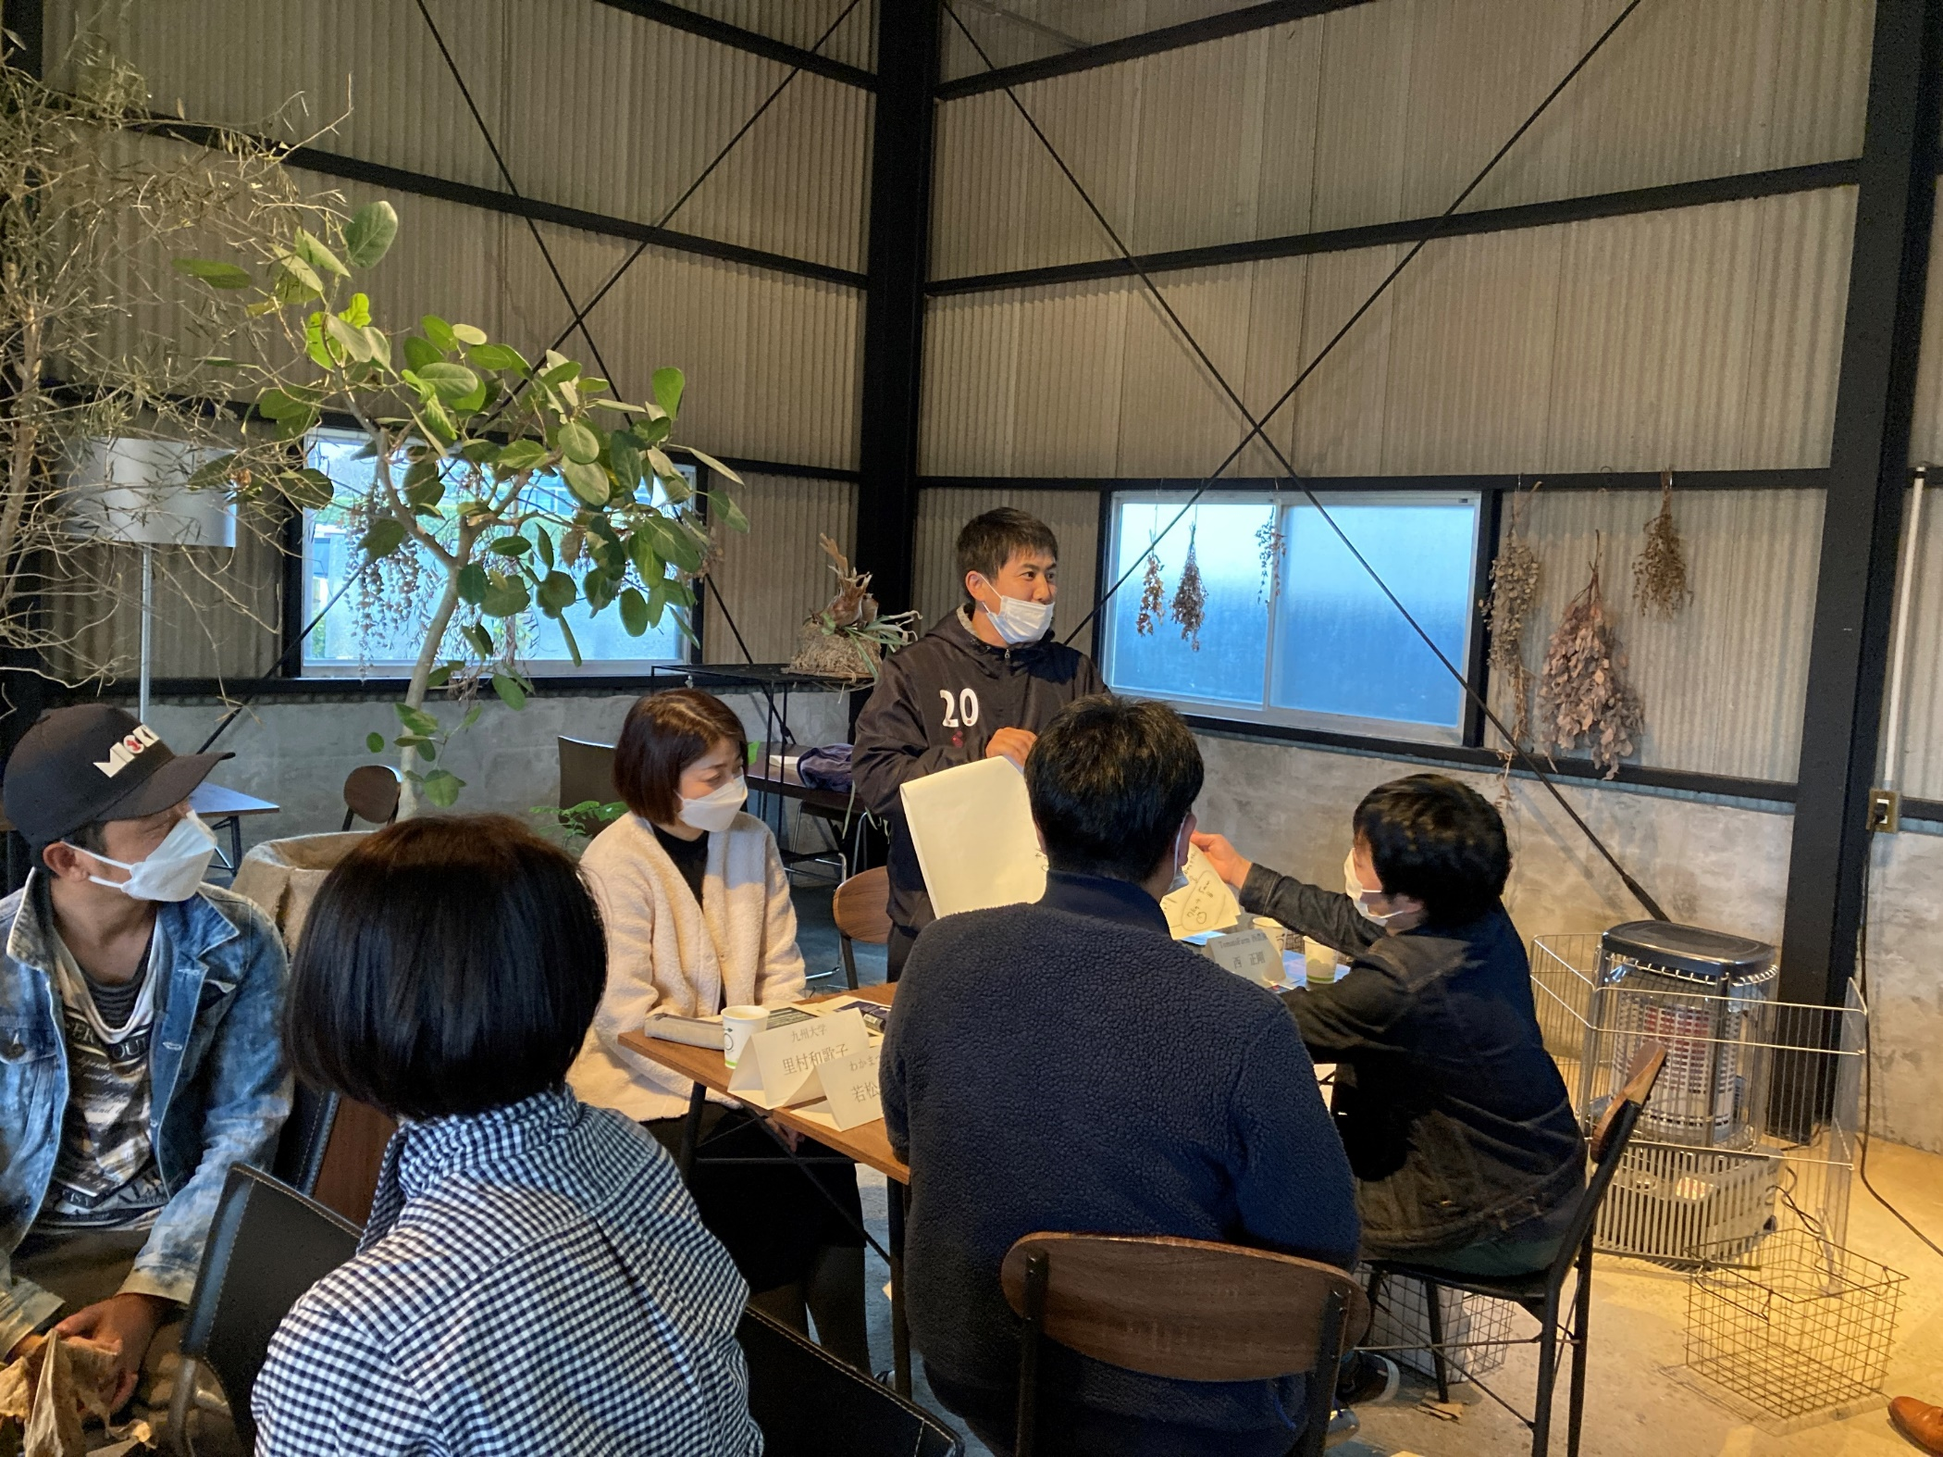
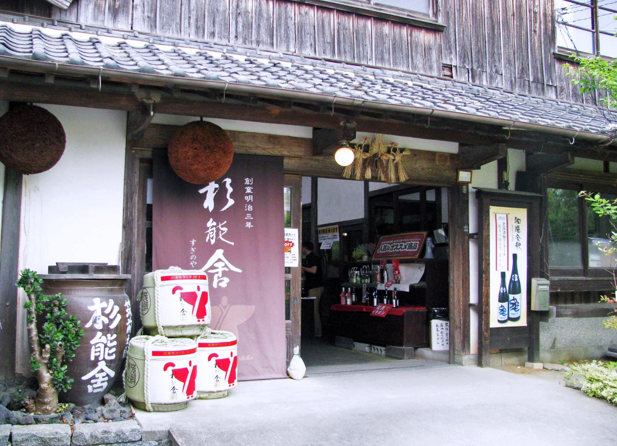
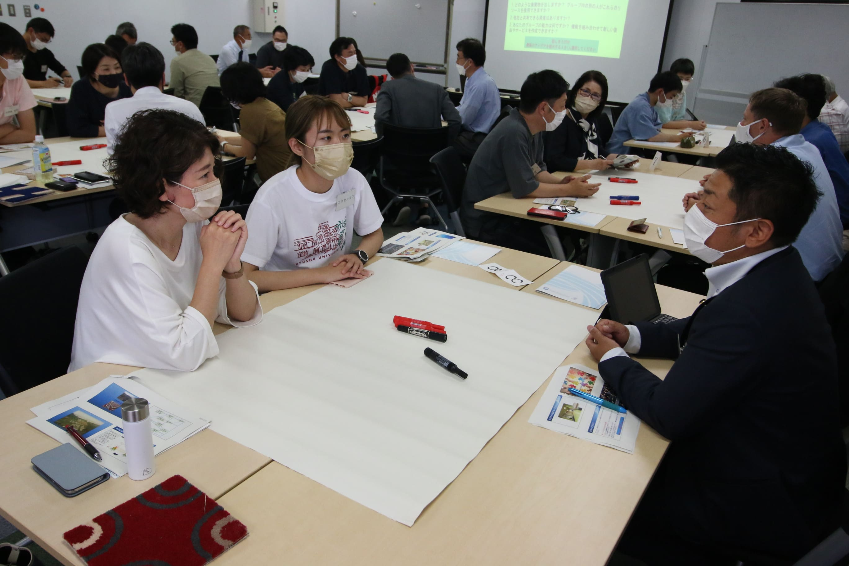

Slide 10
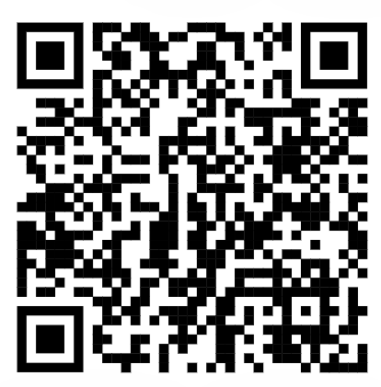
Hume City Council: Circular Essentials
Expressions of interest open now (limit to 40 participants)
Contact:
Luis Fernandez
Hume City Council CE Lead
luisl@hume.vic.gov.au
Let Us Know What You Think
Flow of Program
24 Jan 2024 Payment deadline
26 Jan 2024 Welcome letters
29 Jan – 4 Feb 2024 Online module 1
5-11 Feb 2024 Online module 2
12-18 Feb 2024 Online module 3
19-25 Feb 2024 Online module 4
26 Feb 2024 Workshop 1 – Broadmeadows
29 Feb 2024 Workshop 2 – Broadmeadows
1-7 March Site visits
8 March 2024 CE Roadmap Presentations
15 March 2024 Circular Essential Awards
Cost per company
$1000 for Hume Businesses
$1500 for non-Hume Businesses
$500 for additional participant from enrolled company
https://forms.gle/t4N9yyvqJeSJT8As7
scott.valentine@asiacircular.com

Slide 12
21 Nov | 9:10 – 9:45 AM
Why National Systems of Innovation
are critical to our transition to a
Circular Economy
Heading 1
Prof Linda Godfrey
Manager: Circular Innovation South Africa, DSI/CSIR
Principal Scientist: Waste & Circular Economy, CSIR
Extraordinary Professor: Waste & Circular Economy, NWU

Slide 13
Introduction
An initiative of the South African Department of Science & Innovation (i.e., a national / federal government initiative)
Aimed at guiding the strategic direction and investment in circular economy science, technology and innovation (STI) within and across universities and science councils
To support South Africa’s transition to a more circular economy through STI
www.circulareconomy.co.za
13
© CSIR 2023 www.csir.co.za

Slide 14
UNLOCKING TECHNOLOGY OPPORTUNITIES (Technology development, localization and adaptation)
14
© CSIR 2023 www.csir.co.za

Slide 15
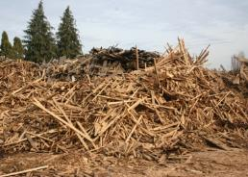
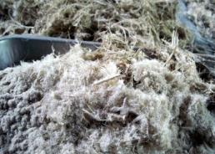
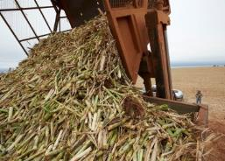
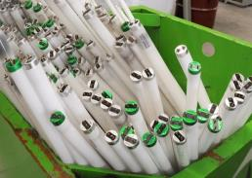
Our initial entry point into CE technologies (2015-2023)
From a waste perspective –
8 years of supporting R&D in high-value product recovery from waste streams (organics, plastic, WEEE, tyres, MSW) in order to incentivize diversion from landfill
Funded by national government and all publicly available R&D
A number of innovative, exciting projects have emerged & taken to market
Beneficiation of forestry biomass waste
Valorisation of waste chicken feathers
Conversion of agricultural waste residues
Recycling REE from fluorescent lamps
Lithium-ion battery recycling
Beneficiation of used textiles
www.wasteroadmap.co.za
15
© CSIR 2023 www.csir.co.za

Slide 16
EVIDENCING DECISION-MAKING (Public & Private sector)
16
© CSIR 2023 www.csir.co.za

Slide 17
Broadening the CE STI scope (2020 – )
Evidencing South Africa’s transition to a more sustainable, efficient, and sufficient circular economy
Why should South Africa, as a developing country, transition to a circular economy?
Understanding our drivers behind a CE transition – resource scarcity, climate, jobs
The opportunities in various resource-intensive sectors of the economy
www.circulareconomy.co.za/csir/
17
© CSIR 2023 www.csir.co.za

Slide 18
Raising awareness on circular interventions within resource-intensive sectors of the economy
Mapping the level of implementation of circular economy interventions in manufacturing
18
© CSIR 2023 www.csir.co.za

Slide 19
EVIDENCING POLICY DEVELOPMENT AND IMPLEMENTATION (Pre-empting policy needs)
19
© CSIR 2023 www.csir.co.za

Slide 20
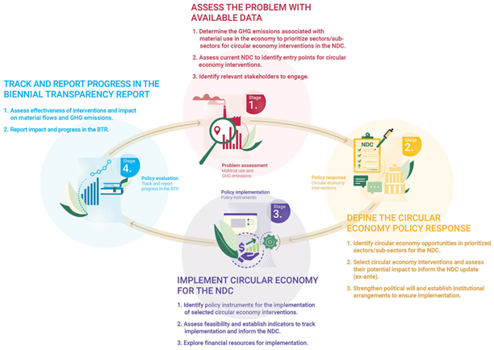
Supporting evidence-based policy for a CE
1. Informing national response to waste plastics management
(piloting the Oxford / Pew Pathways model for SA)
2. Building Circularity into NDCs (piloting the UN Toolbox)
20
© CSIR 2023 www.csir.co.za

Slide 21
SUPPORTING BUSINESS TO DE-RISK AND SCALE INTERVENTIONS (Bringing academia closer to business, especially SMEs)
21
© CSIR 2023 www.csir.co.za

Slide 22
Supporting small business – CE Accelerator programmes
1. Accelerated implementation of biorefinery technologies
2. Scaling and de-risking circular interventions
22
© CSIR 2023 www.csir.co.za

Slide 23
Concluding thoughts
The circular economy calls for disruption, innovation and system change, with a strong role for our NSI
Our universities and science councils are crucial to evidencing our transition; de-risking CE solutions; and developing new innovative CE solutions
Strategic guidance and directed funding from the public and private sectors can ensure that STI remains relevant to support our transition to a circular, low-carbon economy
www.circulareconomy.co.za
23
© CSIR 2023 www.csir.co.za

Slide 24
Thank you
Prof Linda Godfrey Manager | Circular Innovation South Africa | DSI
Principal Scientist | Waste & Circular Economy | CSIR
Extraordinary Professor | North-West University Email: LGodfrey@csir.co.za Web: www.circulareconomy.co.za/csir
www.wasteroadmap.co.za
prof-linda-godfrey-4656616

