Slide 1
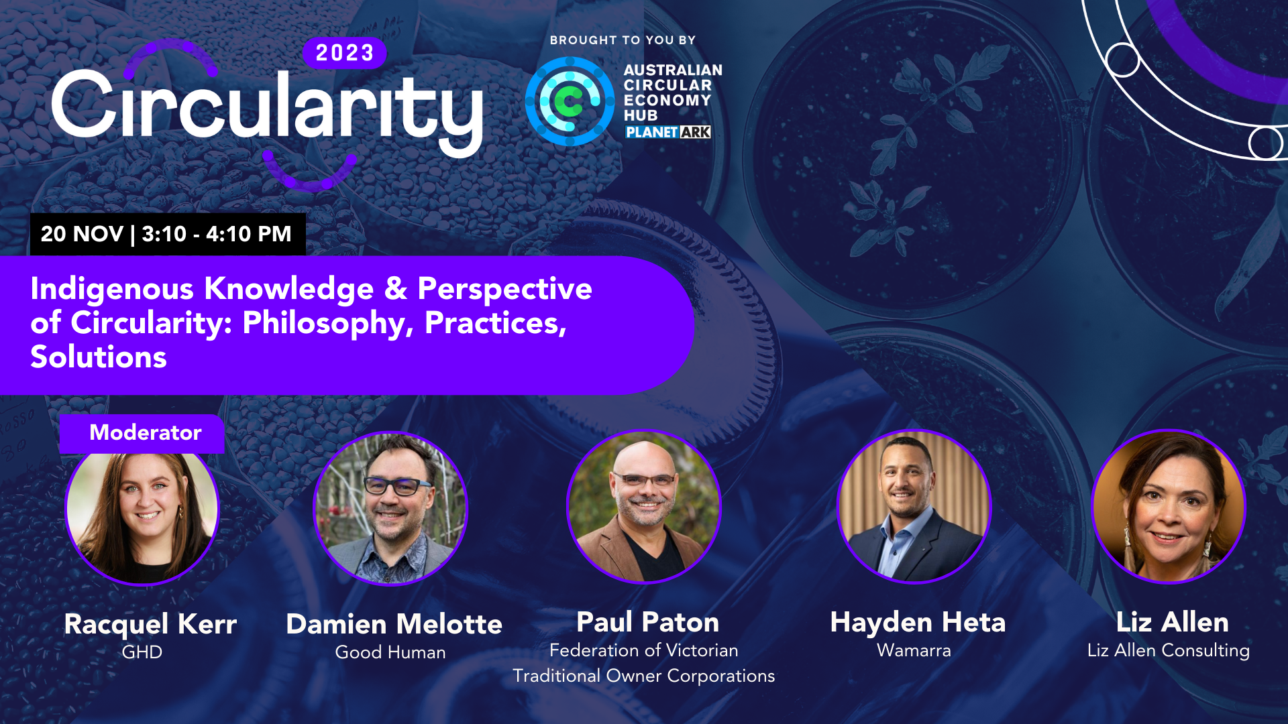

Slide 2
The Indigenous Doughnut
Country Centred Circular Economy Framework
Paul Paton and Damien Melotte.
Indigenous Doughnut implementation example
Hayden Heta.
Notes:
Paul. Acknowledgement of Country

Slide 3
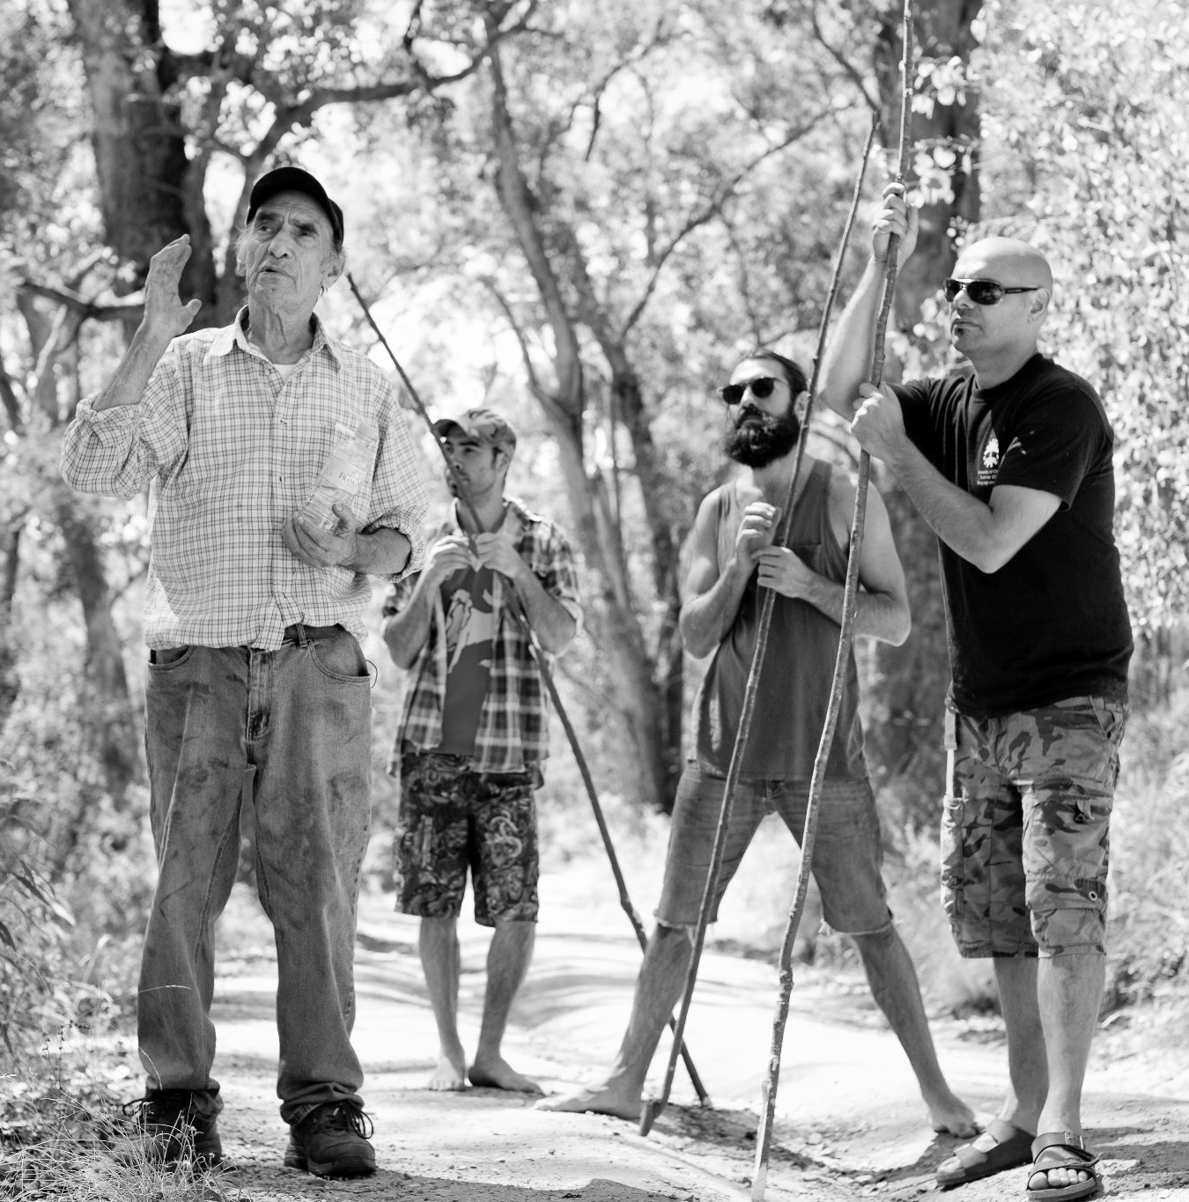
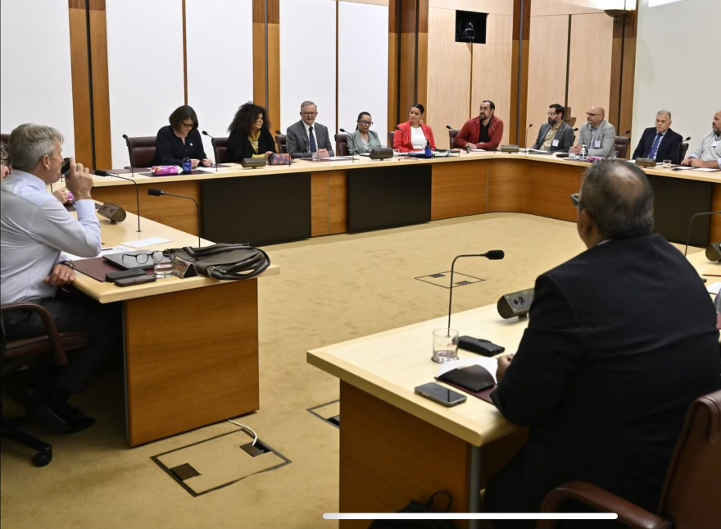
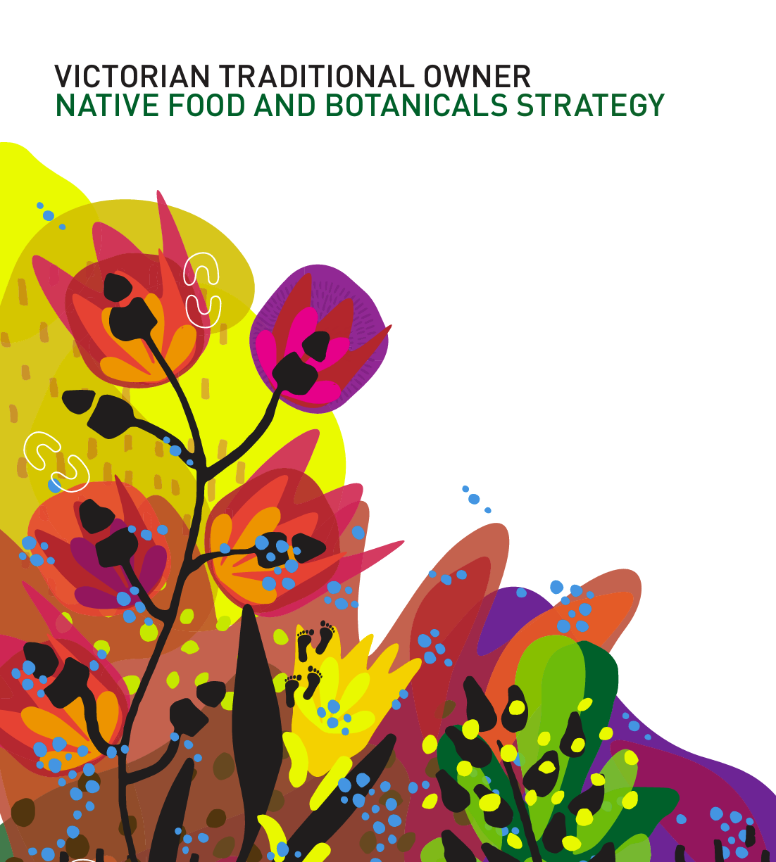
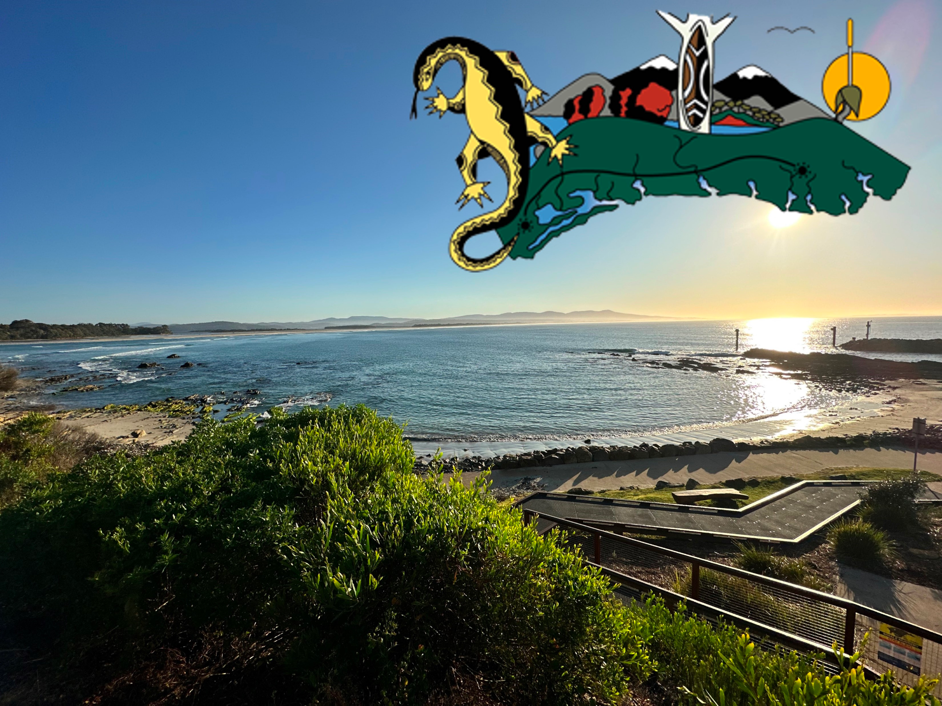
Notes:
Paul introduction. 1 min.

Slide 4
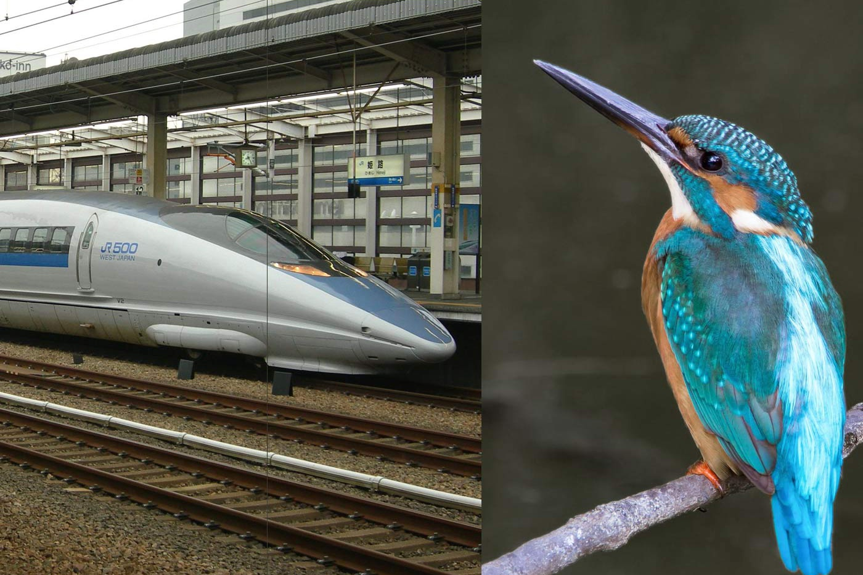
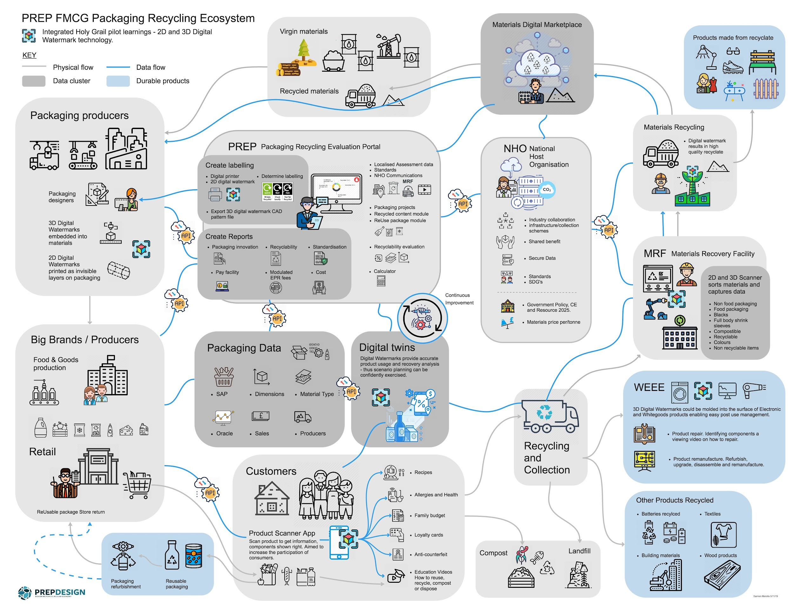
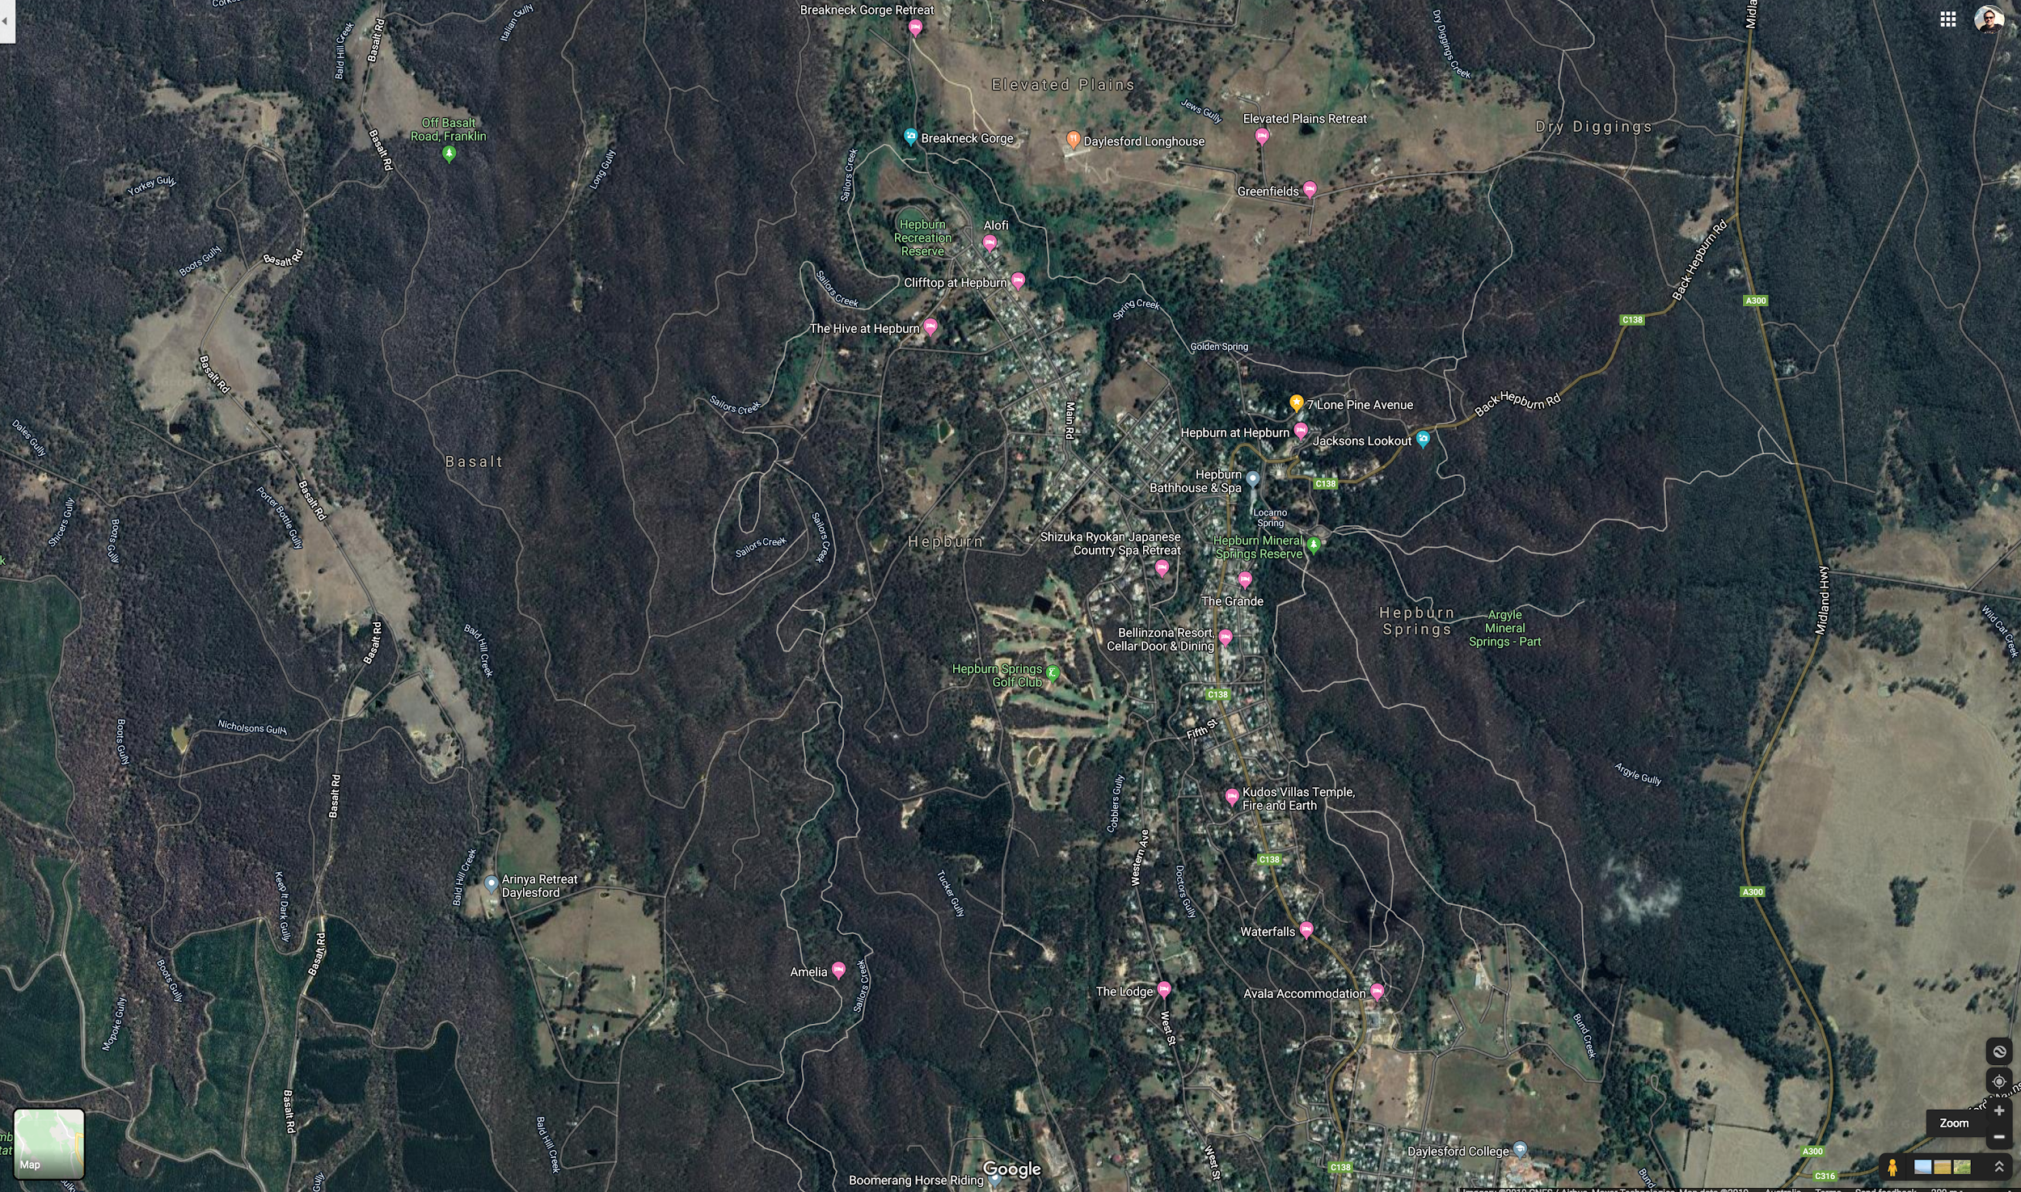
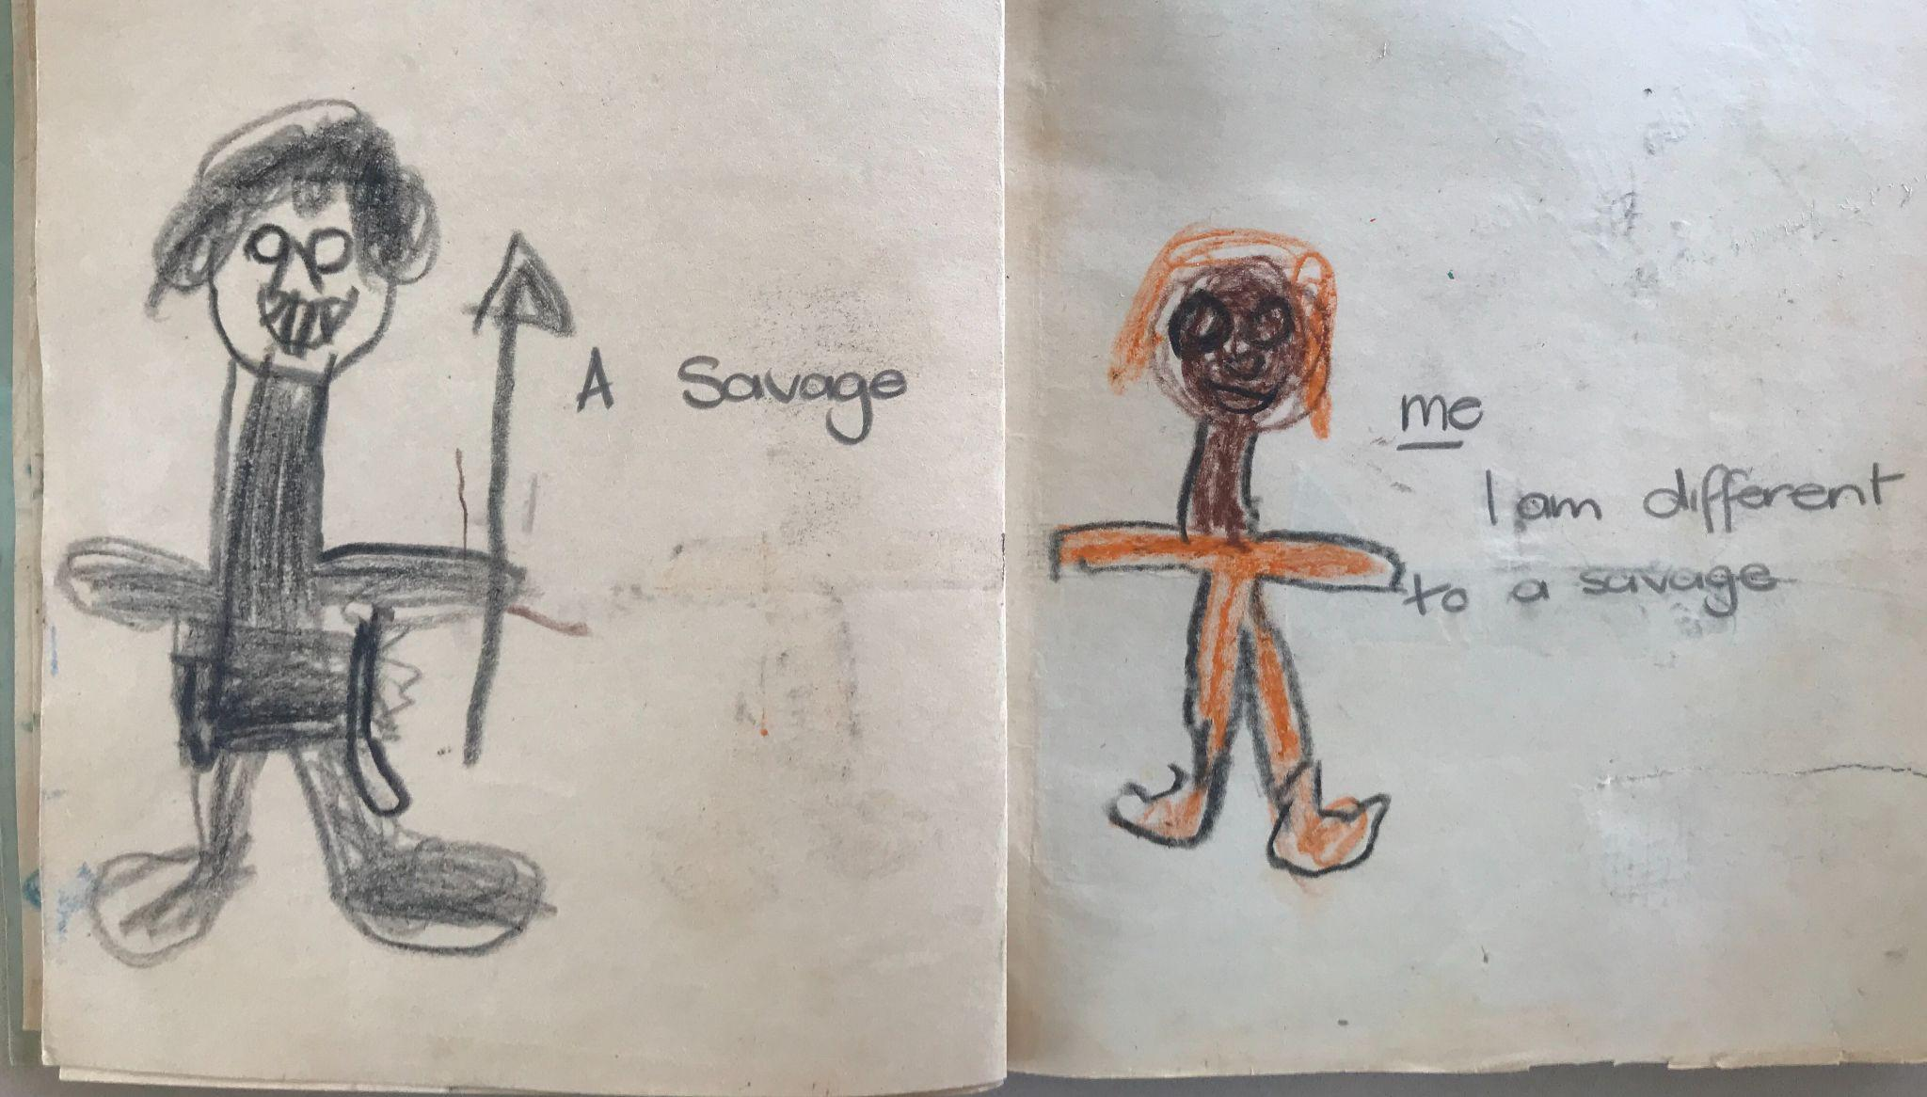
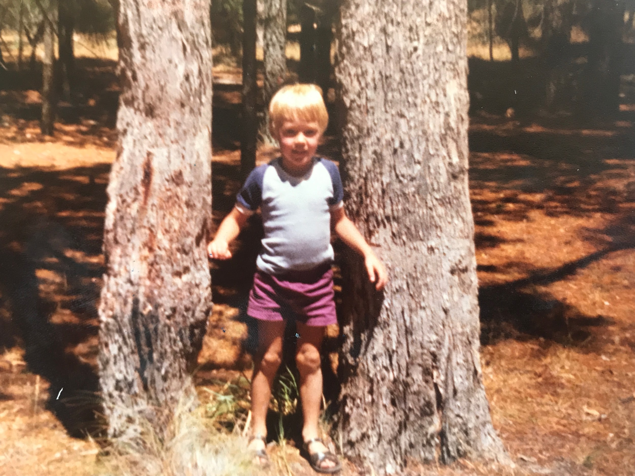
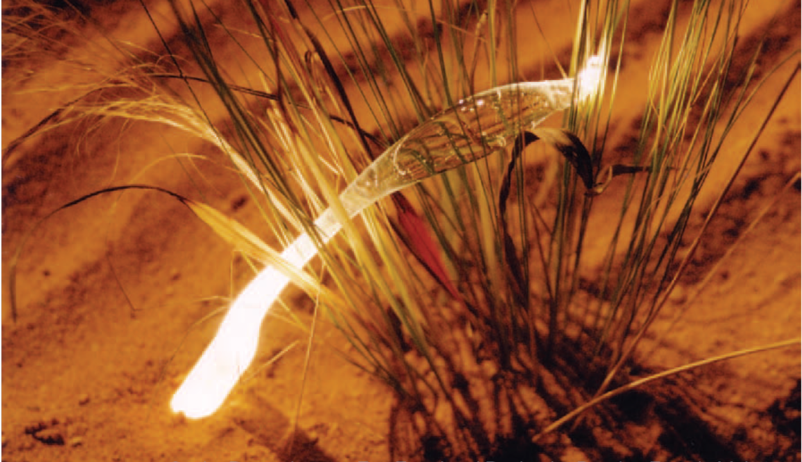
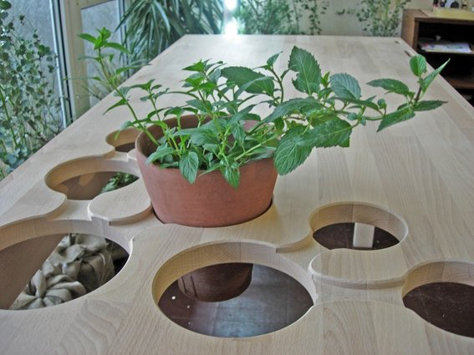
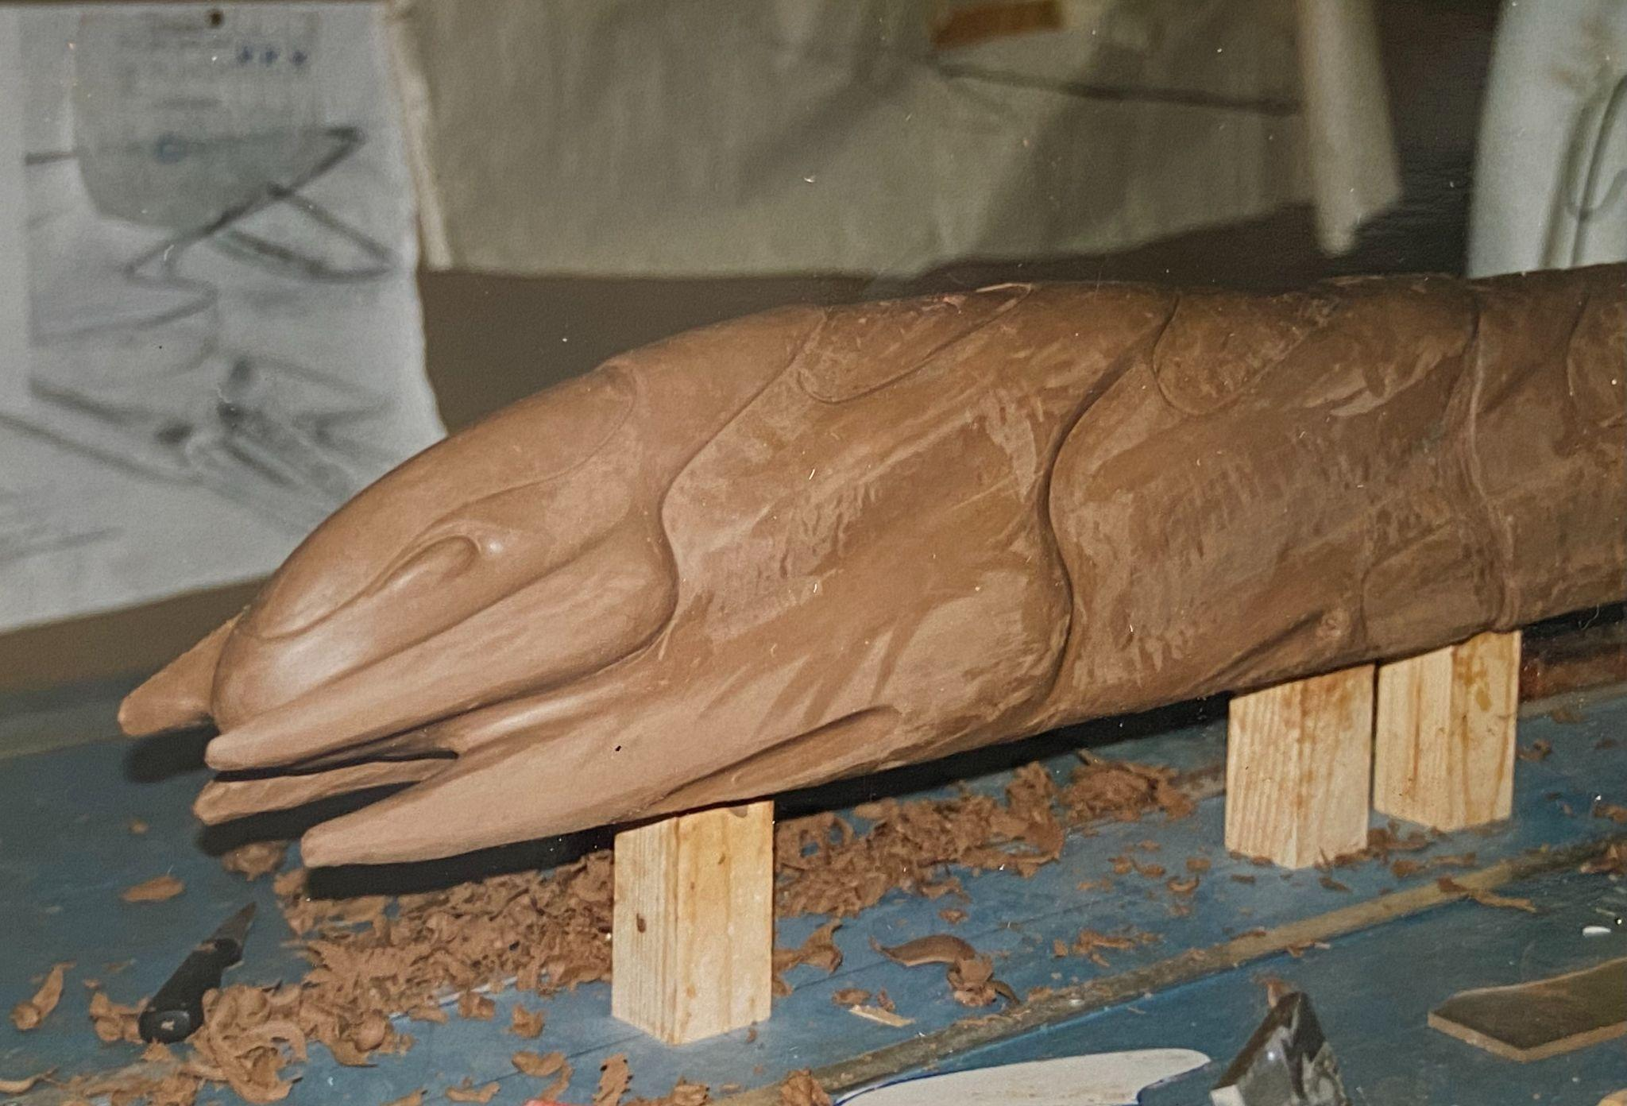
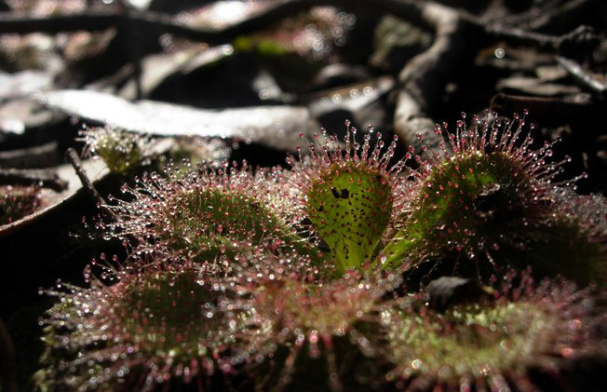
Notes:
Damien introduction. 1 min.

Slide 5
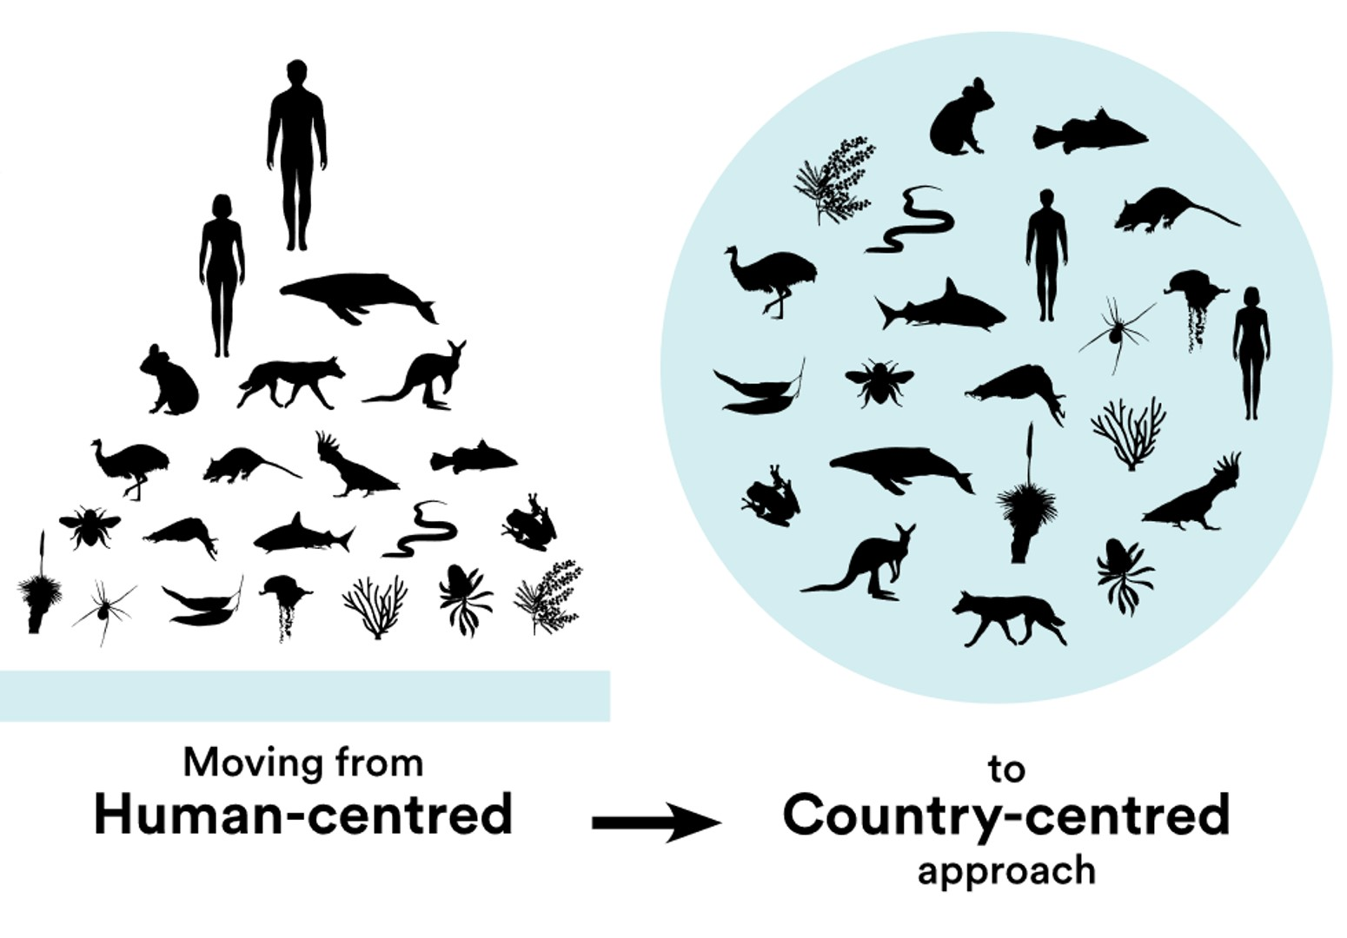
Notes:
Paul. 30 secs - The dominant design process of the last 20 years has been Human Centred Design, which whilst it has been a step forward to include end users in the design process we’ve still been quite disconnected from nature and natural systems which we are all ultimately dependent upon.

Slide 6
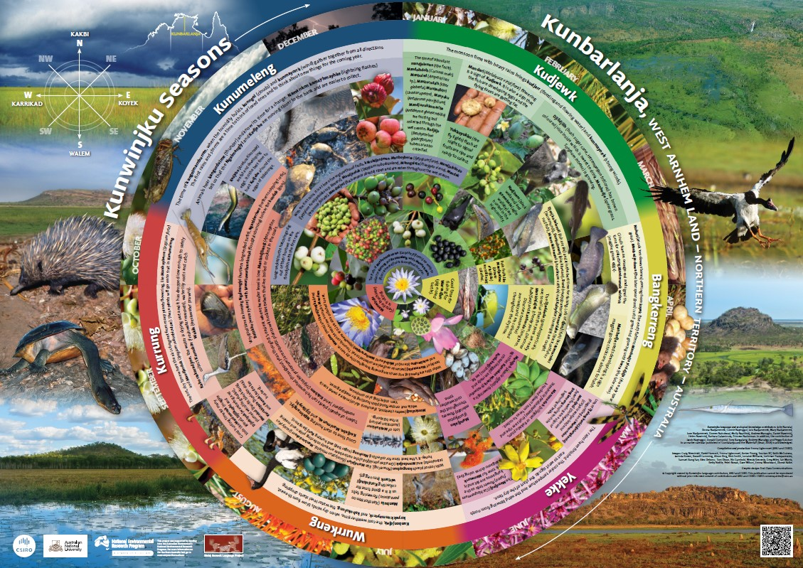
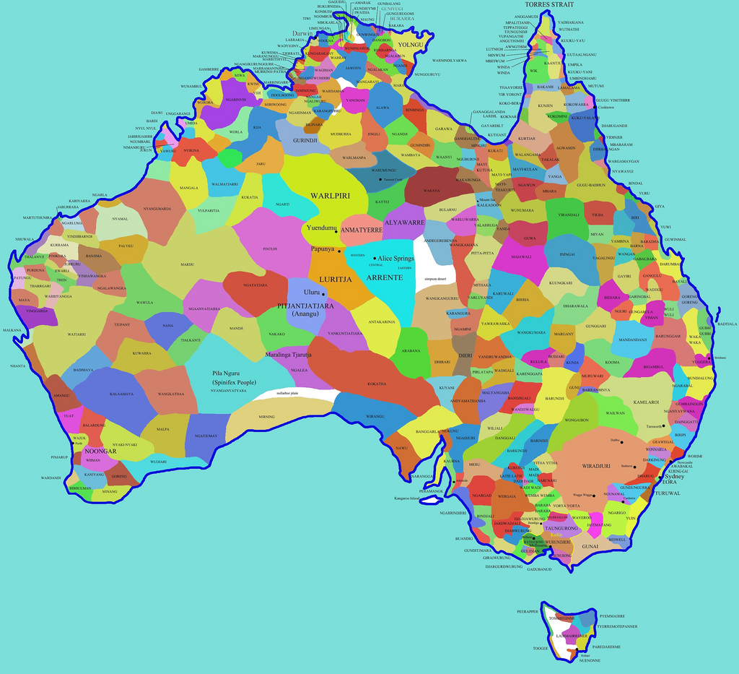
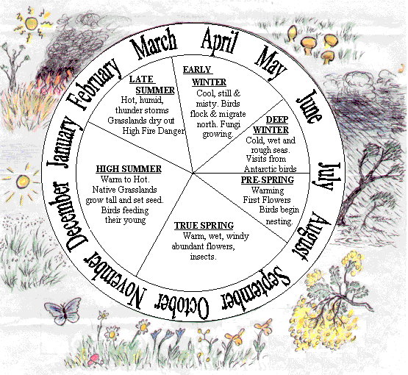
https://www.csiro.au/en/research/indigenous-science
https://www.herringisland.org/seasons1.htm
Notes:
Paul 1 min. Ecosystem thinking is Systems thinking. Each country unique so it has its own seasonal calendar - https://www.csiro.au/en/research/indigenous-science Country is a living system that has seasonal indicators
6-7 Season calendar Wurundjeri https://www.herringisland.org/seasons1.htm
Caring for Country an ‘invisible obligation’.
Human and Ecosystem Participation. Country/Community/Culture are interconnected.
Navigated through Moiety, Totem and Skin name. Totemic Duality. Human spirit and Nature spirit - both within one human.
Sharing. Reciprocity (Intent to maximise receivers benefit Gift type/place/time). /Ngapatji Ngapatji
Collaborative - No concept of 'Conquest or invasion'.
Ethics and Moderation. No cruelty, no concept of ‘Exploitation’. Aunty Mary Graham - Sophroscene.
Cyclic time - Everywhen/Creation Country. Dreaming.**
Dynamic, not static - Adaption to change, built in, seasonal variance.
Established trade routes along Songlines. Knowledge landscapes.
No monetary power structures, wealth based on knowledge gained through experience (wisdom).
Systems Knowledge based Relationships patterns. Not classification as in Western Knowledge systems. North and south not left or right. Names and relationships of people, not number of people, no abstract numbers.
Relationalist Ethos*
Adaptive and dynamic structures, not fixed. Feedback loops culturally embedded. Adaptive and resilient.

Slide 7
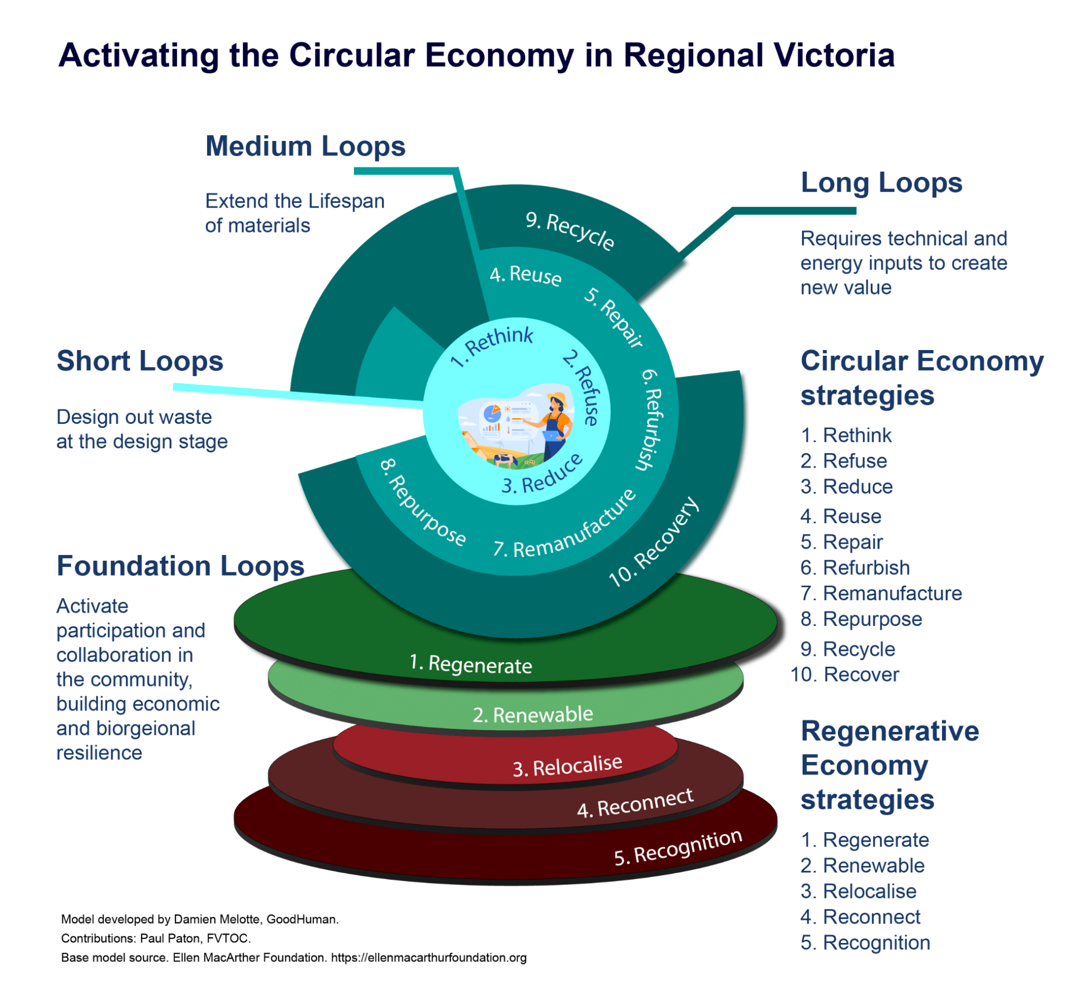
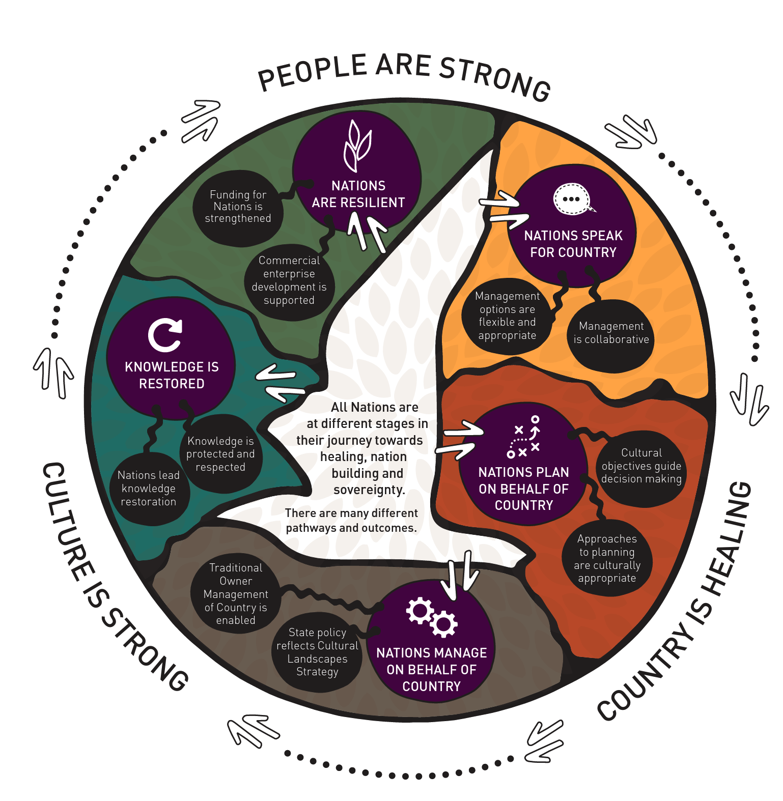
First Nations Circular Economy Leadership potential
Cultural Landscapes hold values associated with our unique history and knowledge. They reflect our network of relationship between human and non-human animals, plants, ancestors, song lines, physical structures, trade routes and other significant cultural connections to Country.
A living Bio-Cultural Landscape is Country Centred Circular and
Regenerative Economics.
Cultural Landscapes and Country Centred
Economics provide tangible common ground.
Notes:
Damien and Paul. 1 min.. Further validated the value for the development of a Country Centred Circular Economy model when looking at strategy development for Local gov in Regional Vic. Paul, Cultural Landscapes.

Slide 8
What is an Indigenous Doughnut? Our intent.
The Indigenous Doughnut is a Country Centred Circular Economy (CC-CE) model. The indigenous doughnut draws on millenia of learnings of managing, living and thriving on Country.
“It has been created to enable a better understanding that our relationship with Country over generations gives us knowledge and authority to give guidance about incorporating the connection and care of Country principles into circular and regenerative economy practice.” Paul Paton July 2023
We invite wider Australia to ‘Walk together’, to care for Country and to build a thriving, restorative and resilient economy that can benefit all.
The Indigenous Doughnut is a CC-CE model that can be:
1.Adapted, translated and utilised by local Traditional Owners, to suit their Country, Culture, Language, Community and Economic priorities.
2.Utilised by all Australian Businesses, Government Agencies and Partners to ‘Walk together’.
Notes:
Paul 1 min. Vision. Wider Australia to use the Indigenous Doughnut model to ‘Walk together’, to care for Country and to build a thriving, restorative and resilient economy that can benefit all.

Slide 9
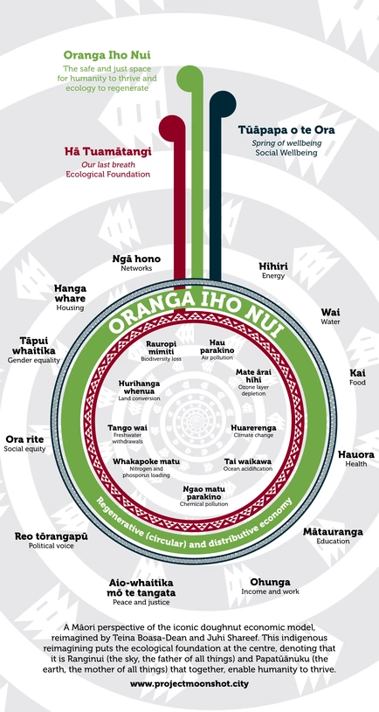
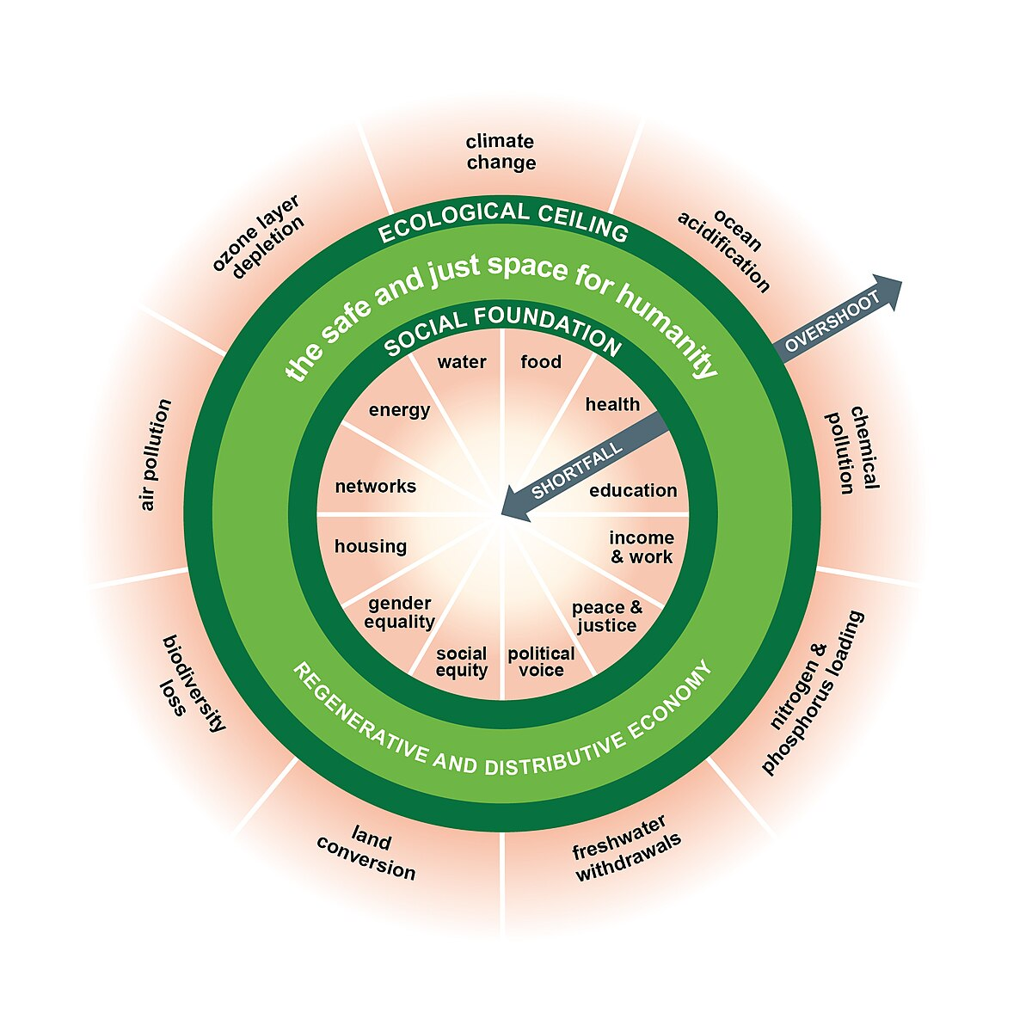
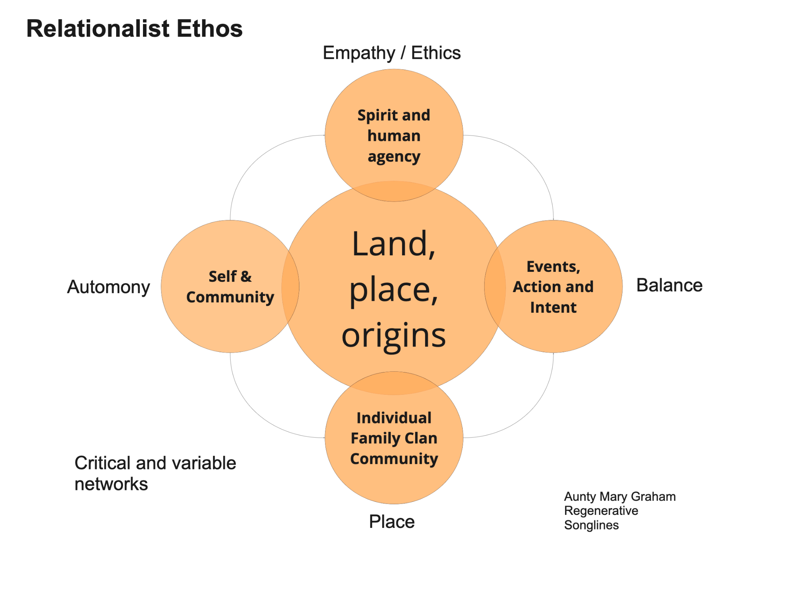
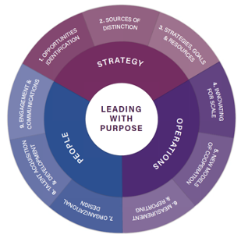
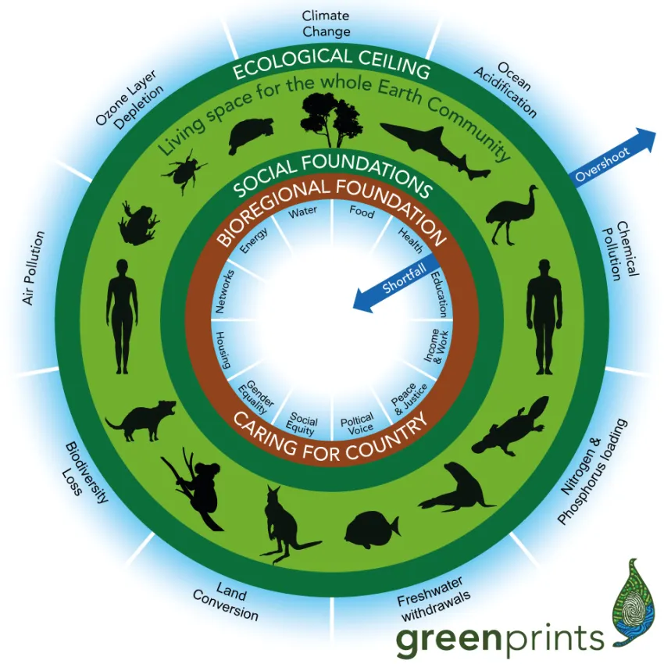
Research and Investigation
https://doughnuteconomics.org/
https://sharedvalue.org.au/the-purpose-playbook/
Notes:
Damien 30 seconds. What started initially as an Australian indigenous interpretation of Kate Raworth’s excellent Doughnut economics, it evolved over time to be more of a Country Centred Circular Service innovation and Shared value framework, which has practical loca business application.

Slide 10
The Indigenous Doughnut. Country Centred Circular Economy, CC-CE.
Page 1.
Care for Country and it will care for you.
Ngapartji Ngapartji
Country
Trade and
Collaboration
Seasons
Resource exchange
Country
Obligations
Sky
Fire
Water
Community
Spirit
Land
Community
Plants
People
Lore
Animals
Trade
partners
Trade and Collaboration
Neighbouring Community
Trade with
neighbours
Country
Notes:
Paul 1 min. At the heart of the model is Care for Country. Country and Community are interconnected through Culture. Each neighbouring Nation has their own deep connection and understanding Country. We were strong at trading, sharing (Ngapartji Ngapartji) and taking care of each other in times of need.

Slide 11
The Country Centred Circular Economy ‘S’ Strategies.
Care for Country and it will Care for you.
C01. Stewardship - An obligation to care for Country. Not to be cruel. Moderate use of resources.
C02. Seasons - Understand Seasonal indicators and considerations.
C03. Species - Know local Species and ecosystem relationships. Local species as Participants.
C04. Source - Identify indigenous sustainable Sources. E.g. Original water tables.
C05. Sharing - Sharing and Reciprocity. E.g. Share abundant seasonal crops with neighbours.
C06. Social Impact - Actions that contribute to societal well-being.
C07. Supply chains - Sustainable, regenerative, fair and transparent supply chains.
C08. Systems - Systems not Silos. Develop collaborative business systems.
C09. Scale - How does it operate on Country at different scales? Macro, Meso and Micro.
C10. Sense and Respond - Feedback Loops. Capture and respond to real needs.
C11. Synergy and Time - Take a broader and longer view of time. Yesterday, Today & Tomorrow.
C12. Songlines and Stories - Respect Cultural knowledge and Lore. Seek publicly available information.
Participate
caring for Country
Notes:
Damien 90 seconds. Talk through the 12 S Strategies. Paul talks to the last one Songlines and Stories.

Slide 12
Enhancing Circular Strategies with CC-CE
The Country centred circular economy strategies have been developed as a complementary strategic layer that can be utilised to enhance the 14R’s
Circular and regenerative strategies - the 14R’s
Country centred circular economy strategies - the 12S’s
Design out waste and pollution
Keep products and materials in use
Regenerate natural systems
Participate
caring for Country
Short loops
R01 Refuse R02 Rethink
R03 Reduce
Medium loops
R04 ReUse
R05 Repair R06 Refurbish
R07 Repurpose
Long loops
R08 Recycle
R09 Recover
Foundations
R10 Regenerate
R11 Re-Localise
R12 Reconnect R13 Renewable
R14 Recognition and
Reconciliation
Country
Community
Lens
R02 Rethink
What CC-CE
Strategies could be considered at the Design stage?
Notes:
Damien 30 seconds. The 14Rs and the 12Ss and how they can work together to build Country centred innovation.

Slide 13
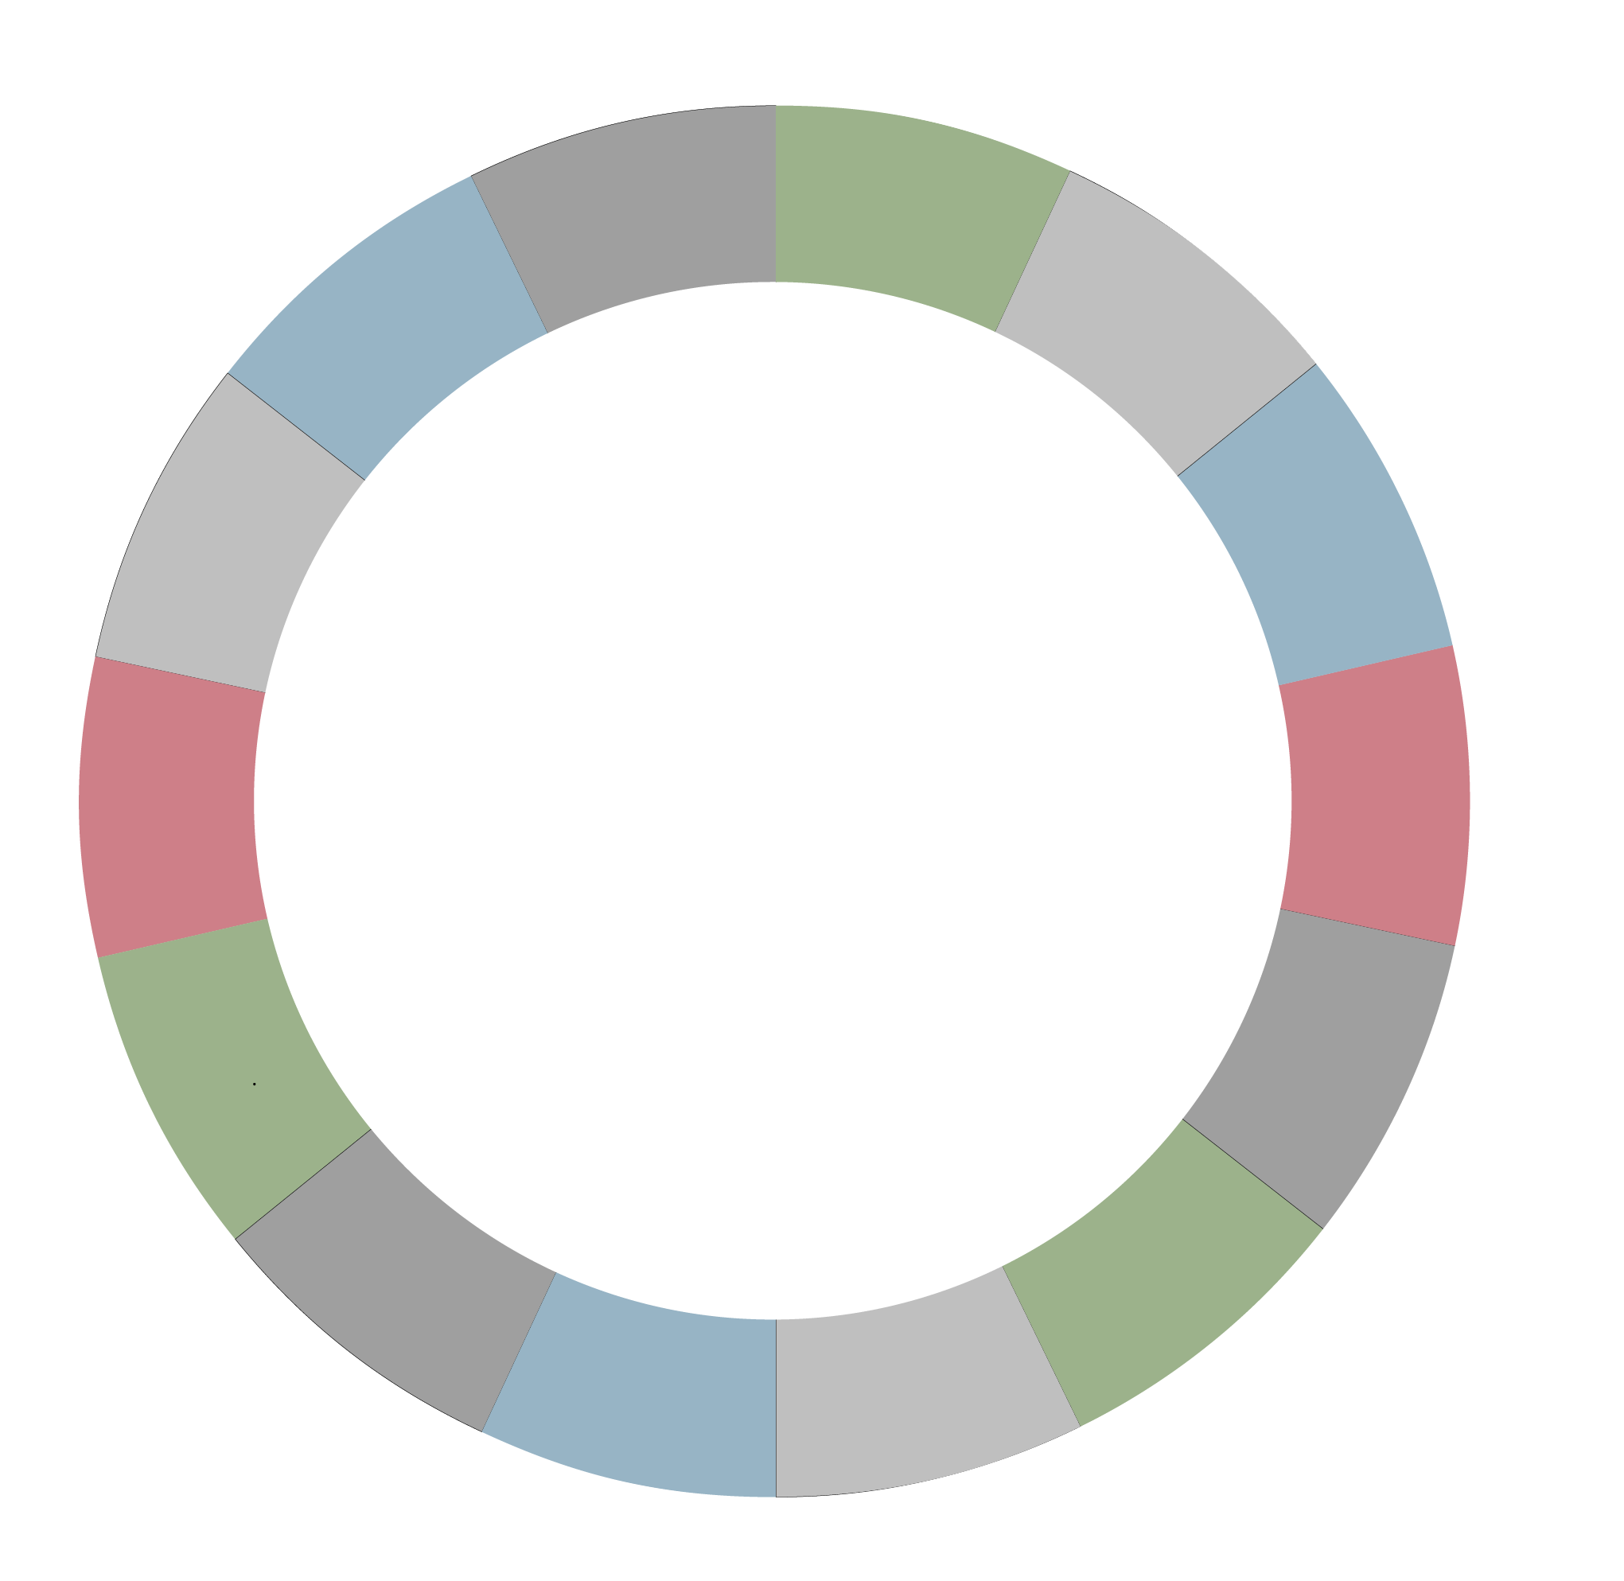
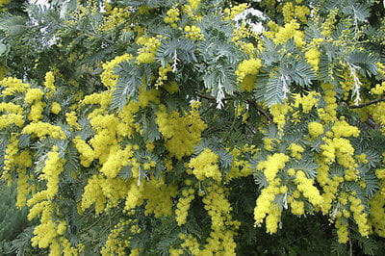
Participation in caring for Country - Walking together
Page 2.
Participating in the Care of Country is at the heart of the Indigenous Doughnut model. Building on Circular and Regenerative Economy strategies, the 12 CC-CE ‘S strategies’ can be used as guides to ‘Walk together’ and can be considered when designing, refining and redesigning partnerships, products and services.
The Participation Loop is a bridge that spans all the elements of a dynamic systems interplay on Country.
Participate
caring for Country
Water
Food
How might we develop better affordable Housing with Country centred circular economy considerations in Gippsland?
Energy
Housing
Country considerations:
C01. Stewardship. Restore biodiversity in construction. C02. Seasons. Pre Spring. Mid-July and August. Colder but drier, good for modular building installation. Good planting season to restore plants on construction site.
Art &
Culture
Education
Country
Sky
Fire
Access and
information
Water
Income
and work
Spirit
Land
Plants
People
Animals
Community considerations:
C05. Sharing. A central shared courtyard for 5 family groups to grow and share food. C06. Social impact. Secure green play space for children, shared care = more ability to work.
Mobility
Political
voice
Wealth
Peace and justice
Community considerations:
C07. Supply Chains. Large amounts of rough sawn ironbark are in storage at the closed mill. How can we repurpose this for walkways and connecting infrastructure between the modular units?
C11. Synergy and time. Ironbark durability rating 1. 50+ years.
Gender
Equality
Social equity
Notes:
Paul 1 minute. The key mechanism of the CC-CE is the Participation loop. The Participation Loop is a bridge that spans all the elements of a dynamic systems interplay on Country. It allows us to take a cross section of a complex system at any given time.

Slide 14
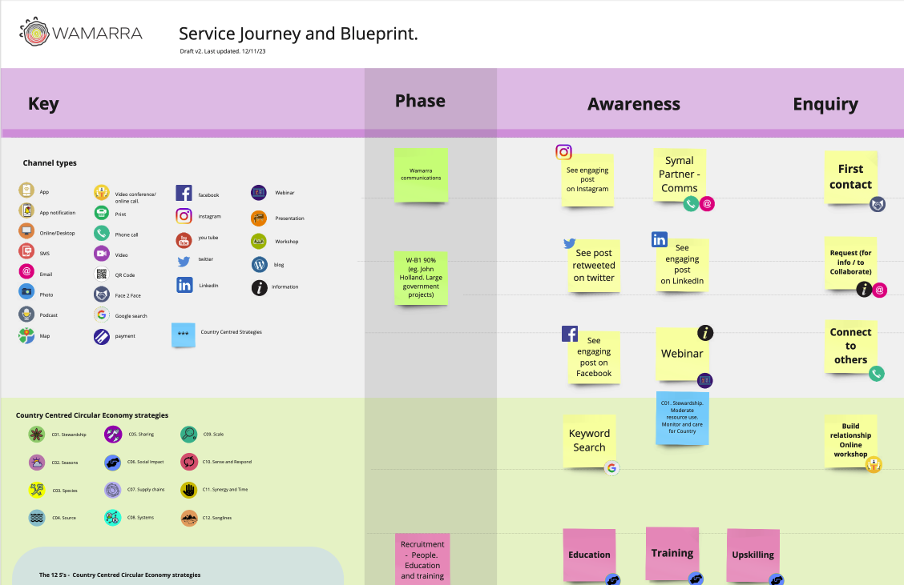
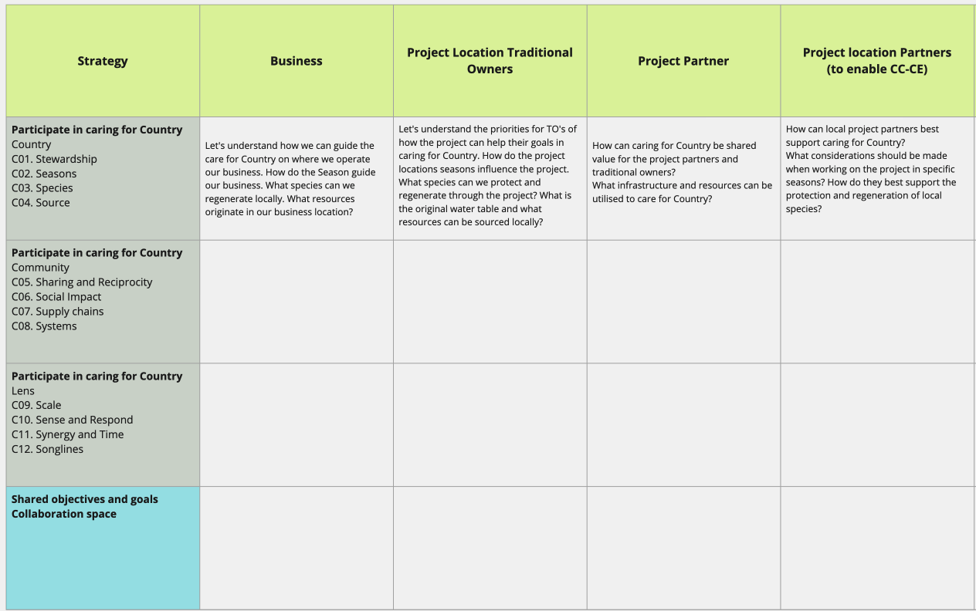
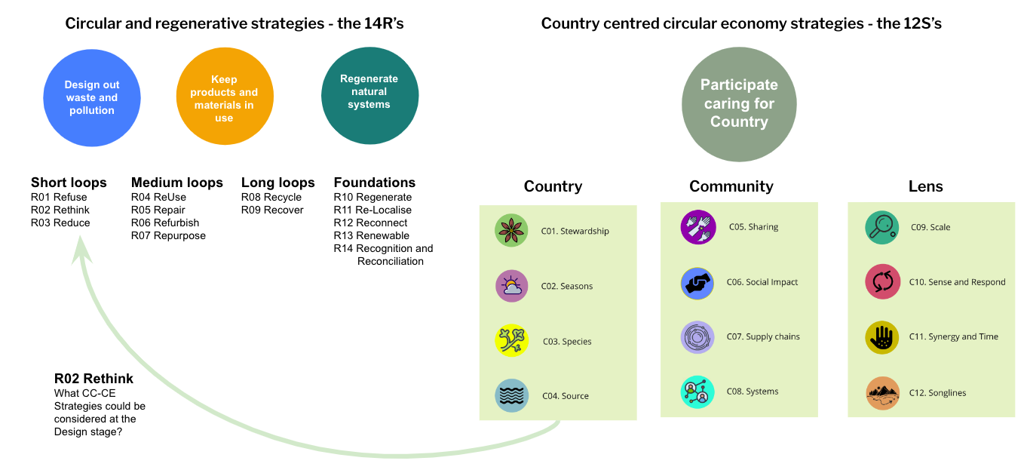
CC-CE Implementation - Walking together
We have been developing tools and processes to bring the CC-CE model to life. Framework for Caring for country shared value and partner collaboration prioritisation. Continuous improvement of practice, tools and methodologies over time.
Notes:
Damien 30 seconds. CC-CE Learning through co-creation and learning through doing. Applying service innovation and digital transformation experience learnings to CC-CE, Wamarra and Hayden Heta.

Slide 15
Implementation - Vision and Roadmap
The Indigenous doughnut CC-CE intends to improve life for all living on Country through shared participation in caring for Country. The CC-CE model, strategies and tools open up shared value pathways and opportunities to bring together the best of both worlds to build a thriving and resilient Australia.
Support TOC and Businesses with Internal CE Transformation and CCCE Leadership initiatives.
CCCE Business and Partner Collaboration. Shared Value. How do we walk together?
Resource and Capability development. Business project implementation.
Notes:
Paul 1 minute. Finish with the roadmap and invitation connect .

Slide 16
Panel Discussion
Kanitba
paul.paton@fvtoc.com.au
damien@goodhuman.com.au
Country
Notes:
Finish.

Slide 19
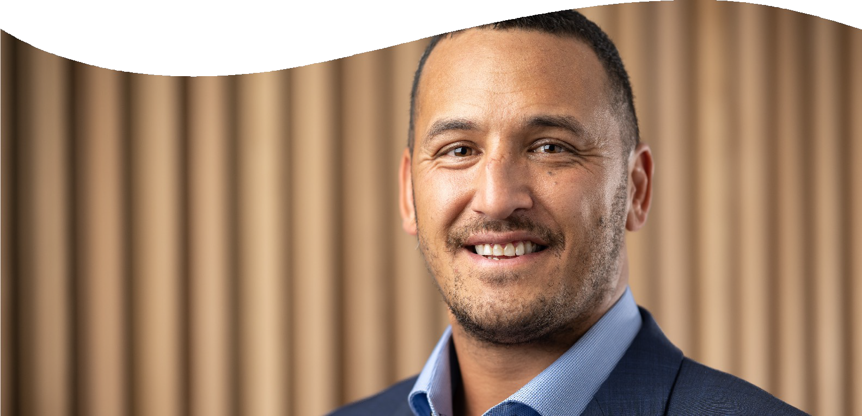
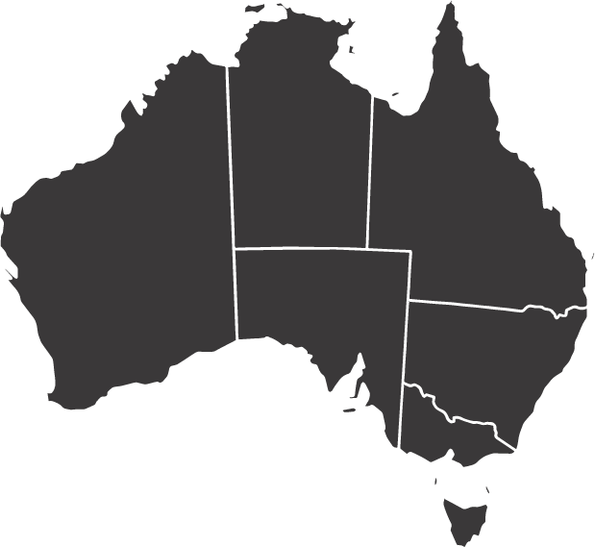
Meet Hayden
Wiradjuri Nation
Albury Wodonga
Hayden Heta
Managing Director

Slide 20
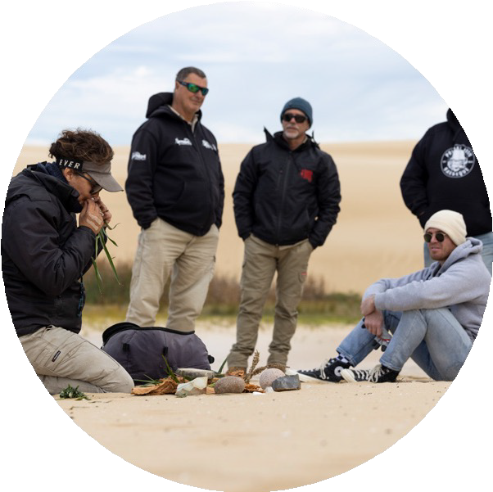
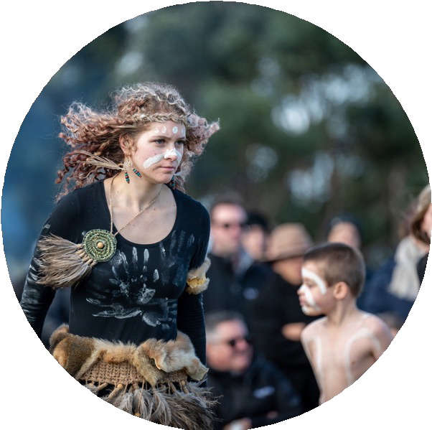
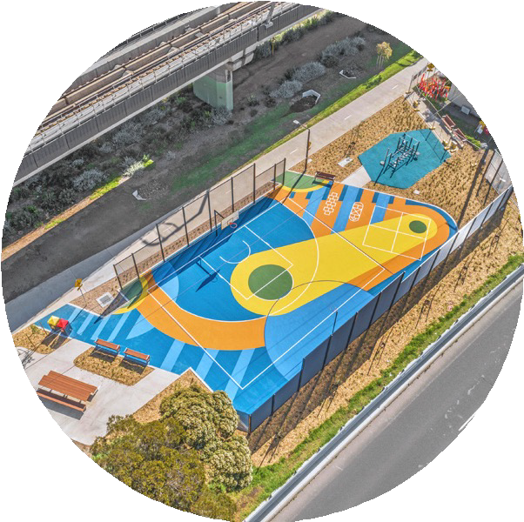
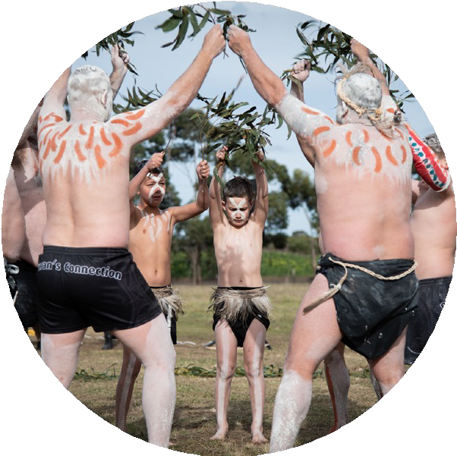
Overview
Our purpose
Embedding our culture
What we do
Legacy

Slide 21
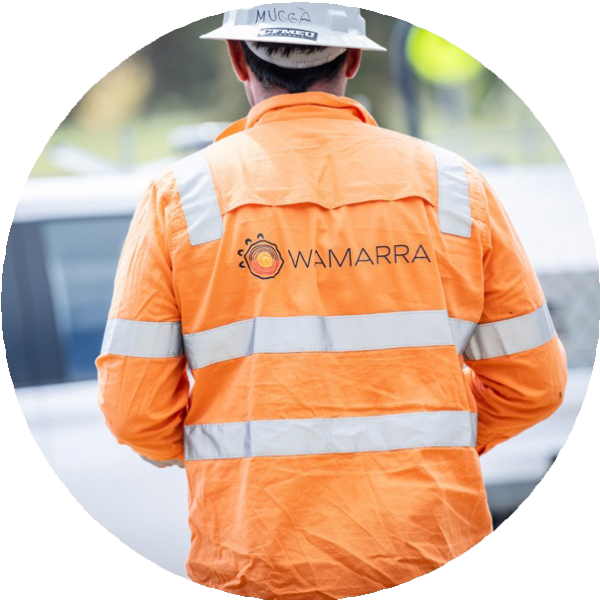
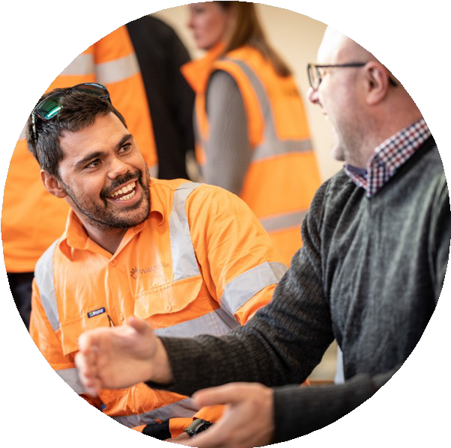
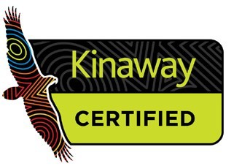
Who we are
Aboriginal owned and operated
Self performing contractor
Civil and landscaping contractor.
Continuity of employment
Upskilling
Cultural safety

Slide 22
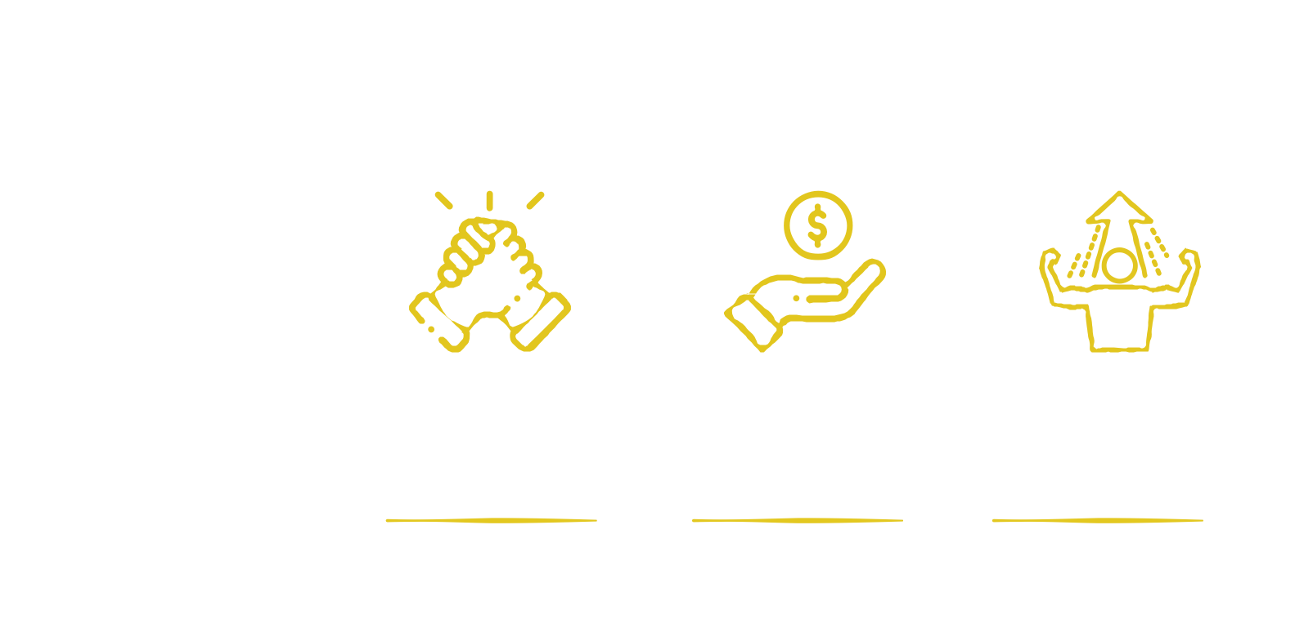
Our purpose
Building meaningful careers for Aboriginal people.
To create meaningful careers
Provide economic and financial independence
Help individuals achieve self determination

Slide 23
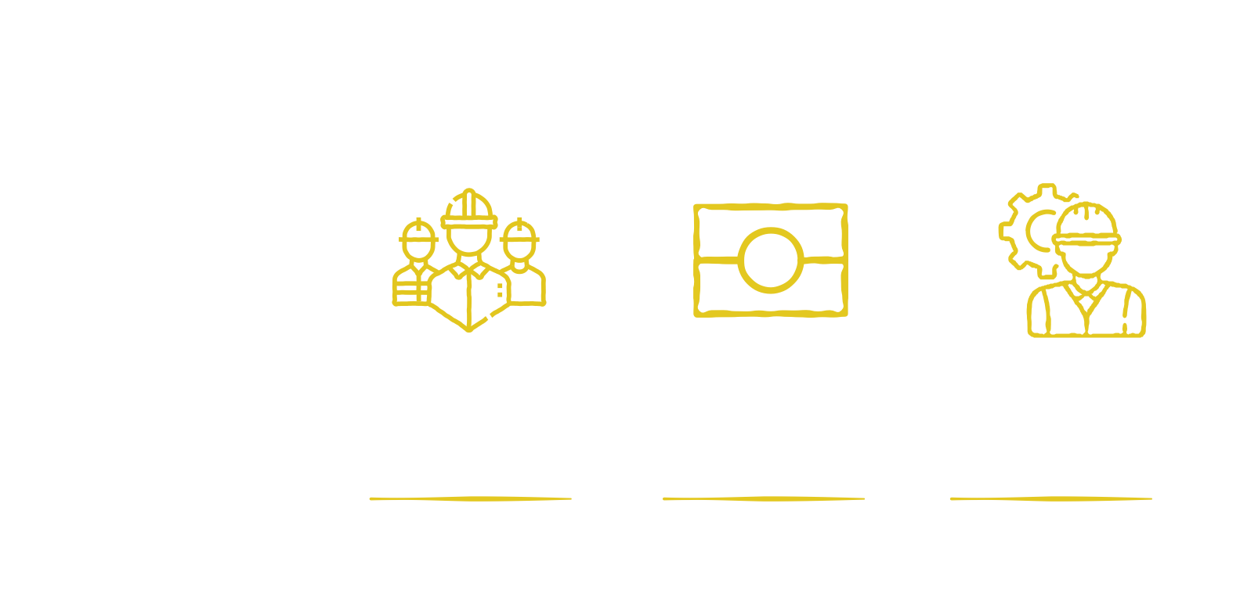
Our team
Our team are skilled in a range of construction trades, from operation
of complex plant and general civil works
to specialist skills in capentry, concreting and more.
97 full time employees
55 full time Aboriginal employees
Strong engineering and management

Slide 24
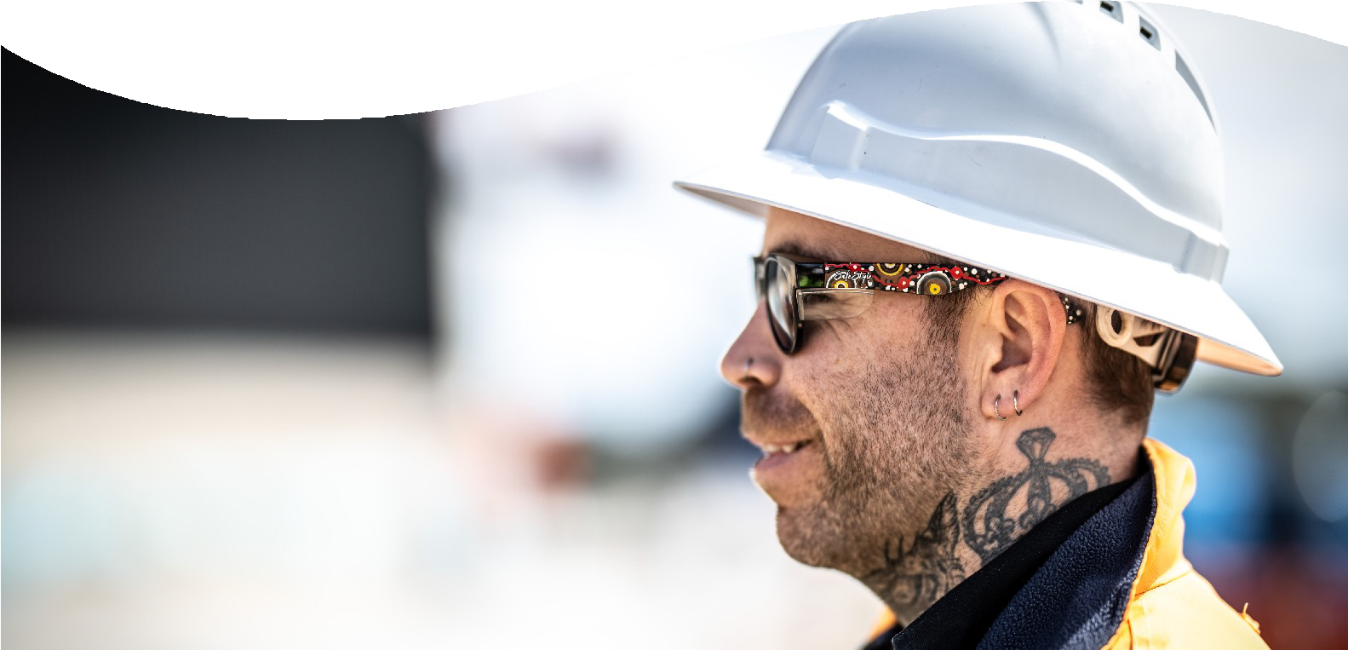
Our cultural identity
Focus on training and development
Our values reflect our people and the broader community
Develop Aboriginal role models and mentors
Support individual growth
Consolidate leadership skills.

Slide 25
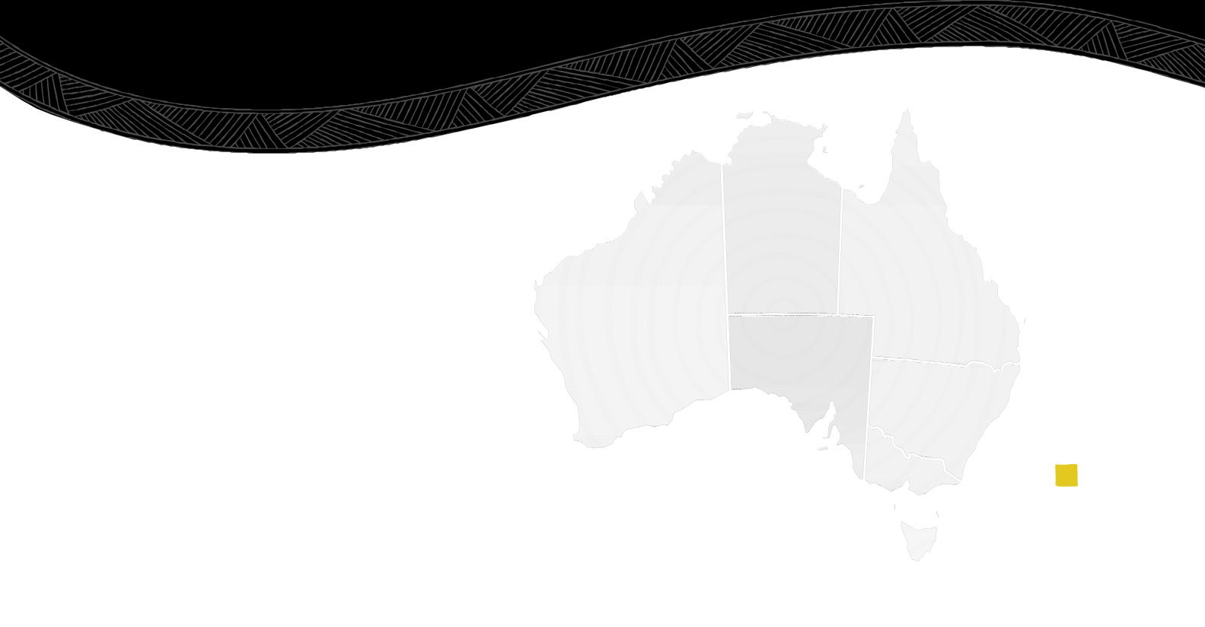
Our Nations map
Torres Strait Islands
Iningai
Kenny Morgan
Labourer /
Carpenter
Stu Burnett
Site supervisor
Muluridji
Gunggari
Our Aboriginal Nations map illustrates the diverse Aboriginal heritage of our
Wamarra employees and one that we’re incredibly proud of.
Andrew Kent
Carpenter
Anthony Walker Labourer
Kamilaroi
Jarrod Hudson Ryan Hudson
Labourer Labourer
Wiradjuri
Allan Norris
Ben Smith
Plant operator
Graham (Wilky) Norris
Labourer
Carpenter / Team
Leader
Hayden Heta
Managing Director
Keahn Jeremaia Concreter
Reid Crowe
Carpenter
Yuin
Sam Sheldon
Carpenter
Andrina Smith
Project
Narungga
Kaurna
Gunditjmara
administrator
Yorta Yorta
Wurundjeri
Andrina Smith
Andrina Smith
Allan Norris
Anthony Walker Labourer
Bradley Kairouz-Lovett
Alex Williamson
Allan Norris
Anthony Walker Labourer
Project
Project
Carpenter / Team
Carpenter / Team
administrator
administrator
Leader
Plumber / Team
Apprentice
Leader
Leader
Daniel Ross
carpenter
Electrician / Team
DjaDja Wurrung
Leader
Dean Morris
Plant Operator
Dylan Moait
Labourer
Graham (Wilky) Norris
Labourer
Brad Taylor
Labourer
Connor Cowley
Dale Owens
Labourer
Palawa
Gunaikurnai
Labourer /
Carpenter
Jayden Lovett
Joe Bell
Luke Roach
Dylan Kerr
Robert (Bobby) King
Plant operator
Andrina Smith
Daniel Harrison
Concreter
Luke Roach
Dylan Kerr
Graham (Wilky) Norris
Labourer
Labourer
Labourer / Carpenter
Labourer
Apprentice carpenter
Project administrator
Labourer
Apprentice carpenter

Slide 26
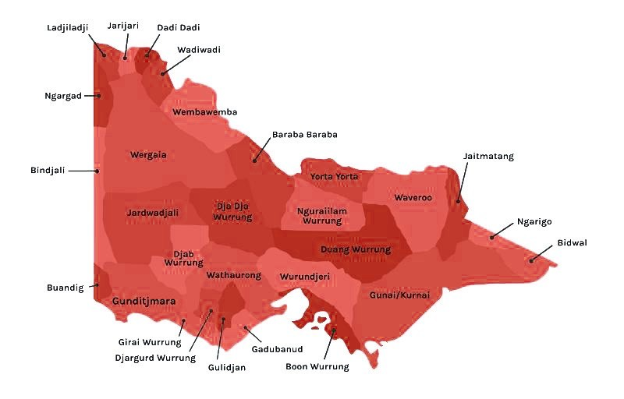
Traditional Owners
Wamarra is deeply committed to engaging Traditional Owners of the land on which we work, providing employment, development and training.
Chisholm Road Prison Project Wadawurrung
Beecroft Reserve
Yuin
LXRP Landscape Intiative Wurundjeri NARRAP team
Griffith Three Ways Roads to Homes Wiradjuri

Slide 27
Aboriginal Employment
We are dedicated to developing long term, mutual beneficial and meaningful partnerships within the civil construction industry, broader Aboriginal community
and within our own workforce.
Destination for mob
Community connection
Deep seeded relationships
Aboriginal cultural support programs
Industry partnerships
Community partnerships

Slide 28
Our programs
Identifies and improves leadership styles
Provides the tools required to promote better decision making
Boosts team building skills
Develops strong communication skills.
Builds capability
Identifies transferable skills
Attracts those wanting a career change into construction.

Slide 29
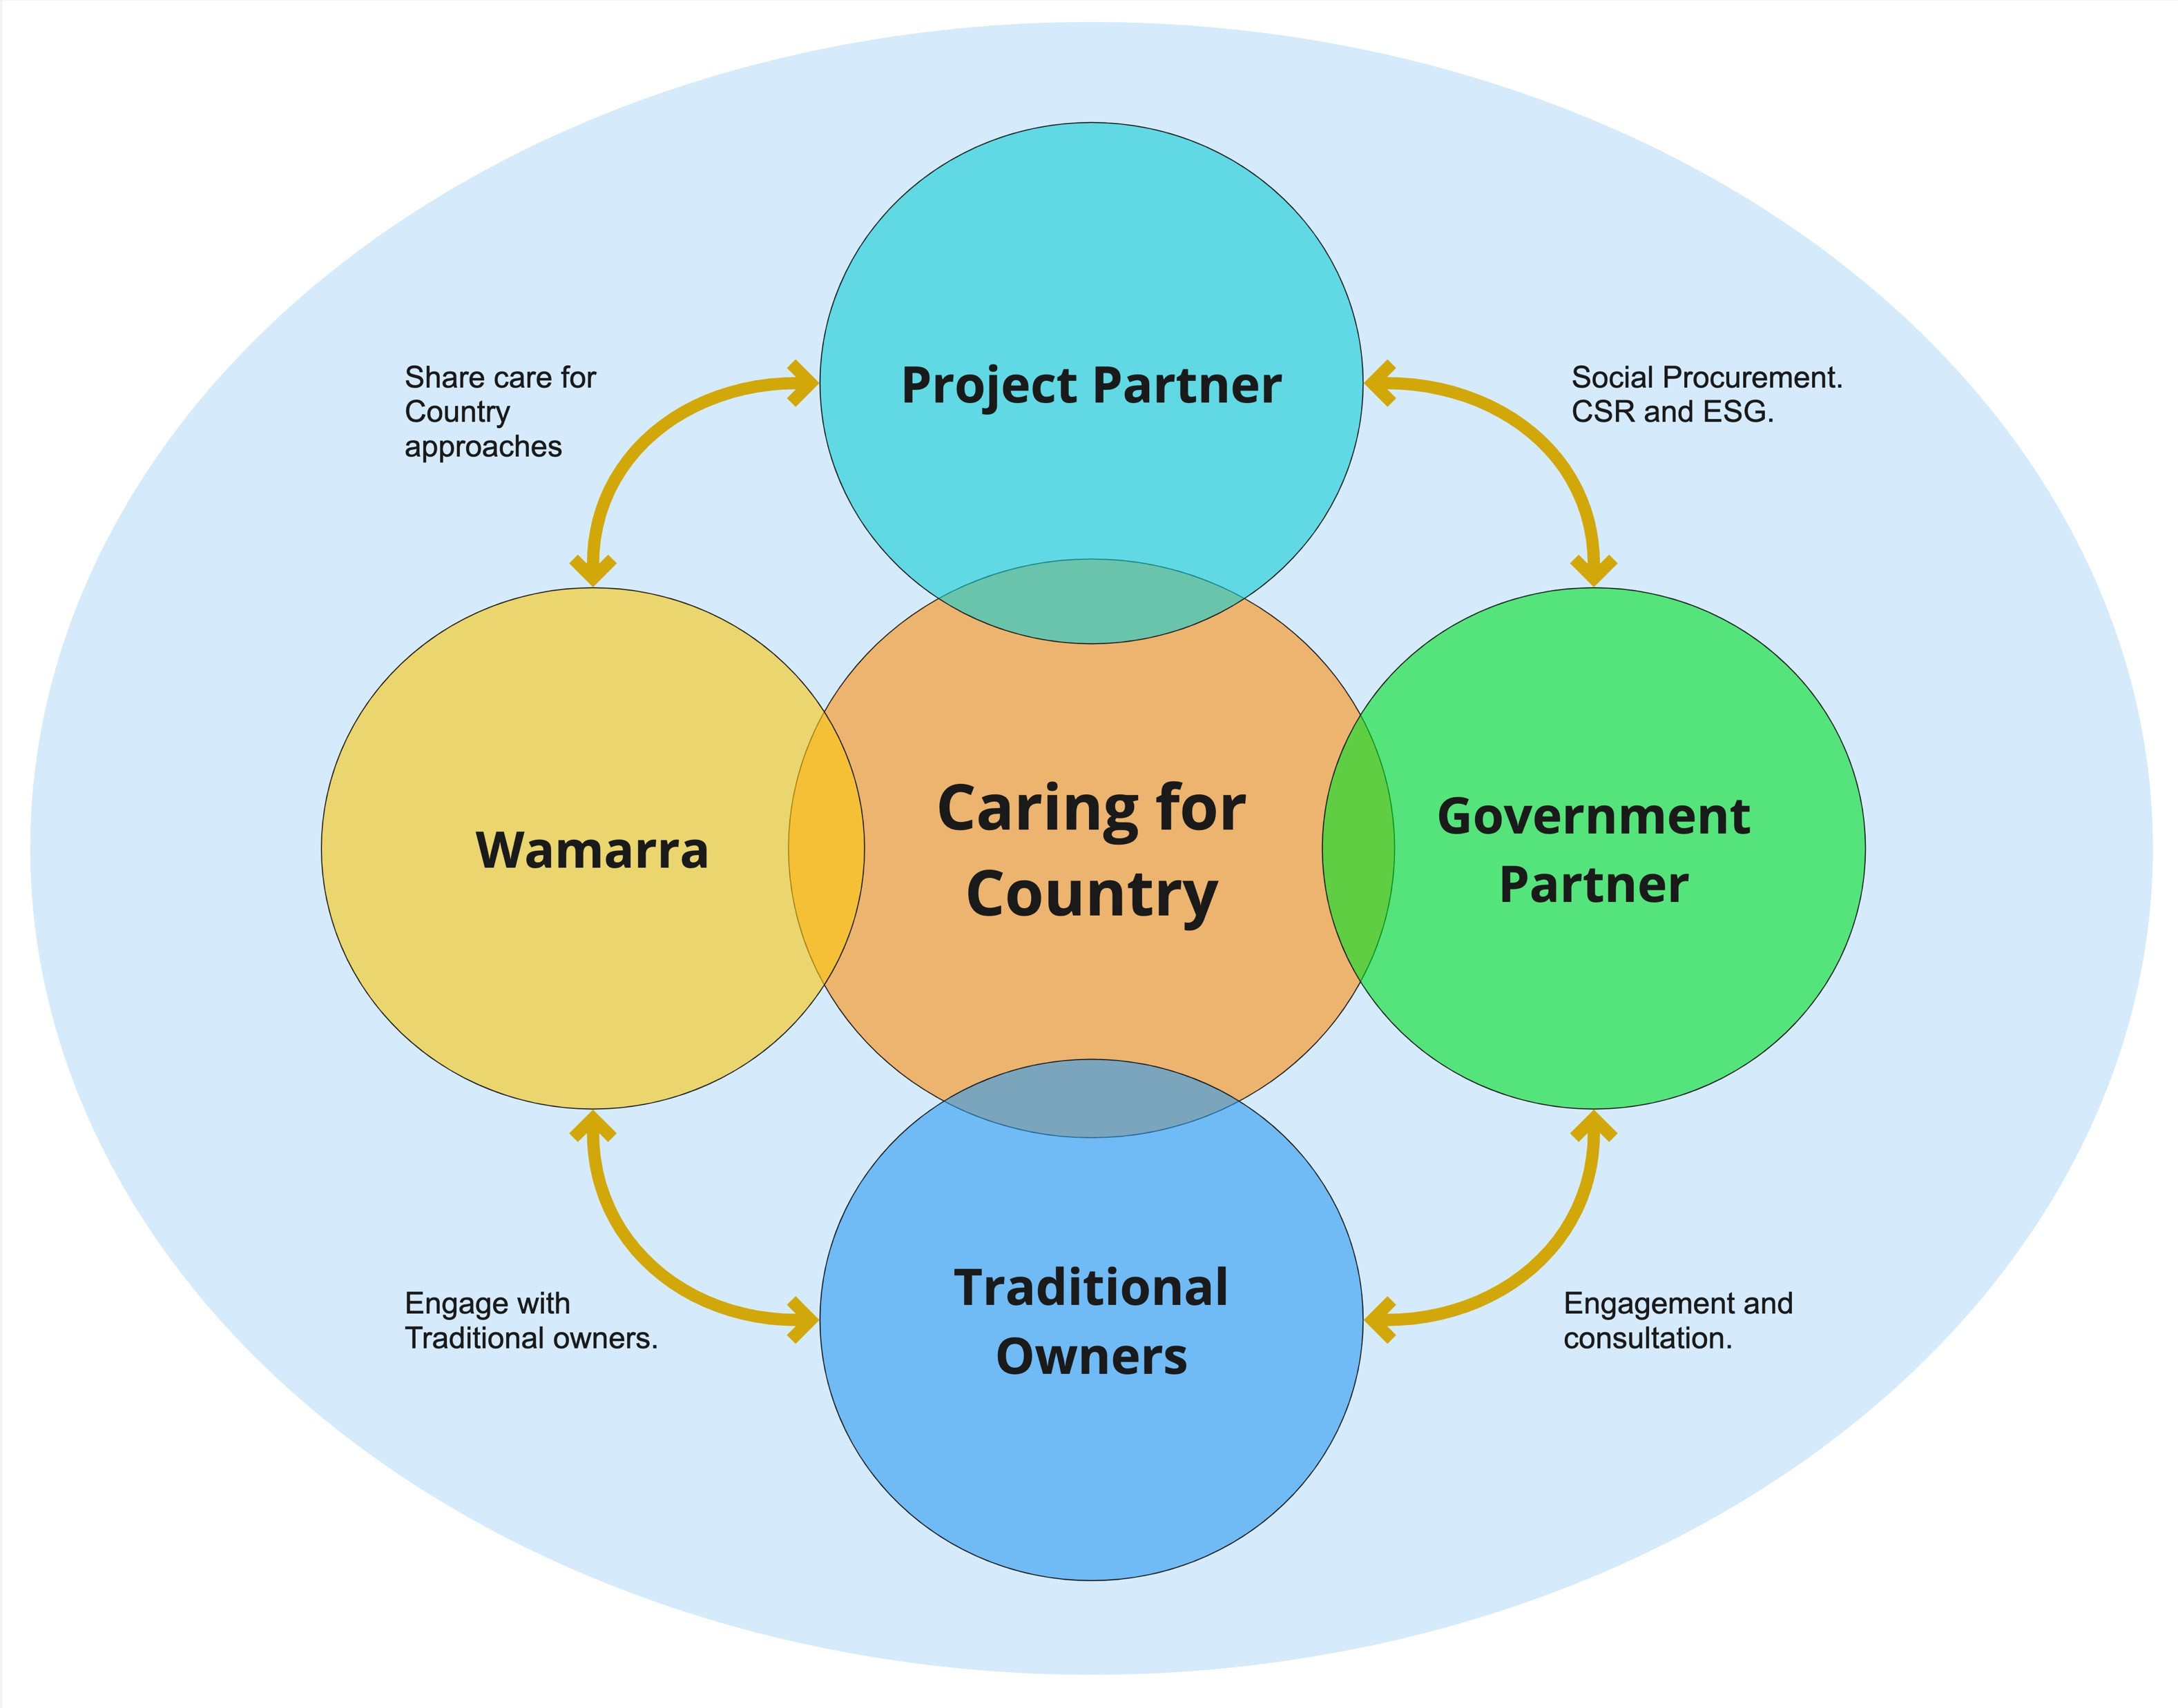
Country Centred relationships
Caring for Country is common ground for all project partners.
First Nations people have a Circular Economy leadership opportunity.
Leading in Circular Economy provides more role-models for Mob entering construction.

Slide 30
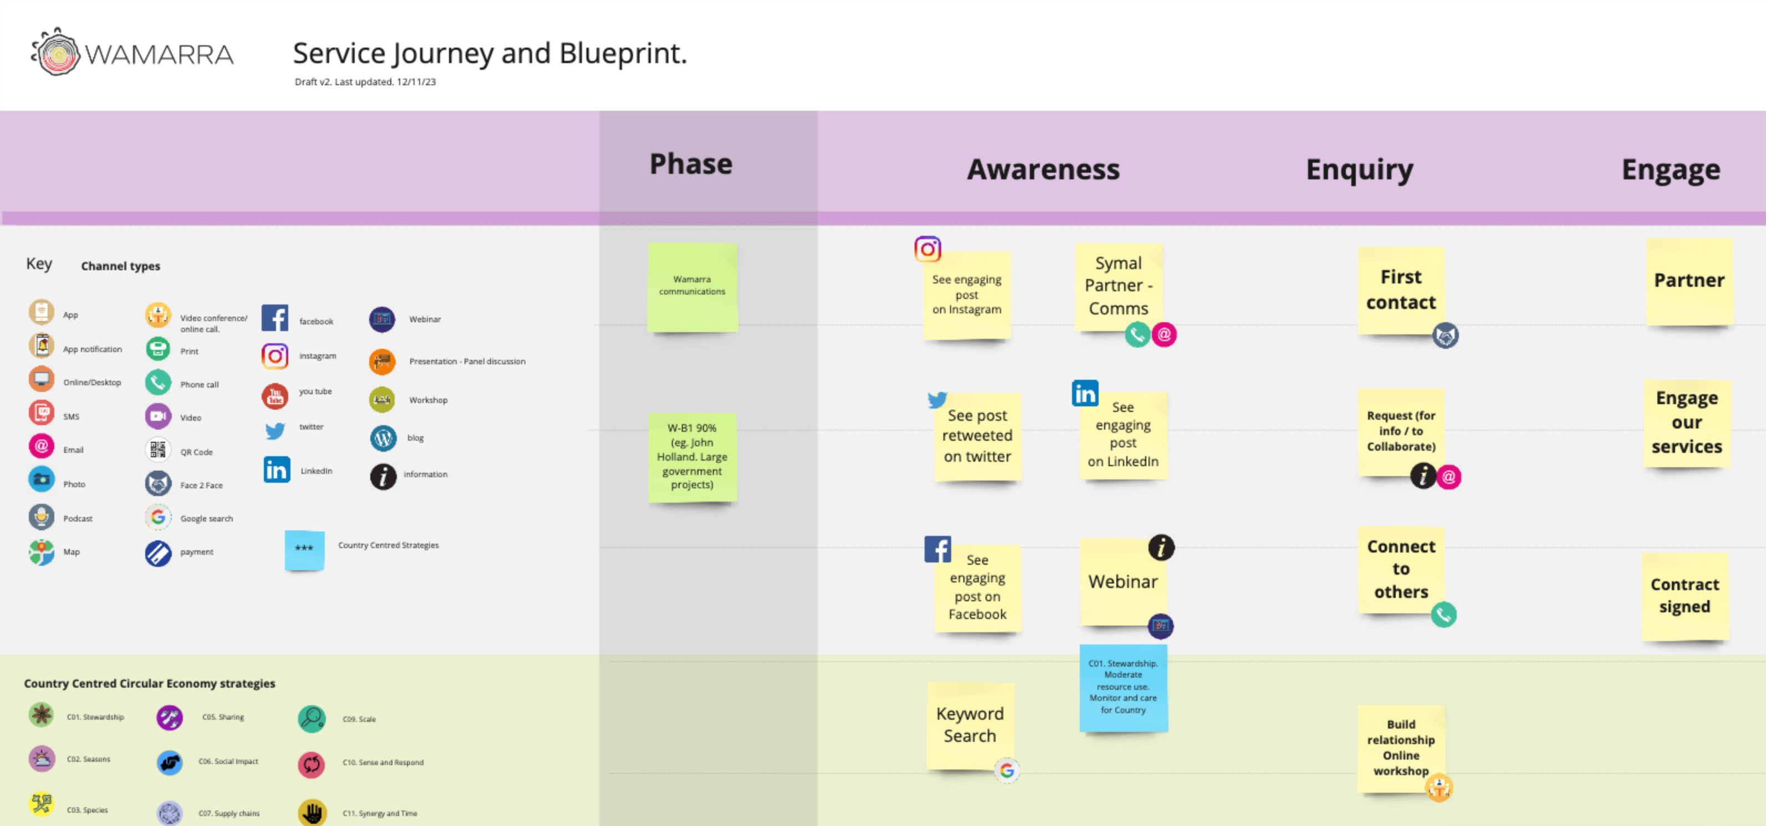
Country centred circular economy
Wamarra Country centred circular economy project board link

Slide 31
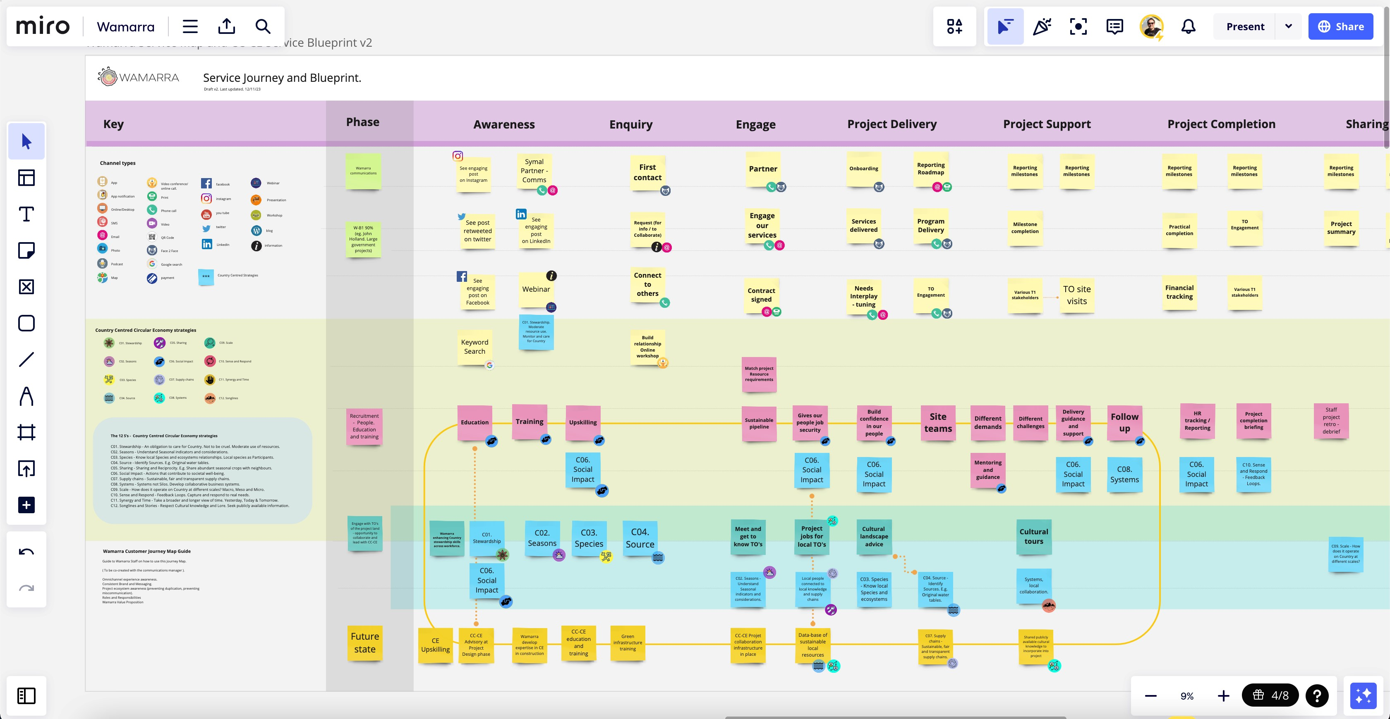
Country centred circular economy

Slide 32
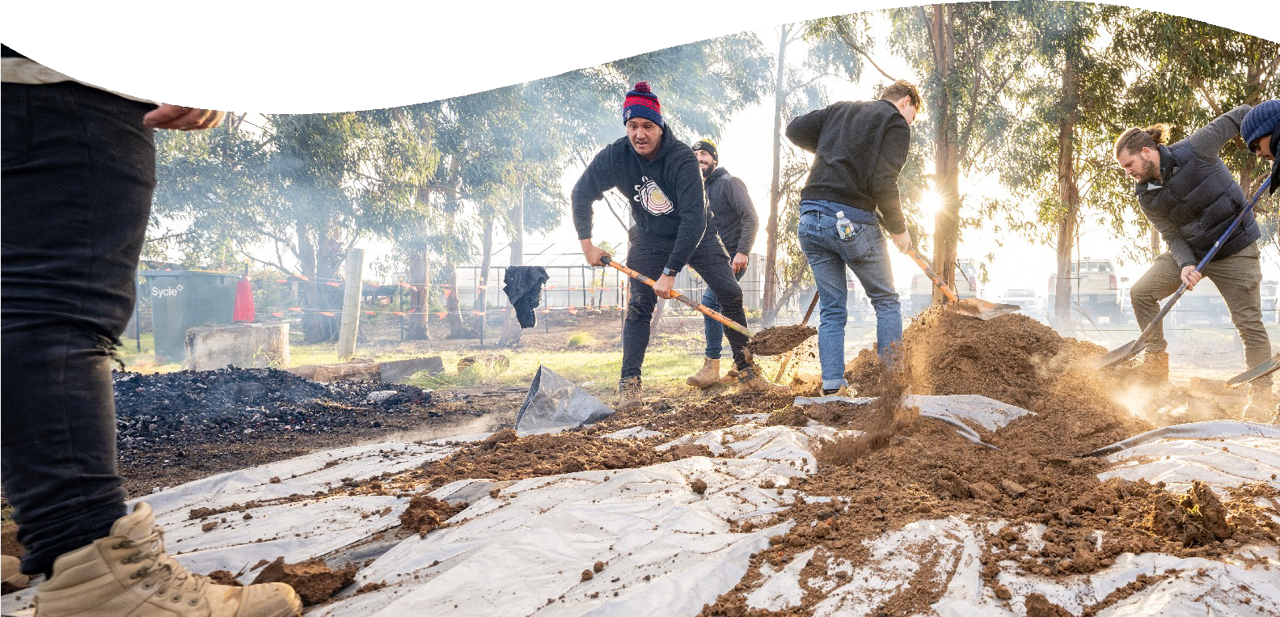
Our initiatives
Cultural awareness programs
Mentoring and leadership development
Buddy system
Cultural heritage immersion programs including cultural tours and events
Reconciliation Action Plan implementation.
Kup Murri

Slide 33
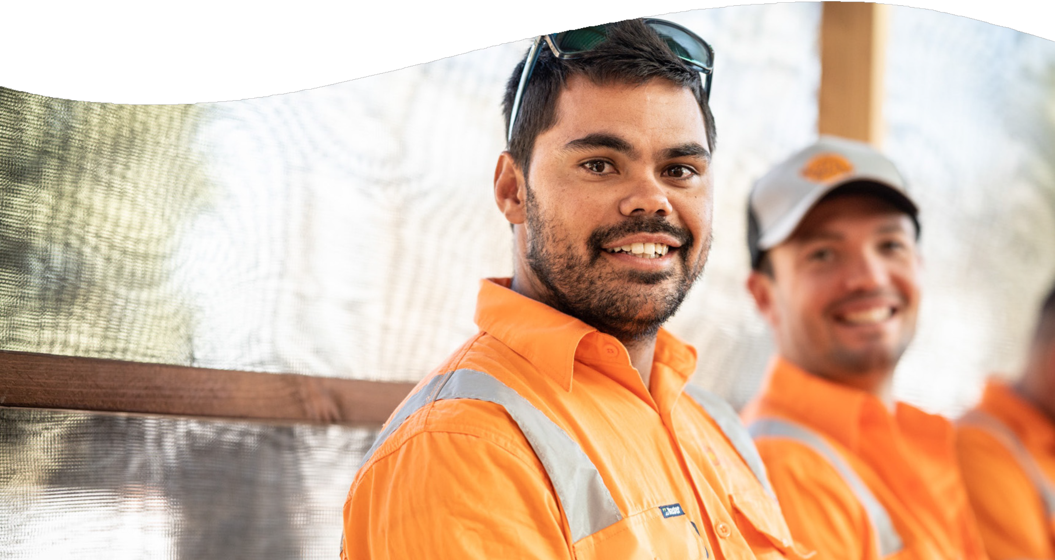
Cultural safety
How do we achieve cultural safety:
Aboriginal mentors and leaders
Comradery and teamwork
Cultural support
Support cultural connection and practices
Genuine and authentic engagement and communication.
Project completion BBQ

Slide 34
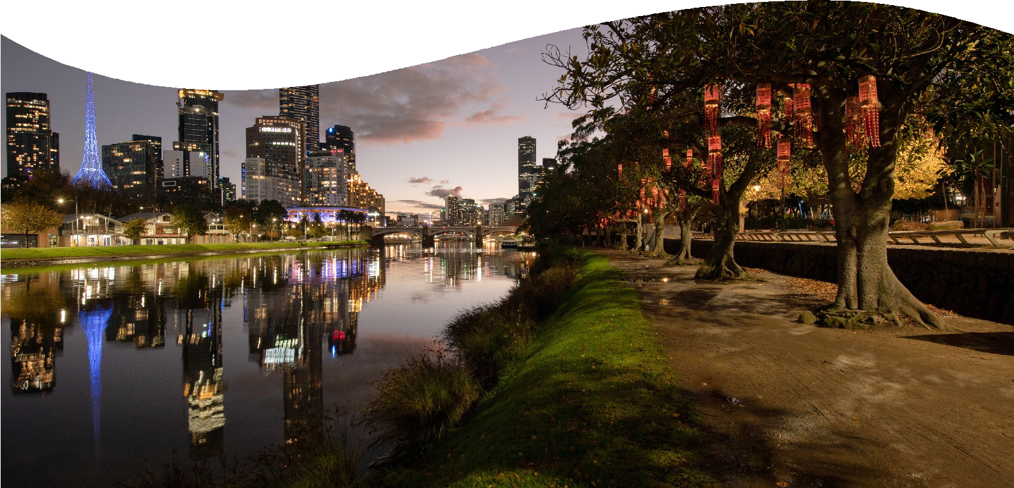
Greenline
Greenline landscape project on the Yarra River will connect visitors and locals to a series of diverse landscape experiences that celebrate the river and the
north bank’s rich layers of history.
Old memories will be honoured, and new memories created through shared storytelling and custodianship.
Client - City of Melbourne
Start date 2024

Slide 35
Bell to Preston
Wamarra delivered the hard are soft landscaping at Bell and Preston train stations as part of the Level Crossing Removal Project.
The use of native planting was used to create a story across the whole revitalised area, with planting that includes native grasses and flowering varieties as well as thousands of trees.
Client - John Holland (WPA)
July 2022 - March 2023

Slide 36
Legacy
Building careers
Community
Enhance Traditional Owner engagement
Social outcomes

Slide 37
p 1800 314 659
e info@wamarra.com.au
204B Hall Street Spotswood, Victoria 3015
wamarra.com.au

Slide 39
Indigenous knowledge and the economy
Land governance
Self governance
Joint Management
Co-existence (third parties)
Relationships
Respect
Opportunities
Governance
Registered Aboriginal Parties (RAPs) are responsible for managing Aboriginal cultural heritage within their appointed areas.
The Traditional Owner Settlement Act provides a framework for the recognition of Traditional Owner rights and settlement of native title claims in Victoria.
? Question of an Equitable standing
Free, Prior and Informed Consent is considered

Slide 40
Industry/Corporates
Traditional Owners
Opportunities
Industry collaboration
- Tendering, strategy and
engagement plans, (RAP’s etc)
Partnerships
- Community benefits/programs
Social Procurement/Supplier diversity
- Indigenous businesses
Training and Employment
-Workforce development
Compliance due to social and legal licence
Because competitors are doing it
Greater commercial opportunities
Want to make a difference
Provide employment opportunities
Vision to keep knowledge and culture alive and to be recognized
Cultural obligation to care/look after country with strategies
Support partnerships with organisations that share the same values and commit to mutual and/or shared benefits

