Slide 1


Circularity Innovation Keynote
CE Implementation Reflections & the Edge Impact (CEP3) tool
Christian Keel, Head of Circular Economy & Lifecycle Thinking, Edge Impact
Prepared for:

Slide 2
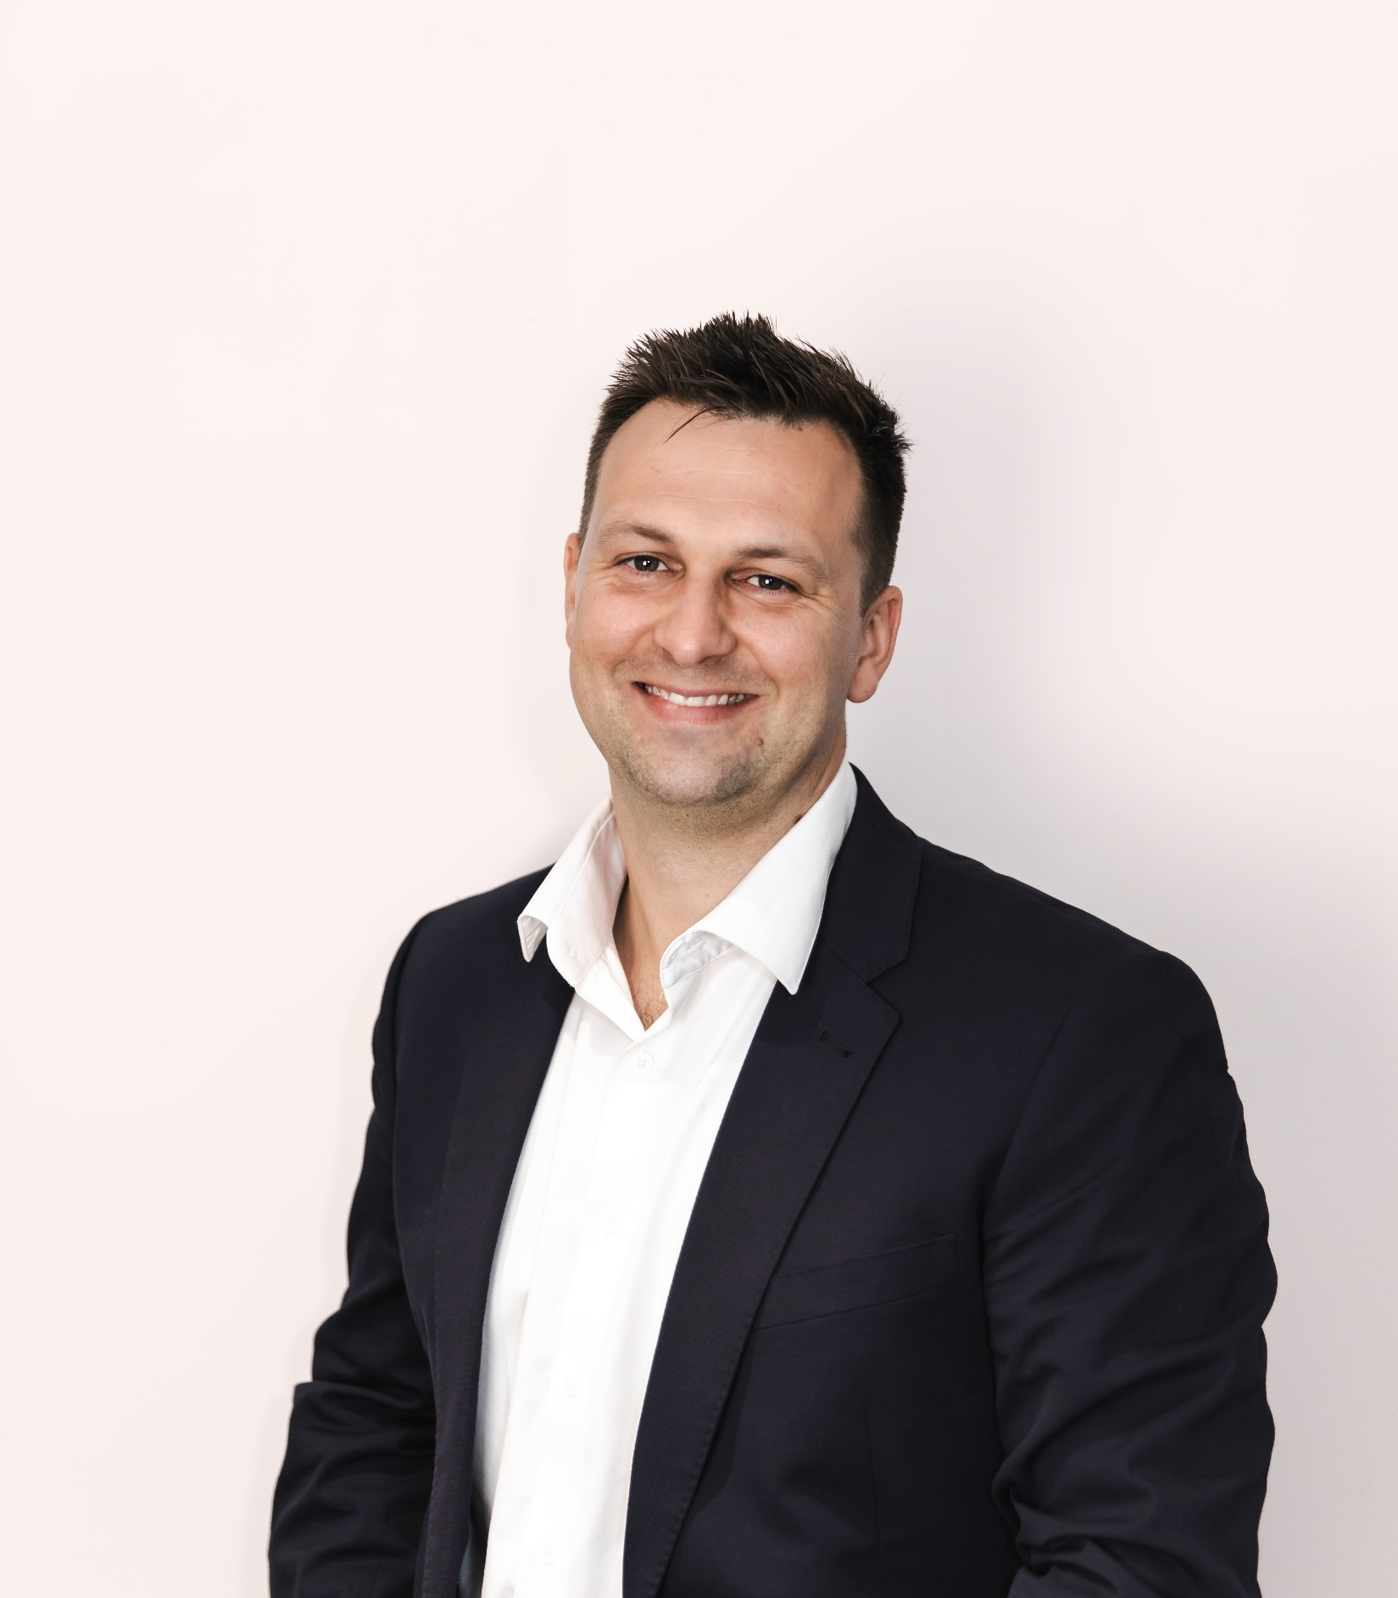
INTRODUCTION
About Edge Impact
Science. Strategy.
Storytelling.
We combine science, strategy and storytelling to help our clients deliver positive global impact. No matter what they want to achieve, or where they’re starting from.
Science allows for robust data and evidence, strategy for a plan that works and storytelling to inspire and drive action.
It’s this unique combination that sets
us apart. It’s the Edge way.

Slide 3
Agenda
CE implementation: current trends
CE implementation: gap analysis
Effective implementation: theory of change
Stakeholder Engagement to unlock results
Edge Impact’s CEP3 Tool: the Circular Economy, Procurement & Scope 3 Rapid Assessment Tool

Slide 4

Navigating the transition
“Innovation is taking two things that exist and putting them together in a new way.” –Tom Freston
Circularity audience
…to here
Taking you from here…
Audience for the tool
Notes:
Text box explaining who this is for – which clients
Circularity audience points to top of pyramid
Bracket below is the audience for the tool

Slide 5
The Current state of Circular Economy Implementation
Circular Economy growth
Australian & New Zealand Advisory Services perspective.
We are seeing:
new circular products and services are being introduced to the market
An increase in level of public interest and engagement
An increase in CE policy considerations (public and private sector)
An increase in CE advisory services (>10% growth projected)
An increase in University graduates with CE training
An increase in Marketing related to CE benefits
We must be approaching 100% circular, right?

Slide 6
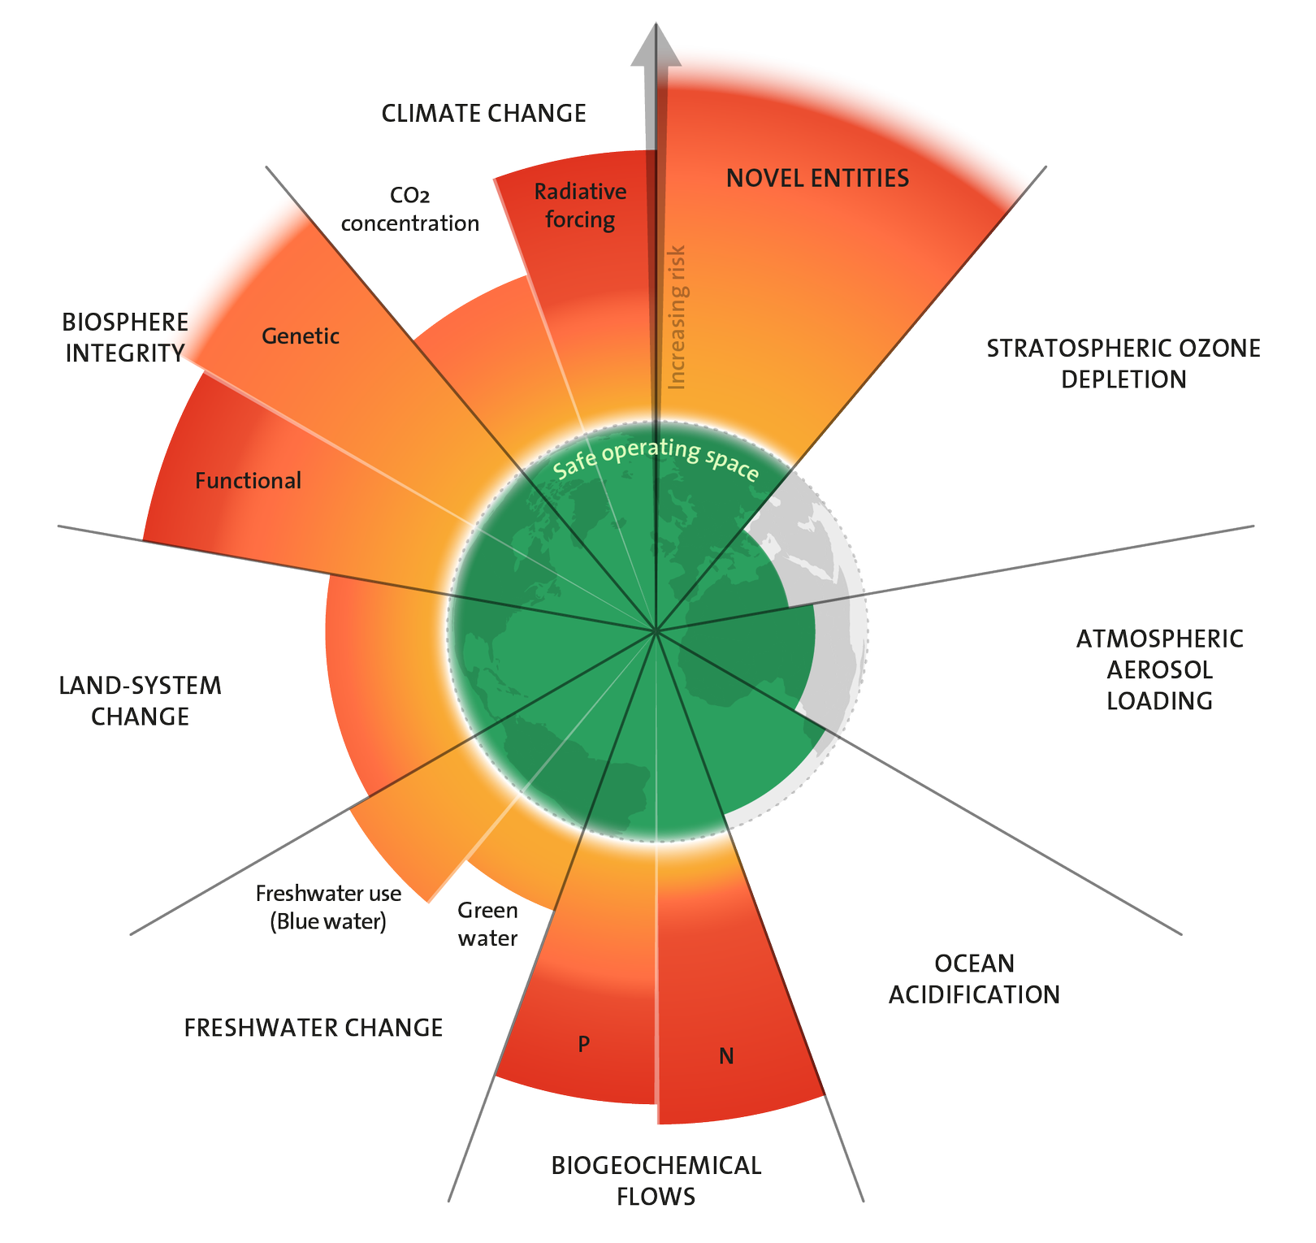
The Current state of Circular Economy Implementation
Globally, we are getting worse at circularity
9.1% in 2018 to
7.2% in 2023
Source: Azote for Stockholm Resilience Centre, based on analysis in Richardson et al 2023
Source: 2023 Circularity Gap Report
Notes:
Overshoot of 6/9 Planetary Boundaries

Slide 7
The Current state of Circular Economy Implementation
How can we break the cycle?
Multi-stakeholder dialogues
“Triangle of Stagnation”
Small pilots
Future commitments
Source: Tom Szaky (TerraCycle and Loop) via Andrew Peterson (BCSD Australia)
Notes:
Going backwards (Globally) in the Circularity Gap report
'Triangle of stagnation' > How do we break the cycle and drive organisations forward
Practically, how do you get started [CEP3]
https://www.greenbiz.com/article/tom-szaky-beware-triangle-stagnation

Slide 8




The Current state of Circular Economy Implementation
Private sector: CE Strategy & Target Setting
If organisations get as far as developing a CE Strategy they usually get to a point where they determine their level of ambition.
Option 1:
Incremental Improvement
Option 2:
Stretch Target
Option 3:
True Circularity

Slide 9
The Current state of Circular Economy Implementation
What are some of the barriers?
Insufficient incentives to select the high ambition case (incl. low cost of virgin materials)
Exclusion (or dilution) of ESG impacts analysis (externalities) in the decision-making process
Anticipated challenges around implementation (reverse logistics, etc.)
Insufficient competitor pressure (‘we want to go second’)
Limited understanding of CE in relation to embodied emissions (incl. Scope 3) and other environmental impacts
Notes:
Circular Economy may be seen as a ‘nice to have’ option
Circularity an afterthought in Business and Product Design

Slide 10
The Current state of Circular Economy Implementation
What could have been done differently ?
1. Engage in broader stakeholder engagement
2. Demonstrate how CE relates to other ESG ambitions
3. Price in the ‘true cost’ of a product and service by including the nature impact

Slide 11
Stakeholder engagement

Slide 12
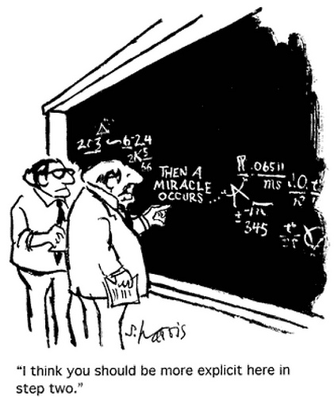
How can we achieve better CE outcomes through improved stakeholder engagement?

Slide 13
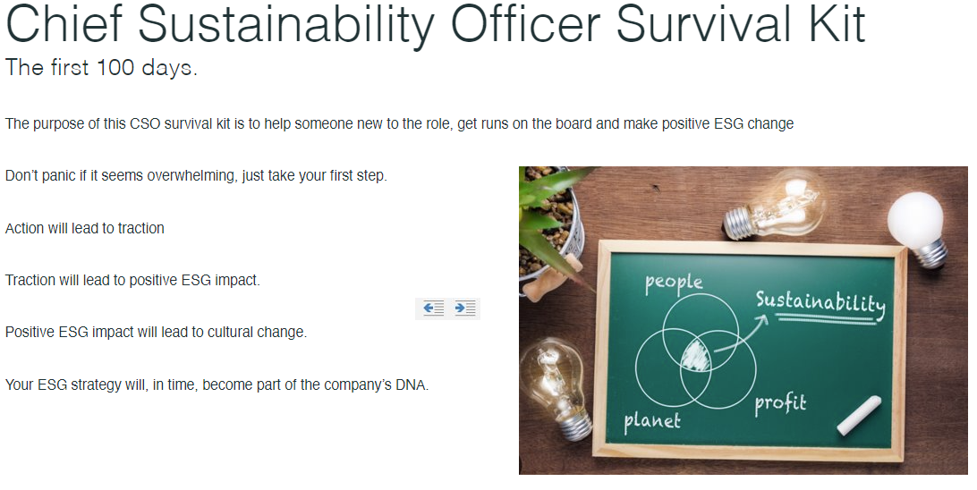
Stakeholder Engagement
Stakeholder Engagement
  Who’s who in the zoo… and what do they do….
Must secure Executive support / endorsement. To be successful this must start and continue at the top table –
Meet with key internal stakeholders to understand sustainability:
    Expectations, Goals, Challenges
Identify champions and ask executive to nominate a team member (Potential future team members)
    Procurement (Sustainable Procurement, Modern Slavery)
    Operations (biggest source of emissions in B2B industrials
    Legal / HR – contracts and policy creation.
    Sales / customer – what are your customers concerned about?
    Befriend your Comms team… you will need / be partnering with internal / external comms…. A lot!
Identify any resistance (there will be some)
    Drill down into what they are trying to achieve
    Find the solution in your ESG strategy
      E.g., Reconciliation vs growth plan (gov contracts)
      Emission reduction vs costs (renewable vs fossil)
Circularity Innovation
Keynote

Slide 14
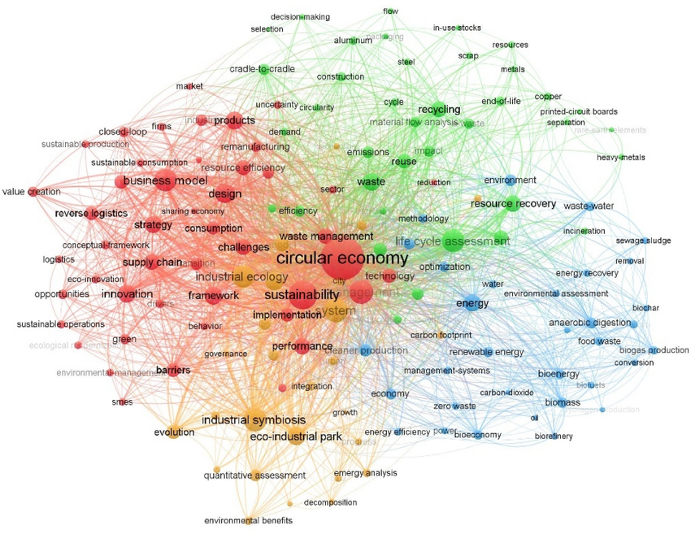
Stakeholder Engagement
Sustainability can be overwhelming
Know your audience
Source: Clean Technologies and Environmental Policy

Slide 15
CE Innovation – CEP3 Tool

Slide 16

CE Innovation – Cep3 Tool
“Innovation is taking two things that exist and putting them together in a new way.”
– Tom Freston
…to here
Taking you from here…
Notes:
Text box explaining who this is for – which clients
Circularity audience points to top of pyramid
Bracket below is the audience for the tool

Slide 17
CE Innovation – Cep3 Tool
The “silo effect”
Circular economy and decarbonisation share the common goal of reducing environmental impact and promoting sustainability, but too frequently these critical transitions are decoupled.
Decarbonisation
Circular Economy
Sustainable Procurement

Slide 18
Edge Impact’s Circular Economy, Procurement & Scope 3 Rapid Assessment Tool (CEP3)
CE Innovation – Cep3 Tool
A practical way to enable organisations to transition from inertia to action within their decarbonisation and circular economy journey.

Slide 19
CE Innovation – Cep3 Tool
Optimising outcomes
A pragmatic rapid assessment must consider circular economy and scope 3 elements and their interaction:
Waste reduction
Reuse materials
Reduce GHG emissions
Reduce biodiversity loss
Notes:
All these components move together

Slide 20
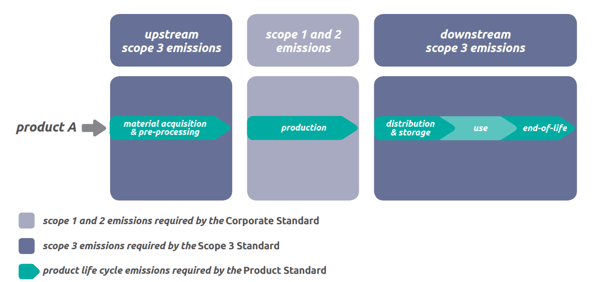
CE Innovation – Cep3 Tool
Rapid sustainability diagnosis – shifting your approach
The upcoming disclosure standards from the International Sustainability Standards Board, coupled with regulations such as the SEC's Climate-Related Disclosure regulation, will necessitate that companies report their scope 3 emissions.
Source: GHG protocol

Slide 21
CE Innovation – Cep3 Tool
Rapid sustainability diagnosis – shifting your approach
The new reporting requirements are a significant step towards enhancing transparency and accountability for the environmental impacts within organisations supply chains.
Source: GHG protocol

Slide 22
CE Innovation – Cep3 Tool
Key Assessment Areas
Commitment
Key Enablers
Procurement Process
Fundamentals
Policy & Strategy
Reporting & Regulation
Footprint
Notes:
The Commitment: Evaluating your existing sustainability strategy and organisational sustainability maturity.
The Fundamentals: Gaining clarity on drivers, impact, and priorities.
The Footprint: Offering high-level guidance on impact areas based on high-risk/carbon intense materials or products, identifying opportunities and "quick wins".
The Policy & Strategy: Connecting key issues to enablers, processes, and gaps.
The Reporting & Regulation: Preparing your organisation for future reporting, disclosure, and regulation.
The Key Enablers: Identifying leverage points for implementing sustainability policies, strategies, or programs.
The Procurement Process: Pinpointing opportunities to embed sustainability into the procurement process, including measurement

Slide 23
CE Innovation – Cep3 Tool
Rapid diagnostic tool - High-level approach
1. Document Review
Review of existing internal
procurement and sustainability
documents against key frameworks and standards (including ISO20400
Standard for Sustainable
Procurement).
The documents reviewed may include artefacts such as:
• Sustainability strategy,
action plan and roadmap
• Whistleblower Policy
• Independent contractor
agreement
• Modern Slavery Statement
• Modern Slavery Questionnaire
• Sustainable Procurement Policy
• Supplier Code of Conduct
• Diversity and Inclusion Policy
• Strategy on a page
2. Stakeholder Interviews
Conducted a series of interviews with key managerial, sustainability and procurement staff with the purpose of validating the reviewed documentation and to understand how sustainability and carbon-related decision-making and procurement processes works in the day to day.
3. CE & ISO 20400 Benchmarking
An Edge Impact in-house gap
and opportunity assessment
framework would be used to evaluate the current as-is state of key governance documentation
against key sections of
the Sustainable Procurement –
Guidance ISO 20400 standard and similar CE guidelines.
The Edge CEP3 Rapid Diagnostic Tool harnesses best practices from ISO20400 Procurement Standards, GHG Protocols, and Circular Economy Principles to quickly assess opportunities within your organisation.

Slide 24
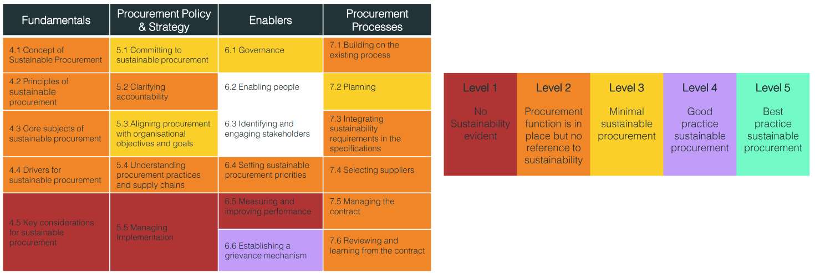
CE Innovation – Cep3 Tool
Initial Findings Summary

Slide 25
Considering the entire supply chain
CE Innovation – CEP3 Tool
Data Spectrum
Accessible all-scope data
3rd party verified EPD
Supplier-estimated factors
Scope 3 emissions pose a dual challenge: acquiring better supply chain data and improving supplier emissions performance.
Transparency
Industry-specific factors
Cost of goods sold
CIRCULARITY INNOVATION
KEYNOTE
Accessibility (difficulty)
Notes:
Update to graph → Y axis transparency and x axis difficulty
Casava example or something similar from Nicole – sourced this slide from Nicole (slide 12) https://edgemanly.sharepoint.com/:p:/r/EdgeEnvironment/06.%20Team%20Folders/SEP/Presentations/UNGC%20Scope%203_.pptx?d=w6c8ce73f14ee4189966d87c43bddcbdb&csf=1&web=1&e=5YyM68

Slide 26
Closing thoughts
Great progress is being made on the Circular Economy front, but stretching ambition and implementation remain a challenge.
Innovation is relative for each entity - How can we move this entity along the journey?
Foundational skills (e.g., change management and stakeholder engagement) have never been more important.
Just get started as there is no time to waste!

Slide 27
2. Change Management

Slide 28
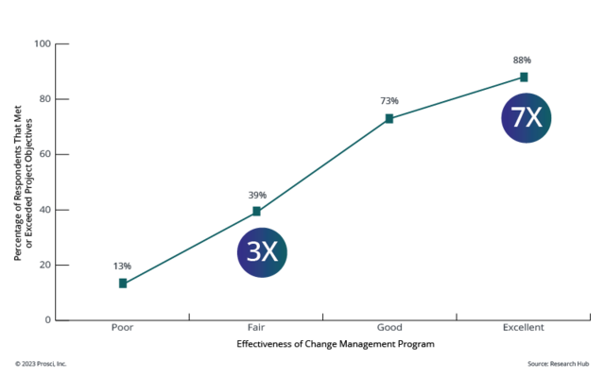
Change Management

Slide 29

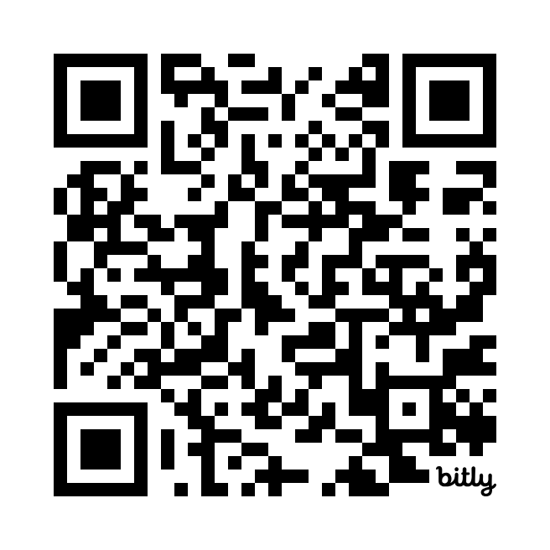
Want to learn more?
Read our article on our new tool below:

Slide 30
Thank you!

