Slide 1






The Role of System Change and Circular Economy
Global Resource Outlook 2024
JANEZ POTOČNIK
Co-Chair International Resource Panel - IRP
Partner SYSTEMIQ
Member Club of Rome
Melbourne, 20th November 2023

Slide 2




















International Resource Panel
Panel Co-Chairs:
Janez Potočnik and Izabella Teixeira
Steering Committee Co-Chairs:
Astrid Schomaker and Steven Stone
SCIENTIFIC PANEL
Internationally recognized experts on sustainable resource management;
Scientific assessments and advice, networks
Science-Policy interface
STEERING COMMITTEE
Governments from developing and industrialized countries;
Strategic guidance, political support, regional synergies
Head of Secretariat: Merlyn van Voore
UNE SECRETARIAT
Direction, procedures, support in development and implementation of assessments, outreach
Strategic Partners

Slide 3
Doughnut - a compass for human prosperity
  Basis human needs
  incl. minimum requirements of resource supply
  Outer limit by Planetary Boundaries
Adapted from Raworth 2017
Notes:
So what is IRP?
IRP was created in 2007 by UNEP to generate independent and authoritative scientific assessments of policy relevance on the sustainable use of natural resources to help policy makers to take effective and long-term decisions on sustainable use of natural resources. This connection between scientists and policy is a fundamental characteristic of the IRP .
‘
So the Panel was created in a similar fashion to the Intergovernmental Panel on Climate Change (or Intergovernmental Platform on Biodiversity and Ecosystem Services), but in this case to provide policy-relevant knowledge not on climate change (or biodiversity loss), but on how to use natural resources more sustainably and efficiently.

Slide 4
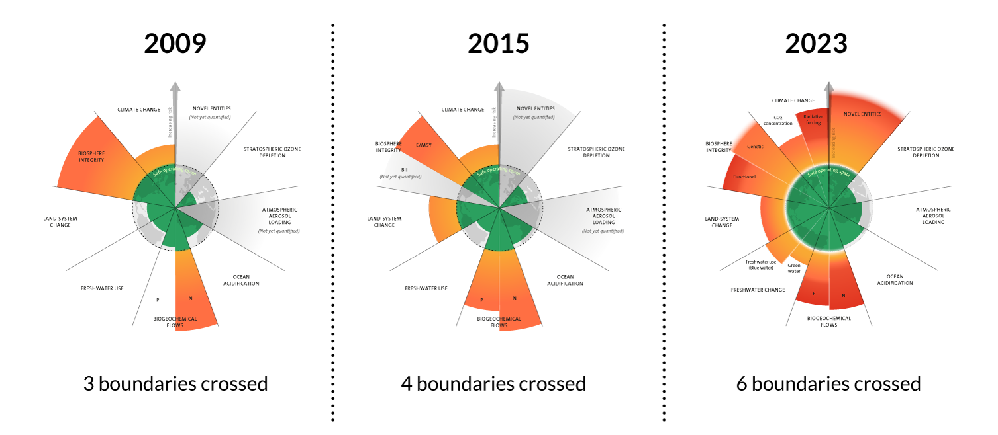
Source: Azote for Stockholm Resilience Centre, based on analysis in Richardson et al 2023

Slide 5
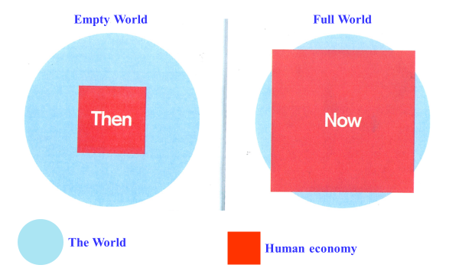
From “Empty” World to “Full” World
Source: Club of Rome: Simplified after Herman Daly
Labour and Infrastructure limiting factors of human wellbeing
Natural resources and Environmental sinks limiting factors of human wellbeing

Slide 6
For the first time in a human history, we face the emergence of a single, tightly coupled human social-ecological system of planetary scope.
We are more interconnected and interdependent than ever.
Our individual and collective responsibility has enormously increased.

Slide 7
Global Resource Outlook 2024
Towards Sustainable and Equitable World
All Pre-peer Review
DO NOT COPY

Slide 8
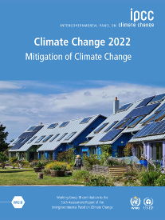
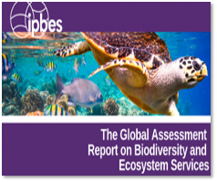
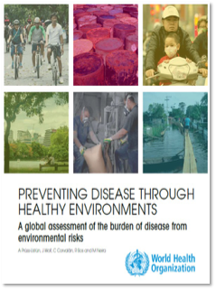
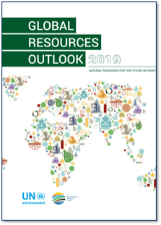
Resources - The Missing Link
IPCC
Climate Change
IPBES
Biodiversity loss and Ecosystem Services
WHO
Environment and Health
IRP
Unsustainable Resource Use
Notes:
The report follows the overall logic and structure of the 2019 edition along the lines of the DPSIR framework: materials flows and pressures, environmental impacts, 8 outlook through scenario exploration and proposal for policy responses.

Slide 9
CHAPTER 2
Drivers, pressures, and natural resource use trends

Slide 10
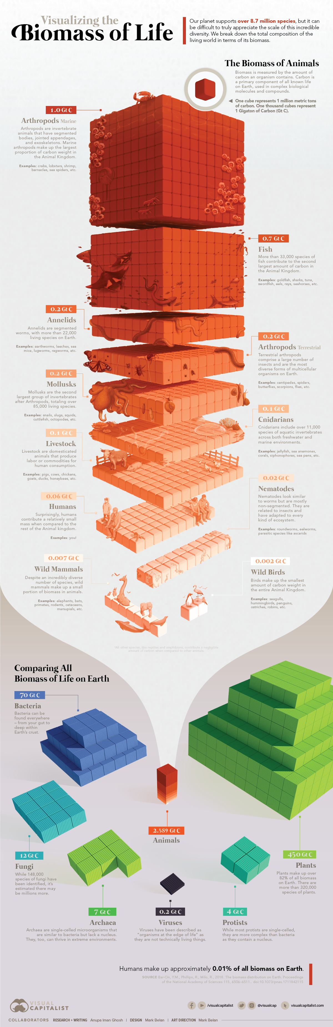
Biomass of Life
Humans in Perspective
Source: Visualcapitalist.com

Slide 11
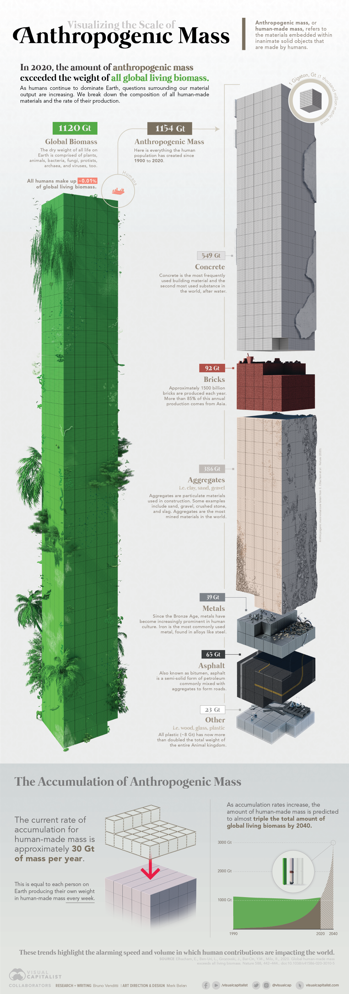
Source: Visualcapitalist.com

Slide 12
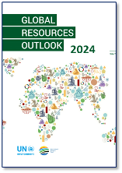
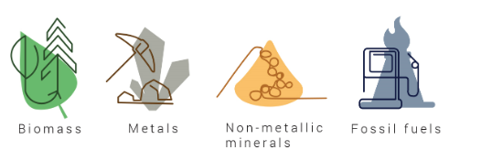


Natural Resources
Provide the foundation for the goods, services and infrastructure that make up our current socio-economic systems
Biomass (wood, crops, including food, fuel, feedstock and plant-based materials)
Fossil fuels (coal, gas and oil)
Materials
Extracted from earth
Non-metallic minerals (including sand, gravel and limestone)
Metals (such as iron, aluminum and cooper…)
Water and Land

Slide 13
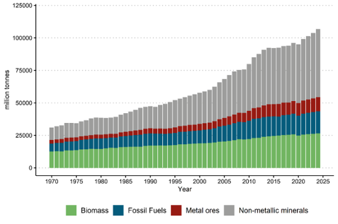
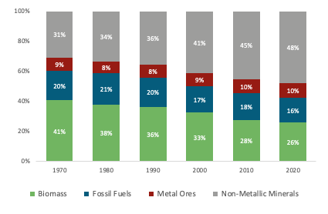
Trends: Global Material Use and Share in 1970-2023
Global Material Use has increased by almost a factor 4 since 1970 due to urbanisation and industrialisation (and population growth)
… which is increasing also the share of Non-Metallic Minerals in Global Material Use
Global material extraction, four main material categories, 1970 – 2024, million tones.
Global material extraction, four main material categories, 1970-2020, shares
Notes:
Environmental impacts occur at all stages of the supply
chain, and they have been intensifying in proportion to the growing global demand for
materials.

Slide 14
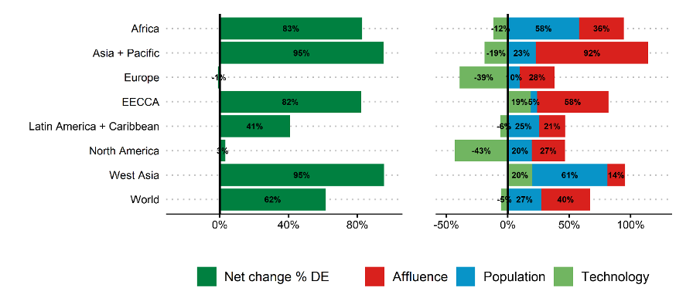
Trends: Drivers of Material Footprint 2000-2022, %
Domestic Extraction
Notes:
We observe a closer resemblance between the results of domestic extraction and material footprint. At the global level, the drivers'
contribution is practically the same for both, which is expected as MF equals DE globally (slight differences are due to rounding). The proportion between population and affluence remains consistent, but the absolute percentages generally shift. The altered impact and technological coefficient result from the reallocation of global direct material extraction among countries during the footprinting process.

Slide 15
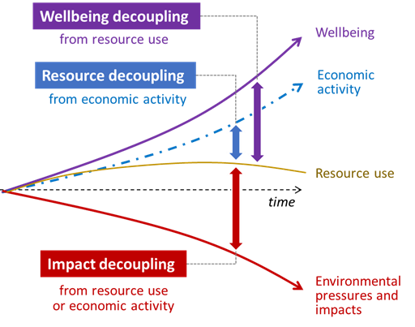




If current trends continue, global material consumption will increase substantially
Decoupling
Notes:
Decoupling of natural resource use and environmental impacts from economic activity and human well-being is an essential element to the transition to a sustainable future.

Slide 16
Circular economy should be seen as an instrument for delivering decoupling of economic growth from resource use and environmental impacts in practice, as well as a part of the bigger picture of economic, societal and cultural transformation needed to deliver the EGD and SDGs

Slide 17

Circular Economy is just common sense
Circular economy was introduced in the European policy space in 2014. It was not a new concept, unknown to science, but it was new to policy makers. In less than 10 years, the concept is well known and broadly accepted globally. This is quite logical since …
Circular bioeconomy is the oldest concept on the planet Earth. Nature is organised according to circularity principles - nothing is lost, and everything has its purpose. So, the only question we humans should answer is do we consider ourselves as part of nature.

Slide 18

The first dimension is often overlooked…
Dimensions
BETTER: Minimise product need through better system design | Refuse and Rethink strategies
LEANER: Optimise product design | Reduce strategies in manufacture and use
LONGER: Maximise lifespan of products and its parts | Reuse, Repair, Refurbish, Remanufacture, Repurpose and Recycle strategies
CLEANER: Minimise waste and pollution | Recovery strategies
Often overlooked, but crucial for effectiveness
1
2
Resource Efficiency
3
4

Slide 19
We must shift away from the prevailing resource wasteful economic approach based on maximising the output of sectors, simplistically defined by GDP, towards an economy that is efficiently meeting human needs and optimise human wellbeing.
The current logic is both ethically and ecologically unsustainable.

Slide 20
From Product Maximisation to Providing Human Needs
It is not not about owing it is about using
We do not need cars … We need mobility
We do not need light bulbs … We need light
We do not need chairs … We need to sit
We do not need refrigerators … We need chilled and healthy food
We do not need CDs … We want to listen to the music
We do not need pesticides … We want healthy plants
Dematerialisation, Rethinking Ownership,
Efficiency should be Complemented with Sufficiency

Slide 21
Demand side and sufficiency
  We can reduce demand (of energy and materials) from consumption as well as from production side
  From the consumption side we can reduce consumption through optimising what is sufficient to meet human needs.
  From the production side we can provide human needs by using less energy & materials – optimising sufficiency of energy and materials needed to meet human needs.

Slide 22

Main question often-overlooked to be addressed
How to meet human needs in most energy and resource efficient way?
https://edistaffing.com

Slide 23
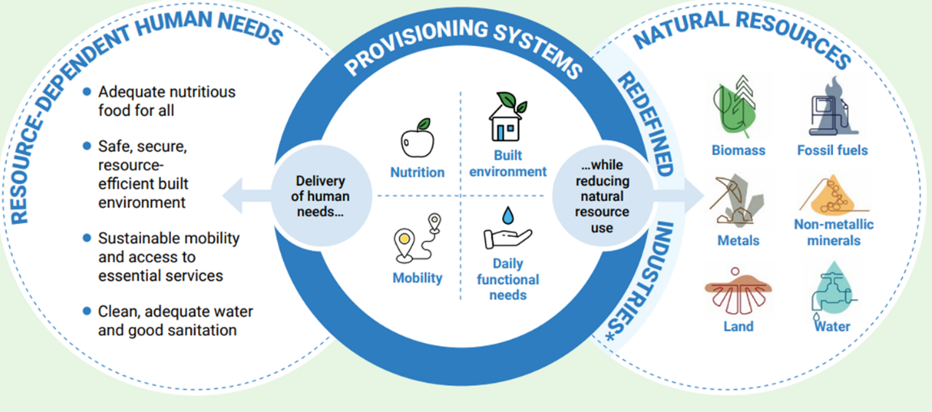
Provisioning Systems use natural resources to deliver human needs

Slide 24
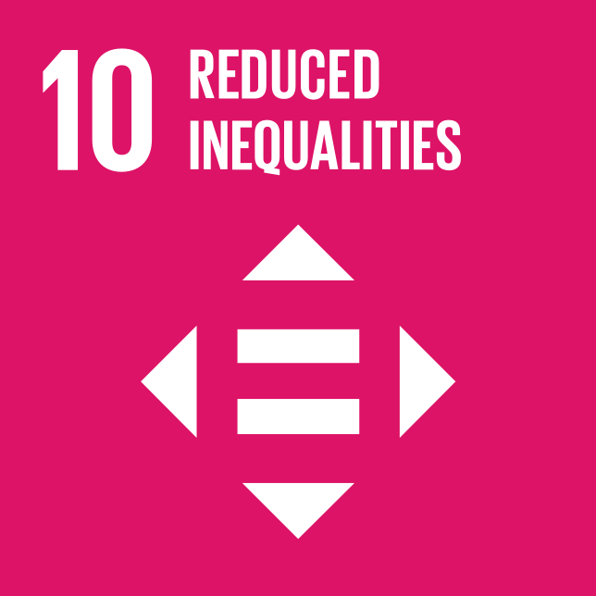

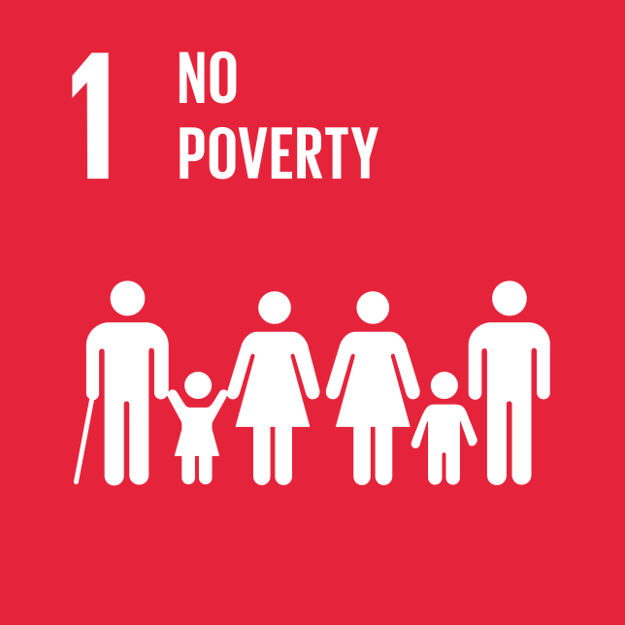





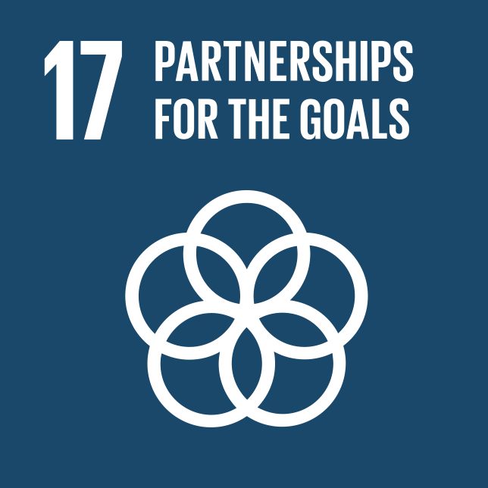
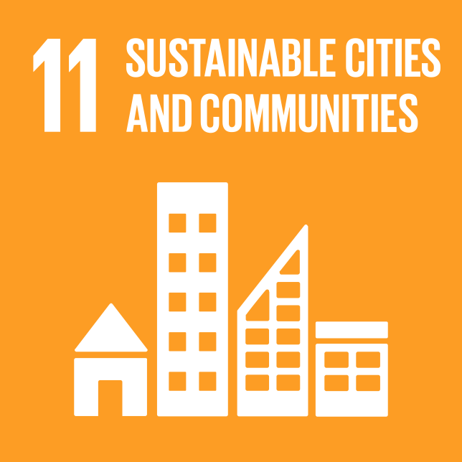
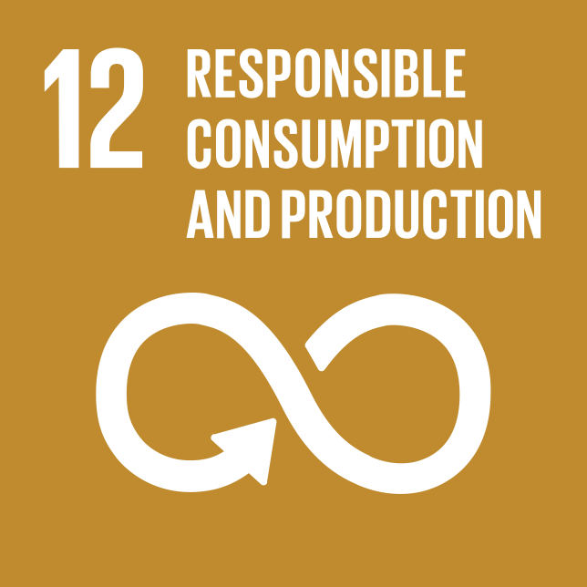
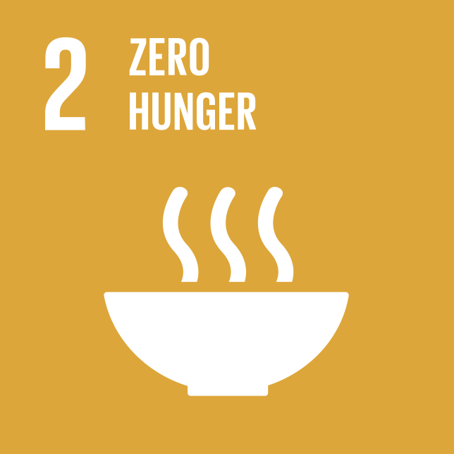

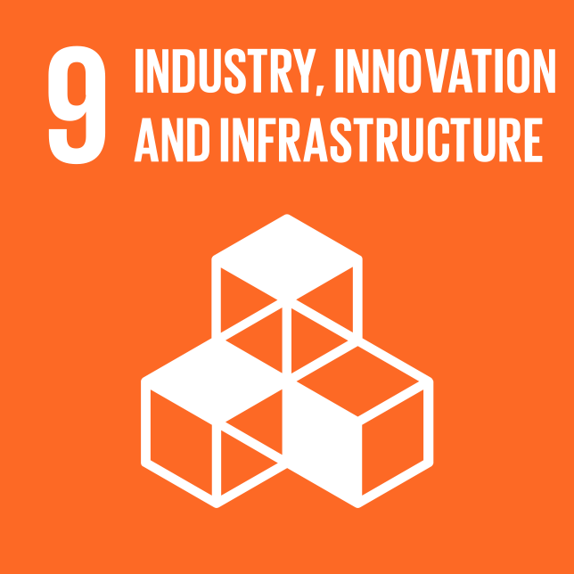

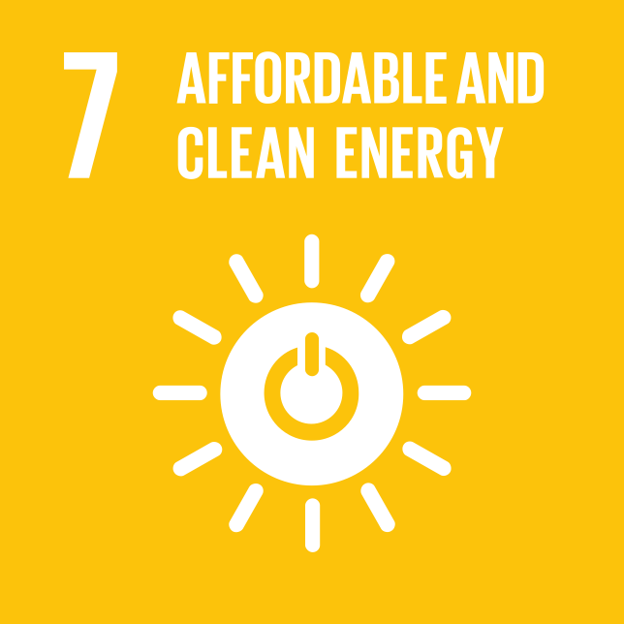
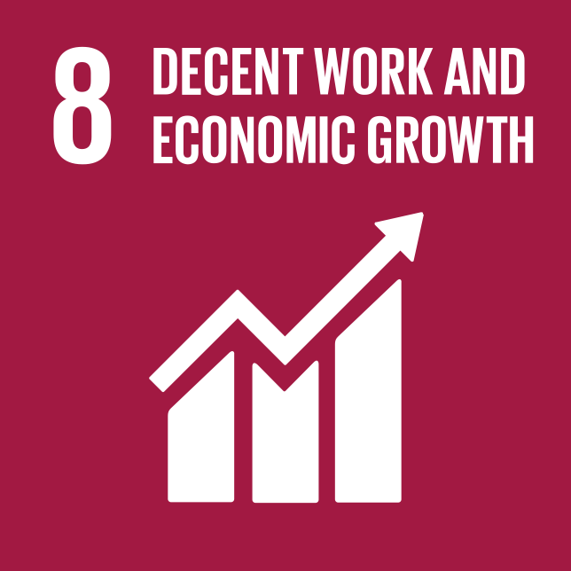
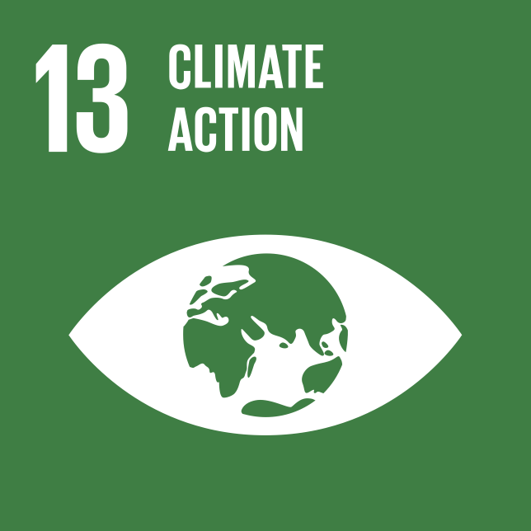

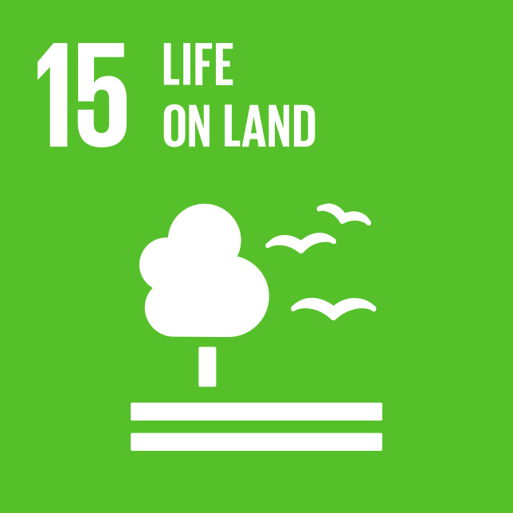







Climate Change
Water stress
Designing solutions for “provisioning systems” would allow and incentivise the cross-sector innovation and shifts to a more future-fit business models leading to the reduction of resource use and deliver multiple co-benefits for people and planet.
WELL-BEING
Health impacts from
particulate matter
Ecotoxicity
PROVISIONING SYSTEMS
through eutrophication
Freshwater biodiversity loss
GRO24 “provisioning systems” in focus:
Food and nutrition, Mobility, Built Environment, Water and Sanitation, Energy, Clothing, Water Sewage and Health, Education, Households and Other
NATURAL RESOURCES
Land-related
biodiversity loss
Notes:
A ‘provisioning system’ is a recently emerged and increasingly relevant concept that groups together related ecological, technological, institutional and social elements that interact to transform natural resources to satisfy foreseen human needs. In this way, the concept enables an integrated consideration of the different ways that material and political-economic dimensions of different provisioning systems interact to use resources to deliver social outcomes with varying levels of success.

Slide 25
From Sector to System: Mobility Example
Example: optimizing the automotive sector OR mobility system
Optimizing sectoral output
Optimizing delivery of human needs
Measuring and aiming to maximize GDP
Measuring and aiming to optimize wellbeing
Replacing combustion with electric vehicles and making them available and affordable to all
Reduced need for mobility and optimal access to mobility based on reduced energy and materials needs
Current approach
Increased infrastructure and land use due to economic and population growth
Maximising value of used materials
Optimized infrastructure due to human need focus
Health and wellbeing benefits
System change approach
Additional roads
New charging points
Reduced climate impacts and pollution, but time still lost to traffic
Modal shift
Higher utilisation of vehicles
Reduced pollution and environmental impacts
Reduced time lost to traffic
Additional parking spaces
but time still lost to traffic
Reduced land Use

Slide 26
CHAPTER 3
Resource use is driving the triple planetary crisis

Slide 27
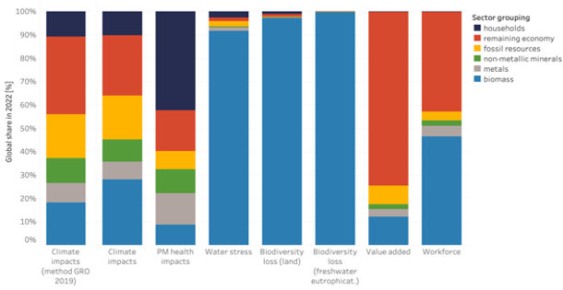
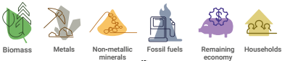

Impacts: Extraction and Processing of Natural Resources Drives all Aspects of the Triple Planetary Crisis
Environmental impacts of materials in the value chain in
extraction and processing phase
60% of global climate change impacts including land use change
40% of air pollution health impacts
More than 90% of water stress and global land and water eutrophication related biodiversity loss
Climate change
Pollution
Biodiversity loss
Economic Impacts
Notes:
The triple planetary crisis of climate change, biodiversity loss and pollution increasingly threaten our future.

Slide 28
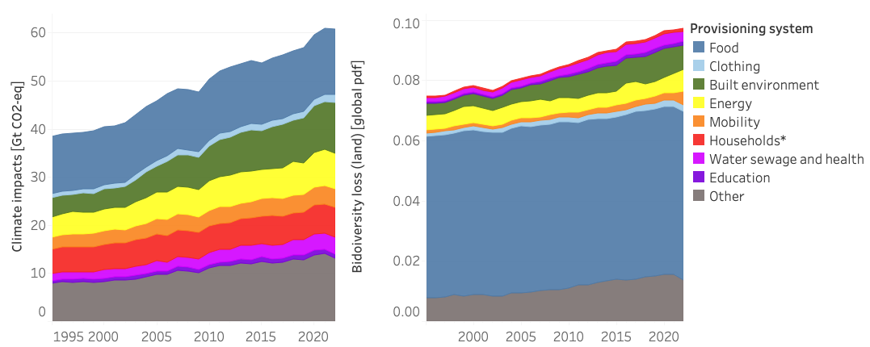
Impacts: “Provisioning systems” - human needs with most environmental impacts requesting our focus

Slide 29
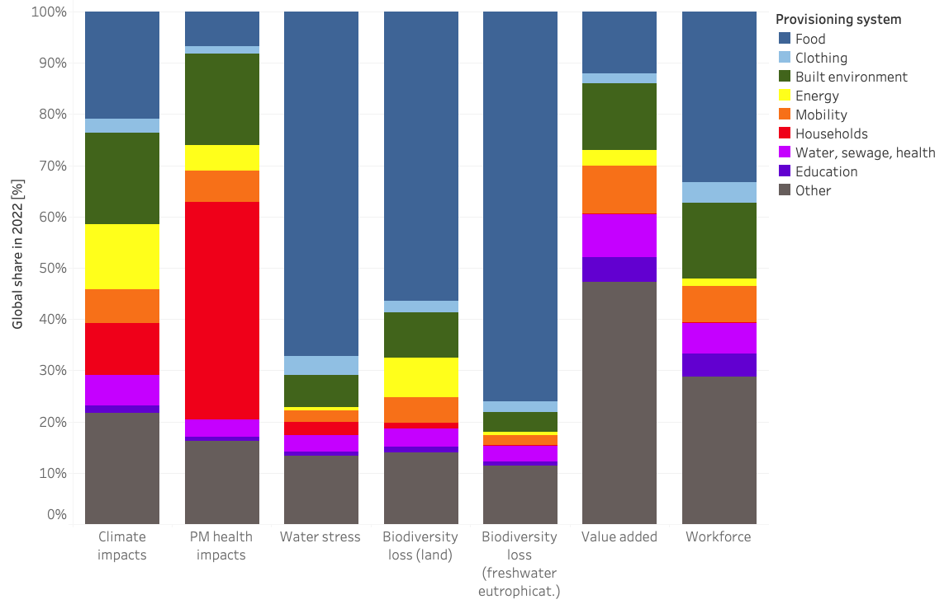
Impacts: “Provisioning Systems” - Human Needs in the Year 2022

Slide 30
Connect resource use to equity and justice related implications
Complementing supply with demand side
High-income countries have benefitted most, and have driven the planetary crisis, while emerging and developing economies hold least responsibility, and are facing the worst impacts. The World Inequality Lab in recently published 2023 Climate Inequality Report showed that the top 10% of global emitters are responsible for 50% of global carbon emissions. This is not just a country-level story: the highest consumers everywhere are responsible.
In high-income countries absolute decoupling should be the aim, whereas, in low and some middle-income countries, where additional resource use is still needed to meet people’s basic wellbeing needs, we should aim at relative decoupling.

Slide 31
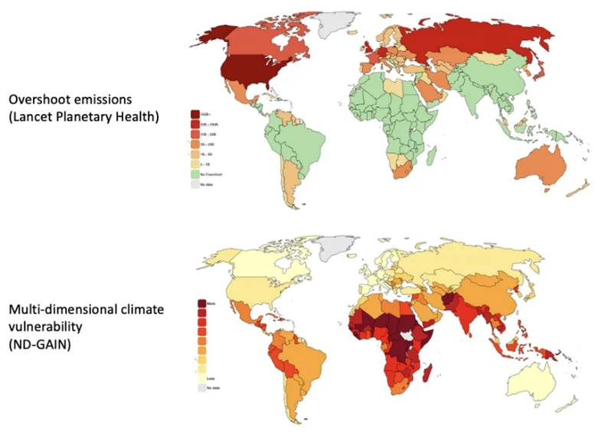
Those Benefiting Most, and Those Facing Worst Climate Consequences

Slide 32
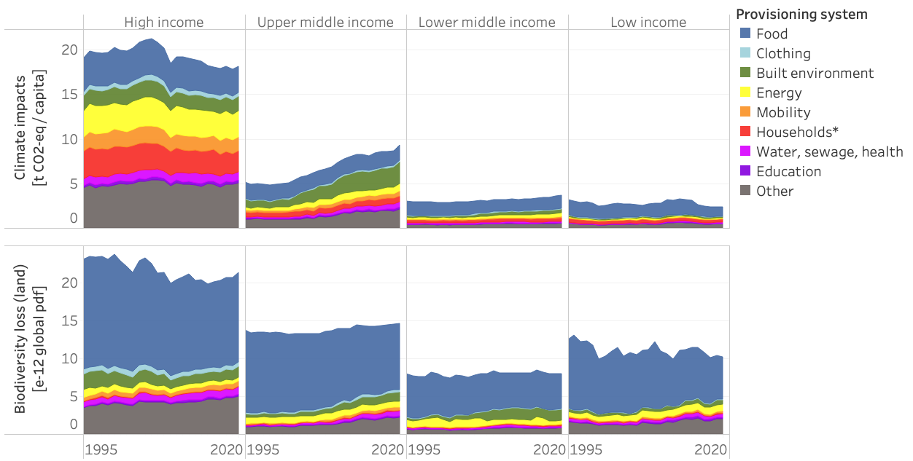
Impacts: “Provisioning systems” - human needs by income groups

Slide 33
CHAPTER 4
Scenario Outlook

Slide 34
Modelling Scenarios Capturing the System Change Dimension
Here the contribution of Australia (CSIRO) is critical
Historic Trends scenario explores the consequences of continued historical trajectories of resource production and consumption, including current improvements rates in resource efficiency as well as production methods and current climate policies
Sustainability Transition Scenario explores a sustainable path for global resource use if we would do a systemic shift to provisioning systems from both a supply and demand side and consumption perspective

Slide 35
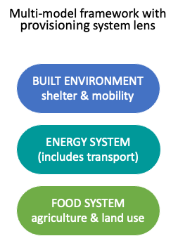
Scenario outlook: Scenario is built up as three ‘shifts’ plus measures to support Just Transition contrasted against Historical Trends
Resource Efficiency
Resource Efficiency
Sustainable Consumption
and Production (SCP)
Climate and Energy
Food and land
Food and Land
Just transition
Just Transition
Notes:
The Sustainability Transition scenario is made up of three shifts, each involving an evidence- based package of measures designed to maintain or improve human wellbeing while limiting environmental pressures and reducing adverse impacts.
The scenario also includes a package of distributional measures to support a just transition and ensure that these shifts do not burden or disadvantage low-income countries or groups.

Slide 36

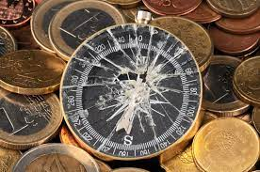
A pathway towards sustainable resource use, which maintains and even enhances human wellbeing, while prevent planetary boundaries to be crossed is possible, but we urgently must change the direction and fix the broken compass
Source: Pixabay
Source: Dentistry.co.uk

Slide 37
CHAPTER 5
A call to action for sustainable resource use: Achieving sustainable prosperity is possible, but transformative action needs to start today

Slide 38
If we want to meet internationally agreed climate, biodiversity, pollution, and land degradation goals, integrating systemic resource solutions into implementation plans is a must. Report will provide a powerful message to high-income countries: absolute decoupling - reducing resource use, while aspiring to continue to increase wellbeing - is a must.
But GRO24 will also show a pathway towards sustainable resource use, which maintains and even enhances human wellbeing, while preventing further transgression of planetary boundaries.

Slide 39






Solutions: Main Recommendations for implementing the Just Sustainability Transition scenario
Institutionalize resource governance and define resource use paths
Redirect finance to serve the transition
Make trade an engine of sustainable development
Create low-carbon, clean and circular business models
Correct market signals to mainstream sustainable production and consumption
Focus actions on the most resource-intensive provisioning systems

Slide 40
To Conclude
Science is Clear and Change is Unavoidable

Slide 41
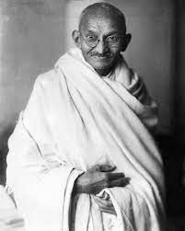
The world has enough for everyone’s need, but not for everyone’s greed”
Mahatma Gandhi

Slide 42


Warned that unlimited material growth and consumption on a finite planet would eventually lead to collapse and decline.
Two scenarios:
Too Little, Too Late: continue our current destructive path and The Giant Leap: the fastest economic transformation in history.
The key outcome is that we will see negative social tipping before severe environmental tipping points and that equality and poverty alleviation is key if we want people to be concerned about regenerative economics and decarbonisation. Even in the Giant Leap scenario Climate change stabilises at below 2°C. This brings serious consequences for societies including extreme heatwaves, flooding, drought and food security …

Slide 43
The World has Changed
1972
Population on the Planet
3.8 billion
2022
The Growth of Limits
Climate Change, Pandemics, Biodiversity Loss, Security Threats …
Population on the Planet
8 billion
To make our future sustainable
some basic shifts would be needed:
Notes:
[PLACEHOLDER – TITLE SLIDE TO BE INCLUDED]

Slide 44

1
From Humans in function of economic success and development to an economy in function of delivering human needs
We must set the order right!

Slide 45
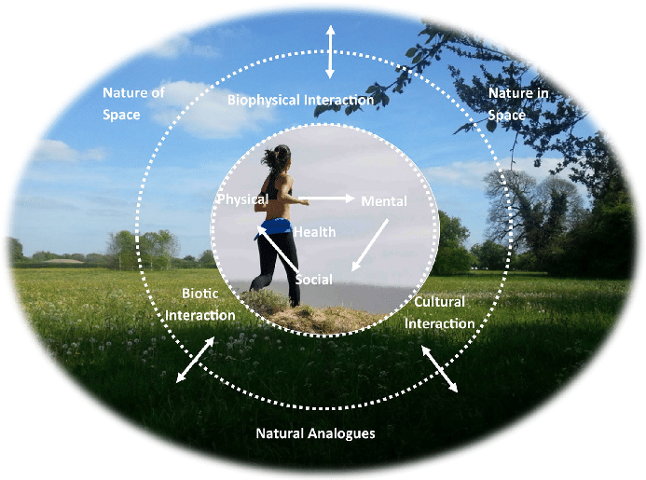
2
From economy considering Humans as external/superior to Nature
to an economy acknowledging that we are embedded with Nature
Destroying Nature is destroying ourselves!

Slide 46
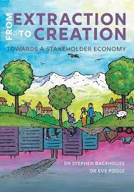
3
From extraction-based production
to a creation-based production
We should stop stimulating extraction based economic success and reward responsible, innovative, creative ways of meeting human needs!

Slide 47

4
From an egoistic, short-term based interests’ governance structures and logic to cooperation and sharing sovereignty.
We must improve our collective resilience. We need a convincing intergenerational pact!

Slide 48

Let me finish the story in my former country …
Quote from Alan Ford, most famous comics from Ex-Yugoslavia, explaining well where the current rules of capitalism and the established practice of the economic system are leading us …
It is not the problem to drive withouth the breaks …
The problem is to stop.
Source: Diplomacy and commerce exhibition-alan-ford-running-a-lap-of-honor-in-the-museum-of-yugoslavia

Slide 49



THANK YOU
for helping us delivering the future we want!

